Slide 1
Virtis/Opis 1. Financial & Administrative Overview 2. Customer Satisfaction Survey
Virtis/Opis User Group
Helena, Montana
August 2 – 3, 2011
Ala Mohseni
Project Manager
AASHTO BRIDGEWare

Slide 2
Virtis/Opis Family
Virtis/Opis Licensees 2010-2011
Local Agencies
City of Phoenix
LA County
Santa Clara County
Associate Members
Manitoba
NY State Thruway Auth.
International Licenses
Notes:
Virtis 37 Total Licensees
32 member DOTs (including DC, Puerto Rico and FHWA)
2 Associate members (Manitoba and NY State Thruway)
3 local agencies (Phoenix, LA, and Santa Clara)
1 International agencies (Italy)
Opis 23 Agencies

Slide 3
Why use AASHTOWare?
Incorporates “best practices”
Users share solutions and costs
License fees cover overall expenses ensure software products are kept current with technology and functional requirements
Each product “self-supporting”
Non-profit operation
Management and oversight by agency (DOT) personnel
AASHTO staff project management/assistance
Notes:
The AASHTOWare Program offers member agencies a number of unique advantages over custom or commercially available solutions including:
The incorporation of best practices; both thru the design and development of software based on AASHTO specifications and the fact that task force direction comes about through the formation of consensus
Because the program is operated on not-for-profit basis, our sole focus is on satisfying the membership’s needs and priorities– there is no other motivation for operating the program– license fees are set to cover expenses– and products are supported, maintained and enhanced to keep products current with functional requirements and technology– as long as their is

Slide 4
Virtis/Opis Revenues
Notes:
Total Revenue for FY2011: $3,261,666

Slide 5
How the Dollars Were Spent
Notes:
Total expenditures: $3,605,125 (Some prior year carry-forward)
Enhancements Via License Fees $1,696,052 (47% )
Enhancementys Via Service Unit Contributions $38,000 (1%)
Service Unit Work $10,000 0% AASHTO Admin/Overhead $158,935 (4%)
Support & Maintenance $949,332 (26%)
Professional Services $59,914 (2%)
Capitalization $163,083 (5%)
WY BRASS Royalties $358,742 (10%)
Task Force Meetings $144,870 (4%)
User Group Meeting $26,197 (1%)

Slide 6
Administrative Topics
AASHTO Administration & Overhead
Staff salaries, benefits, and overhead
Contracted Project Manager
Proportional share of SCOJD, T&AA and indirect costs
Legal Services
Technical and Applications Architecture Task Force
Technical resource for SCOJD and product task forces
Develop and maintain software standards and perform QA Reviews
Capitalization (5% of Revenues)
Governed and controlled by AASHTO Executive Committee
Covers risks associate with software development
Seed money for new projects
Legal expenses associated with patenting and third-party testing
National Transportation Marketing Campaign

Slide 7
AASHTO Administrative Expenses Breakdown
Notes:
Total Administrative Costs in FY 2010: $242,362
Project Mgr. Contract – 21%
Salaries – 21%
Benefits – 14%
Overhead Allocation – 27%
Office Supplies and services – 7%
Indirect Services – 5%
Legal Services – 3%
Other 2%

Slide 8
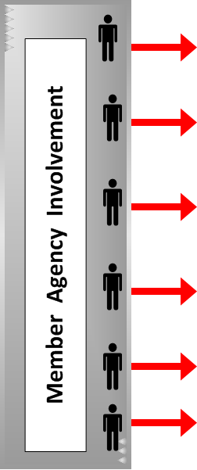
How is AASHTOWare Managed?
Notes:
Board of Directors & Executive Committee Meet Twice a Year… Establishes and revises policies governing the Cooperative Computer Development Program as called for within and consistent with this Administrative Resolution and AASHTO's Governing Documents. Approves the creation of projects and products and the revenue and expenditure budgets of the activities within this Program as part of its overall budget approval role. Approves the appointment by the AASHTO President of the members of the Special Committee on Joint Development.
Special Committee on Joint Development provides management oversight of AASHTOWare Program & Products. The SCOJD studies all policy issues and topics with respect to the AASHTOWare program in consultation with all active product and project task forces and brings recommendations before the AASHTO Board of Directors and Executive Committee for action, as appropriate. They review and approve all procedural documents, manuals and other guidelines pertaining to the process and management of the AASHTOWare program
Include in their charge is the approval of appointments [and removal] of Product and Project Task Force members as necessary and the designation of chairpersons. They review project proposals and authorize solicitation of membership for participation and funding for AASHTOWare projects; and, establish advisory and user groups when appropriate on the recommendation of the product and/or project task forces
A full-time AASHTOWare Project Manager is retained to coordinate product/project activities, and fulfill contract administration and project management functions. As authorized by the executive director, the project manager leads/participates in contract negotiations and revisions; oversees invoices, payments, and other financial transactions; coordinates software development activities with other AASHTO committees; promotes awareness of the product capabilities and gathers potential enhancements for the products; and assists the task force in related matters as needed.
The Task Force provides the day to day management of the product. They guide software support and development services performed by contractors, determine the functionality to be included in enhancements; they oversee the development and execution of the annual work plans, including the associated budget, for the product and work with SCOJD to improve the overall AASHTOWare program.
The task force typically are comprised of 7 to 9 representatives from the agencies and serve on a rotating basis; they represent expertise in functional areas as well as IT. Included with their many duties, the task forces are responsible for (1) long range product direction, (2) annual consultant contracts, (3) quality assurance and control, and (4) responding to questions from users. The task force also determines the appropriate software platforms needed to meet the overall needs of the participating agencies and review and approve product releases. A typical member is a long-term or high-level administrator or user and has been active in the User Group for several years.
The Task Forces are oftentimes assisted by Technical Advisory Groups which provide subject matter expertise in defining functionality and software requirements and fulfill a variety of other roles; the TAG’s also oftentimes perform detailed reviews of beta code and make recommendations to the task force on approval of deliverables and product releases.
The Technical Advisory Group(s)s are appointed by the Task Force and assist the Task Force in working with contractor in development of new product/enhancement(s). Their composition and the number of members setting on the TAG are based upon need; the members are users familiar with the product/functions and are usually from agencies contributing funding. Their duties/business is generally conducted by e-mail, conference calls, and [sometimes] face-to-face meeting as required; typically, the TAG is chaired by a Task Force member.
User Groups are independent organizations with their own Constitution and/or Bylaws. The User Group represents member department’s interest in the product, and provides advice and recommendations on the product’s (1) effectiveness, (2) deficiencies, and (3) any needed product enhancements. The User Group also recommends product training and support needs, details and recommends prioritized maintenance, enhancement, and support needs. The outcomes of the User Group are submitted to the Task Force as recommendations and helps for the basis for the upcoming fiscal year’s work plan.

Slide 9
Virtis/Opis Customer Satisfaction Survey FY 2012
ONE PAGE - Significantly shorter than FY11 Survey
Ten main questions (1-10 scale) in Four Areas:
Software features/operation (3)
Contractor/Customer Service (5)
Documentation (3)
Agency related (2)
Survey as a Software Program or Excel Version
Lots of room for providing comments
A gift of ATTACHE 8GB
Notes:
For those who return the survey during VOBUGS, we have a gift of ATTACHE 8GB Flash Drive

Slide 10
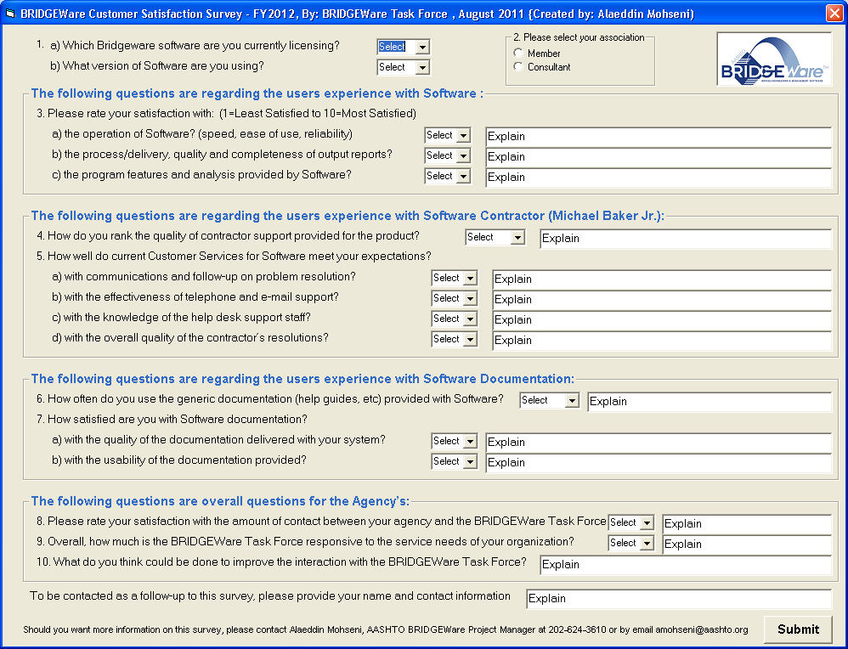
VO Customer Satisfaction Survey

Slide 11
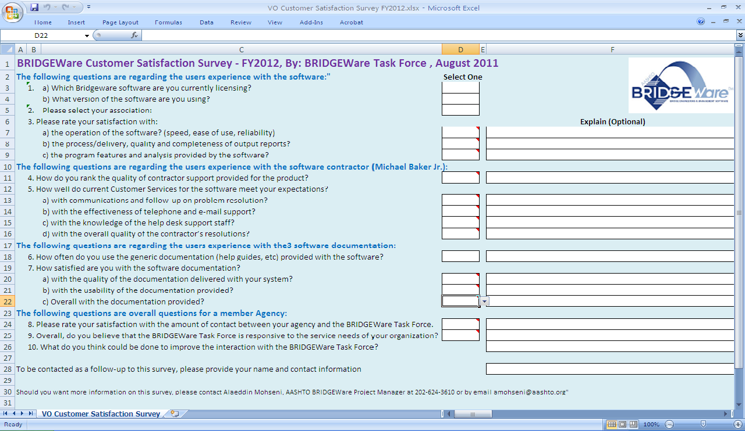
VO Customer Satisfaction Survey

Slide 12
Questions?

