Slide 1

Image Placeholder
(replace with photo that reflects your presentation content or delete photo entirely)
Upgrading with ARC Tool
Mary Smith, P.E.
Notes:
-Use BrDR as much as possible for load rating inventory
-Right when I was starting, our resident expert was retiring. Left a big gap, we were left to navigate how to upgrade – now looking at the ArcTool to help with that. That’s why I’m here – talk about how we’re starting to use it

Slide 2
BrDR Version Upgrade – MDT’s Testing Objective
Understand how upgrading to new version will impact operations
Functionality
  Make sure models will run and produce results
  Test user interface/workflows
Results Comparison
  Identify trends
  Understand reason behind differences
Notes:
Jump right in –
After a new version of BrDR is released, we want to test it before adopting and putting it in production.
Why:
Good understanding of how new version will affect our rating inventory and operations (posting, permitting)
Testing objective falls out into two categories
- Functionality
- how affects workflow and procedures (make sure can sign-in, models will run)
- Results-Based
- identify different results (beneficial or unfavorable), highlight trends, try to understand why we’re seeing differences (bug fixes, enhancements, code changes, new bugs)
Aware of what we’re getting into

Slide 3
BrDR Version Upgrade – MDT’s Testing Approach
Minimal
Testing
MDT
Extensive
Testing
Manual comparison
  Check functionality of program
  Result comparisons for approximately 25 structures (representative, complex,and commonly permitted)
Feedback from other states, consultants
Challenges/Considerations:
  Limited Resource Availability
  Ongoing Load Rating PCA
  Procedure Development
Notes:
MDT falls somewhere in the middle on the spectrum of no/little to extensive testing.
What we’ve been doing in the past 4 years since I’ve been here – upgrade to 6.8.3, 6.8.4, 7.0, 7.1, now 7.2. We’ve had pretty limited testing – mainly related to making sure models still “work’. Our permitting engineer also runs analysis and compares results between versions for a list of bridges that he came up with – representing typical structure types, complex or commonly permitted bridges). Bulk of this work has really fallen on Dave to provide a recommendation based on his findings.
Beyond that, we typically resort to wait and adopt new version once it’s been out for awhile, based on feedback from other agencies or consultants.
Some of the challenges or considerations with our current approach:
-Limited internal staff – duty on the side, have to fit it in with other workload; permitting engineer sees a bulk of the workload but permitting work keeps getting busier and busier
- Think we recognize the importance and value of testing (whether beta or testing new version after release). Just haven’t had the staff/resources to be able to support a robust testing program.
Are on a timeline to update ratings for all bridges by 2024 – 4 consultant contracts, receiving approximately 70 rating submittals each month (mostly BrR)
- Potential for large impact if we’re not aware of issues associated with new version; flip side is bug fixes or enhancements. Whatever decision we make has potential to impact a large number of ratings given the rate we’re seeing these. Comes down to balance of timeliness and making sure we’re confident in the new version
- Procedure Development - working towards documenting procedures, how we can create a repeatable process that’s easily documentable; how we’re going to test, upgrade, document results

Slide 4
BrDR Version Upgrade – MDT Testing with ARC Tool
ARC Tool trial run – upgrade to BrDR 7.2, focus on prestressed concrete structures
Limitations
  Timber
  Curved Girder/3D FEM
Good supplement to MDT’s testing approach
  Improved efficiency → larger dataset comparisons → comprehensive understanding of impacts → higher confidence to upgrade in timely manner
  Easily documentable, repeatable process
MDT Testing Approach
ARC Tool
Functionality
Make sure models will run and produce results
Test user interface/workflows
Results Comparison
Identify trends
Understand reason behind version differences
Notes:
When heard about the ARC Tool – seemed like a good way to address some of our challenges and fill gaps we had in our testing objective.
- Current testing approach was primarily geared towards functionality –things as simple as logging in, can make sure models run/produce results. Can generally compare results (but not really a large enough sample size to get a good grasp on trends that might affect inventory).
- ARC Tool really fills in the results comparison component - allows us to compare larger sample of bridges. Larger sample size will allow for identification of trends for structure types (vs individual bridge issues), give us a more comprehensive view of impact to our rating inventory and operations. Also is good starting point in determining what needs to be dug into further.
Right off the bat – there are some limitations.
-Can’t use ArcTool for timber – doesn’t support Madero, sounds like it’s planned for 7.3 release with LRFR engine. This is problematic for us because MDT has a significant population of timber bridges in our inventory – 400ish state-owned, large percentage of county-owned
- Curved Girder/3D FEM – my understanding is this is still a work in progress. Ultimately can’t replace some of that work that Dave was doing to test complex/highly permitted/highly impactful bridges
This is where we landed – it can’t completely replace our current testing approach, but can be a good supplement. Addresses a lot of the challenges we have – allows for more confidence to upgrade in timely manner. Also – provides quantifiable results within specified tolerance to help inform data-driven decisions; easily documentable, repeatable process
I started looking into implementation – Jeff Olsen helped set up and give some ideas on organization and workflow. Decided to do a trial run for the upgrade from 7.1 to 7.2 with primary focus on small subset of PS concrete structures; see what kind of information it would give us, how we might be able to use it to fill in the gaps.

Slide 5
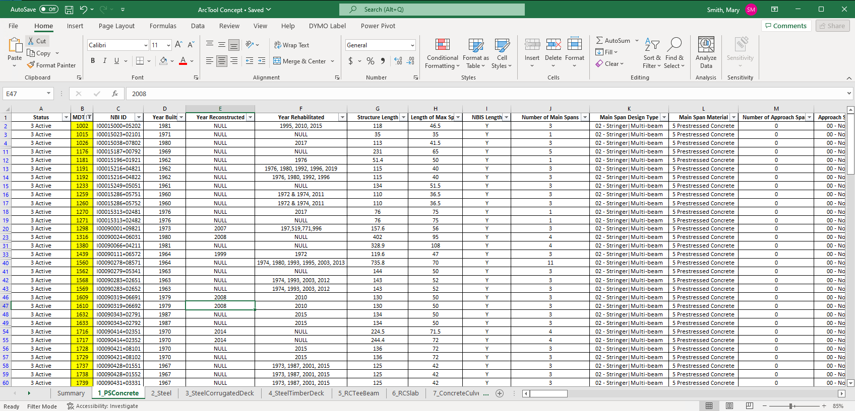
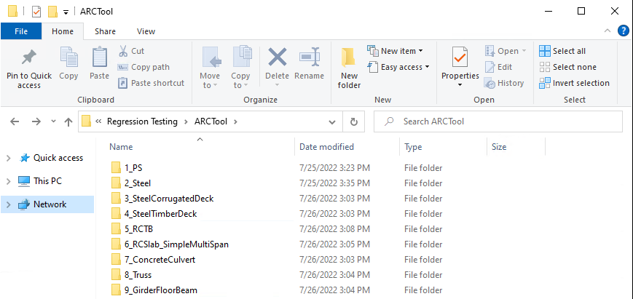
MDT ARC Tool Setup – Datasets
Developed representative datasets based on structure type and rating methodology
Notes:
I’m going to walk through how we set things up and used the tool – to be clear, this is not the only way to do things (there may even be a better way) – it’s a work in progress, we’re hoping to sort that out.
To start with, we identified 9 common structure types – may add more in the future.
For each structure type, exported xmls from version 7.1 (MDT’s production version) to create representative datasets – serve as the foundation for testing throughout different versions. Went through our inventory, looking for completely modeled, up-to-date ratings. I started with a spreadsheet of inventory data; made it easy to filter and decide which bridges to keep in dataset, plus now I have a master list with bridge info that corresponds to the models in the datasets.
Datasets are also organized by rating methodology (LFR or LRFR)
- Mainly because of evolving BrDR guidance – there’s some variation with how default rating method was set up in different models; rather than using a template based on member alternative default rating method, we’re best to set temmplates to LFR or LRFR to ensure we correctly reflect the methodology the bridge is rated in

Slide 6
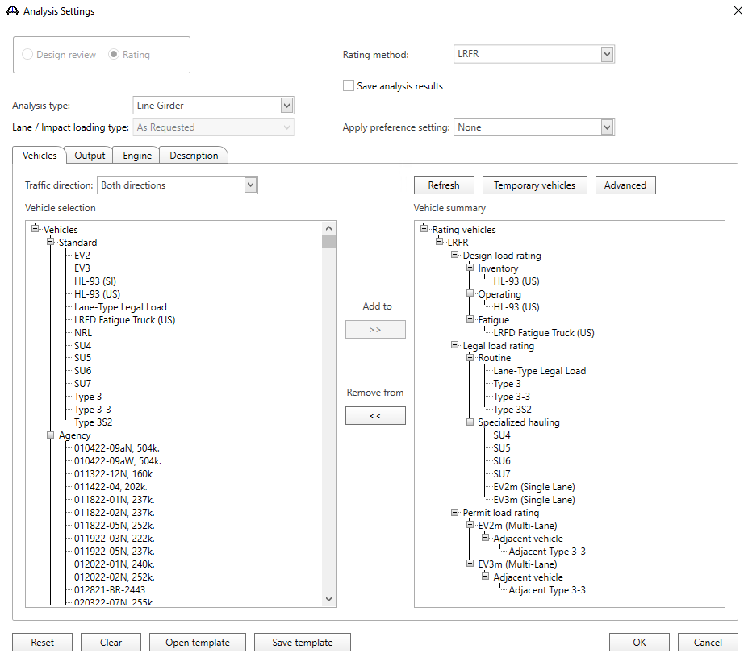
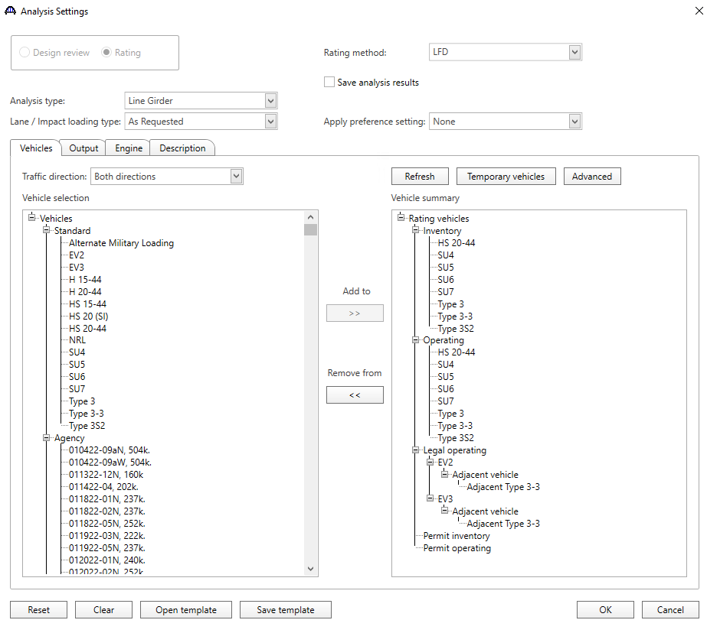
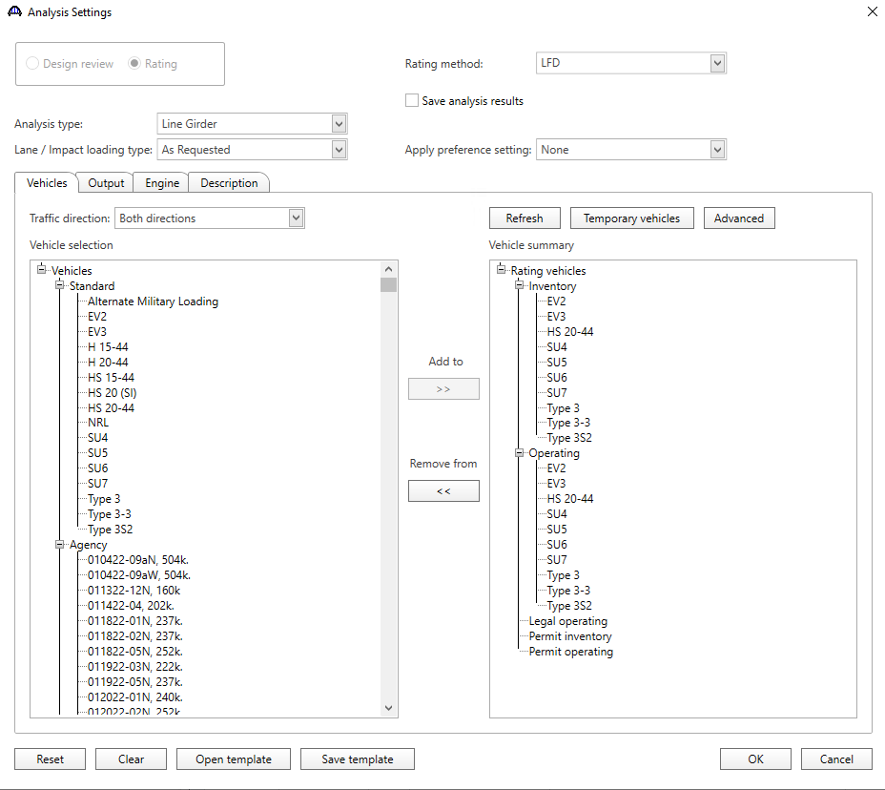
MDT ARC Tool Setup – Analysis Templates
Developed vehicle analysis templates to use as basis for comparison
LRFR Rating Template
LFR-Legal Operating Rating Template
LFR Rating Template
Notes:
After developing datasets, needed to figure out what kind of results we wanted to compare and set those analysis templates.
May be unconventional, but initial inclination was to compare results for all of MT’s legal loads – so it’s the same analysis template used in routine load ratings. This also helps to test how postings might be affected (posting triggers based on each legal vehicle), and also multi-lane Evs (workaround that analysis as permit vehicles to allow inclusion of adjacent legal load).

Slide 7
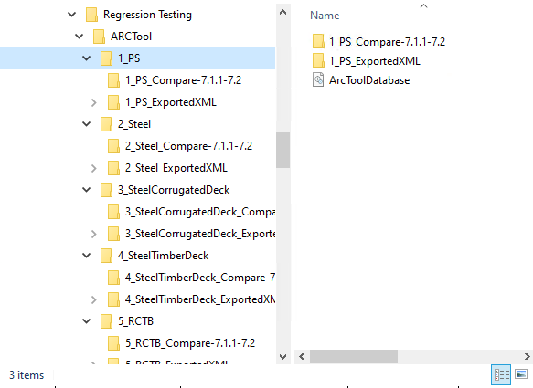
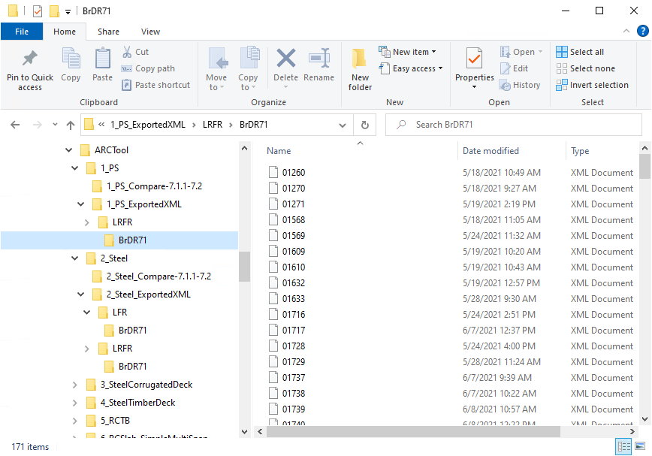
MDT ARC Tool Setup – Folder Structure/Organization
Exported XMLs
  Methodology
  Version
Version Comparisons
ARC Tool Database Backup
Notes:
For each dataset (structure type), set up 3 main types of folders/files
Folder for exported .xmls for that specific dataset – notice in file path (intermediate screenshots aren’t shown) that it includes subfolders for methodology (i.e. LRFR) and BrDR version exported from
- example: all LRFR ratings for the PS dataset that were exported from v7.1 are stored here.
Reasons for setting up this way – already went over methodology. For version – you can add to/append – my understanding is that ArcTool is forward compatible but not backwards compatible. So file exported in 7.1 can’t run in 7.0 with ArcTool. This helps to stay clear on which xmls are compatible for which comparisons.

Slide 8
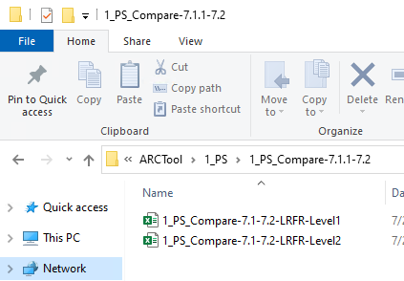
MDT ARC Tool Setup – Folder Structure/Organization
Exported XMLs
  Methodology
  Version
Version Comparisons
ARC Tool Database Backup
Notes:
Set up a folder for each version comparison – this is where I file spreadsheets/results for Level 1/ Level 2 comparisons (exported from ArcTool)
Using a specific naming convention with thought in mind that we’ll be adding version comparison folders as we move forward (could even do beta testing comparisons this way); this helps to keep organized and clear on things

Slide 9
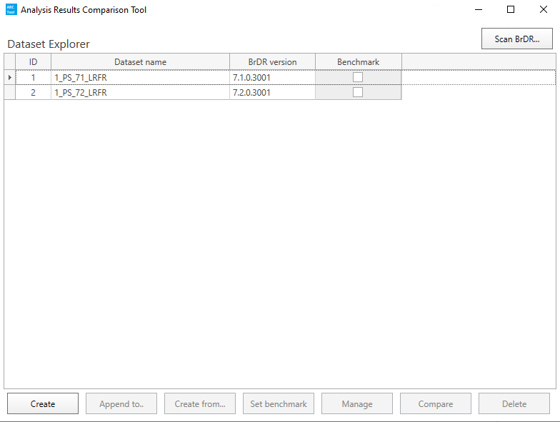
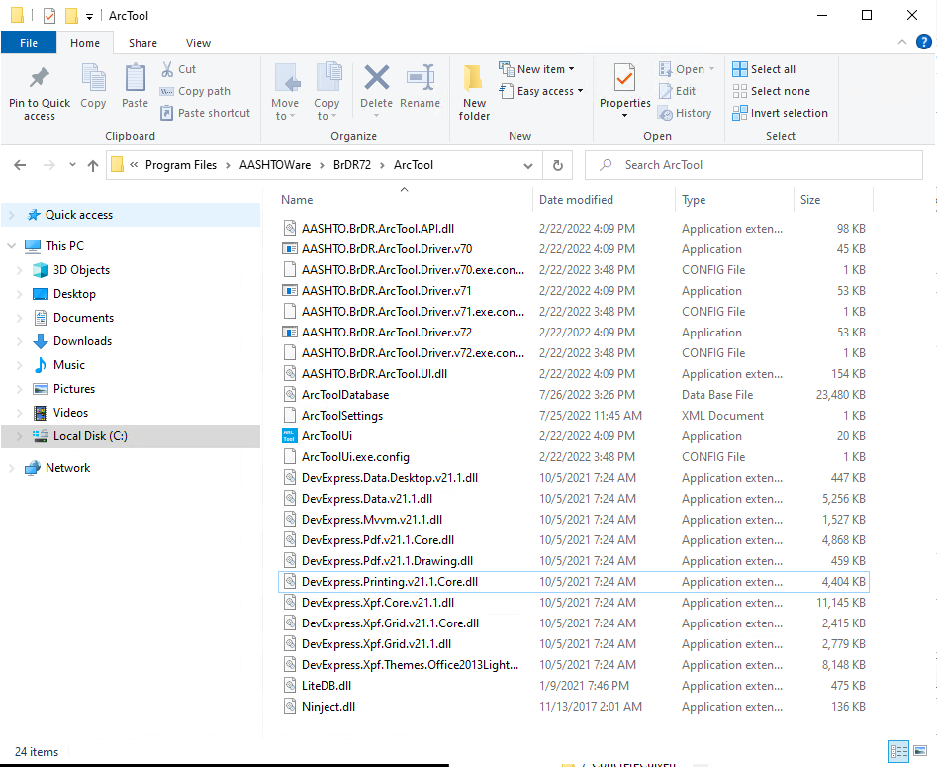
MDT ARC Tool Setup – Folder Structure/Organization
Exported XMLs
  Methodology
  Version
Version Comparisons
ARC Tool Database Backup
Notes:
ArcTool Database backup –
The ArcTool database is a local database that stores results after they’re generated with the ArcTool. The idea is to copy and paste from the C Drive and keep a current/up-to-date database here that can be copied back to the C-Drive whenever a new version of BrDR and ArcTool is installed. This way past version results will be retained, can copy into blank default database when ready to test next version (won’t have to run past version again).

Slide 10
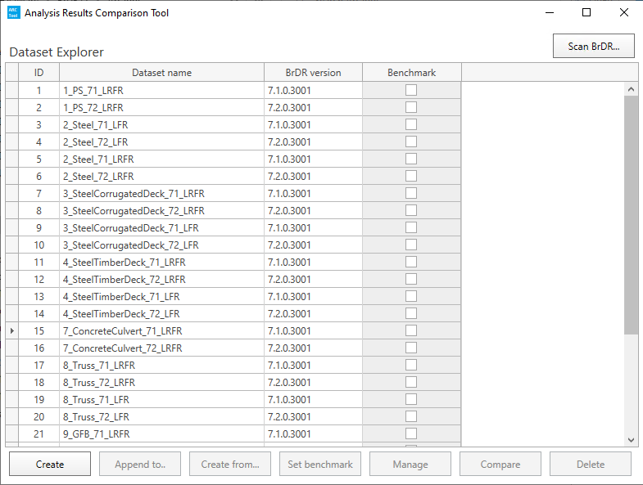
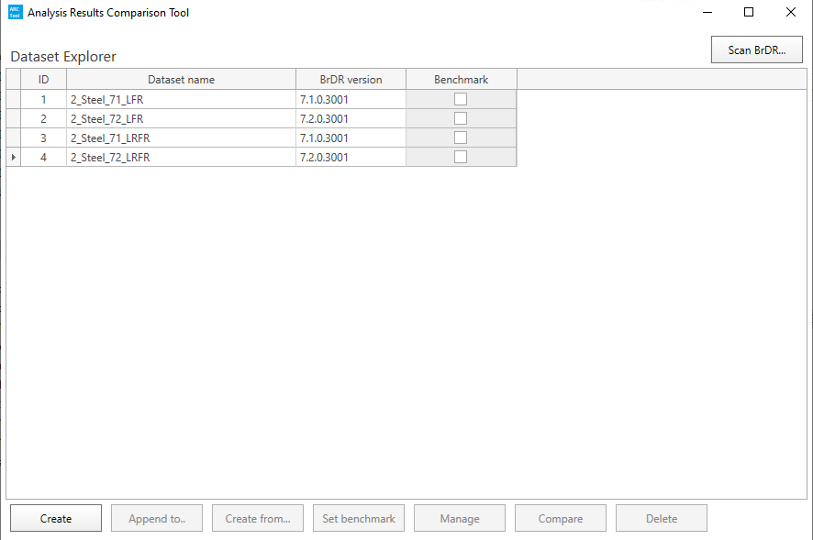
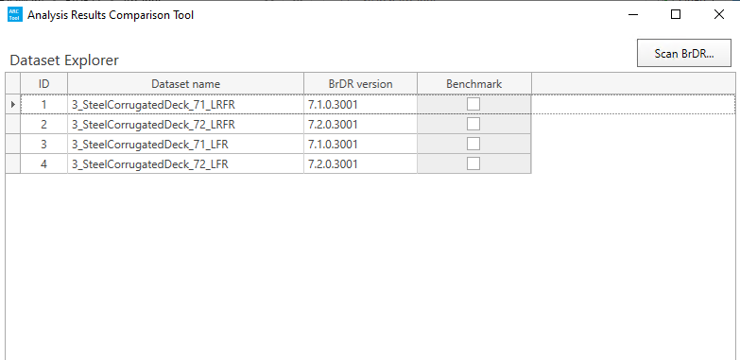
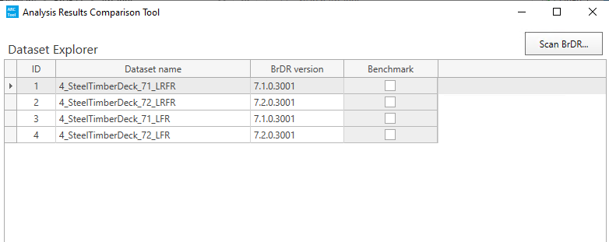
MDT ARC Tool Setup – Folder Structure/Organization
Exported XMLs
  Methodology
  Version
Version Comparisons
ARC Tool Database Backup
Notes:
Initial thoughts are that it will be easier filekeeping to separate out by structure type

Slide 11
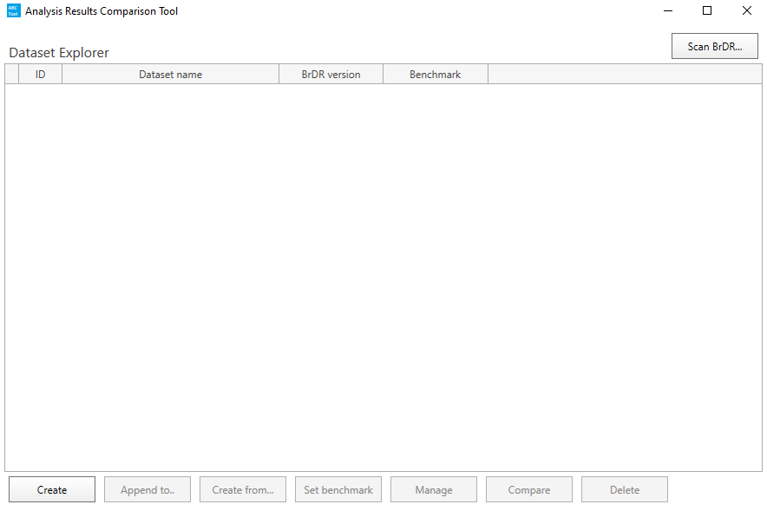
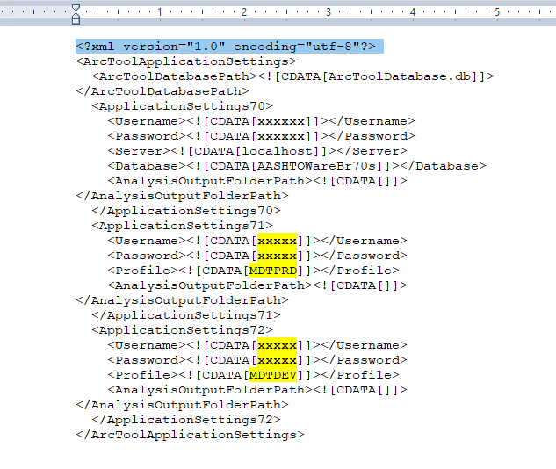
Using the ARC Tool – Getting Started
Need to install BrDR versions you want ARC Tool to generate results for
  Make sure each version has the analysis template you plan to use
Update ARC Tool settings with database information
Notes:
Once we had datasets of representative structures, analysis templates and file structure set up, we were ready to fire up the ARCTool. A few highlights of steps that needed to be done - this is included in the tutorial and I think Promiles will be running through this in example, but I just wanted to highlight a few steps at the beginning.
Need to make sure all versions you want ArcTool to generate and store results for are installed on your computer. For example – we were using 7.1 in production, I was testing 7.2. I was starting from scratch (blank database) and has to generate results for both versions, so I had to make sure my computer had both 7.1 and 7.2 installed.
Update ARCTool settings with database info so that ArcTool can find and import analysis settings
- This got a little tricky trying to sort out the databases – every time we download a new version, it has to go through ISD. A copy is taken of the oracle database and migrated to be used as a test database – ISD usually works their magic. For future, I’m understanding I can request to download the SQL database that comes with the software to avoid the test oracle database/conversion.
**Another thing to note – when downloading new version, have to request from ISD to select the ARCTool option in the download

Slide 12
Using the ARC Tool – Getting Started
Copy/paste database backup to replace default (blank) database
Notes:
Goes back to the back-up database. When a new version is downloaded, ArcTool database is empty.
For example: when we go to 7.3, I can replace the blank database with the one I have filed that has stored results for 7.1 and 7.2. The idea is that we don’t need to start from scratch again when testing the next version upgrade. Can continue building on the database by copying and pasting to move around
I can see this taking some good file management (probably back-ups to the back-up to restore in case the wrong database inadvertently gets overwritten)

Slide 13
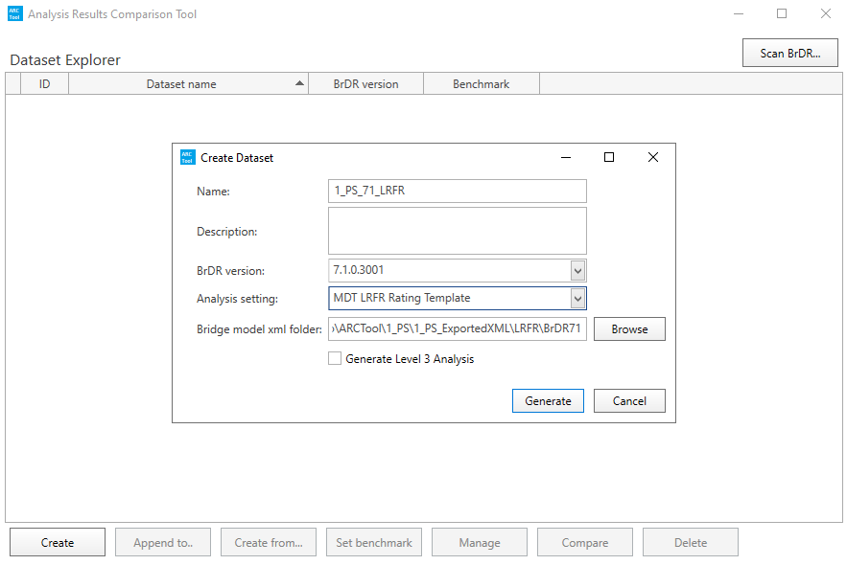
Using the ARC Tool – Creating Datasets
Notes:
After ArcTool scans and imports analysis templates
Created datasets in ARCTool that corresponded to our file structure – i.e. structure type, methodology, version. For example, this is for PS concrete bridges, LRFR analysis in v7.1
Naming convention is intentional – dataset, version results are run in, methodology
Select the Analysis Template – LRFR template
Find bridge .xml folder
**side note – noticed this may need to be local folder (had to copy to desktop rather than point to shared drive)
Select “Generate” – starts running analysis and storing generated results
Level 3 Analysis – in-depth comparison (deal load, live load, capacity), don’t plan to select this as default. Only for specific bridges that are determined to need more in-depth analysis

Slide 14
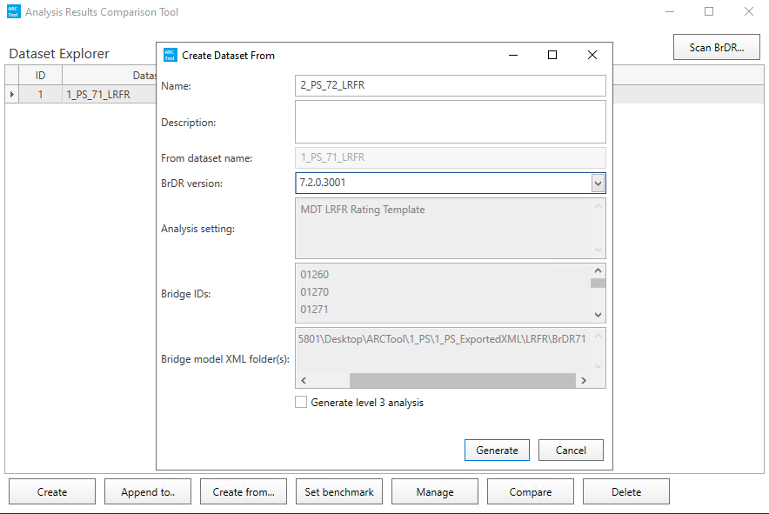
Using the ARC Tool – Creating Datasets
Notes:
This is a specific example for that same dataset (PS concrete bridges, LRFR analysis) but in version 7.2
“Create From” option – Set BrDR to v7.2 and “Generate”
Moving forward, this is where we could do the same for v7.3, 7.4, etc. This is also where you can append and generate results for additional bridges. (will be compatible with next version)

Slide 15
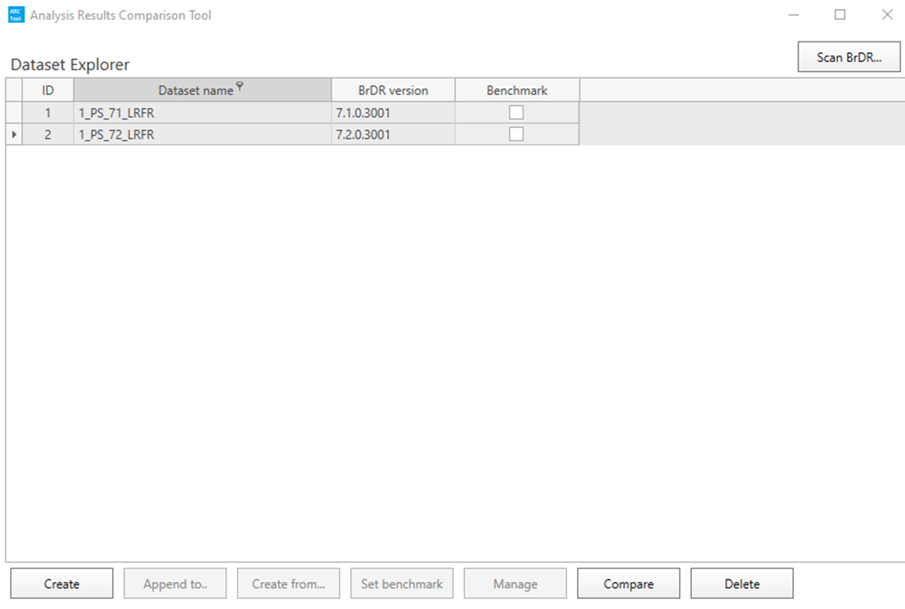
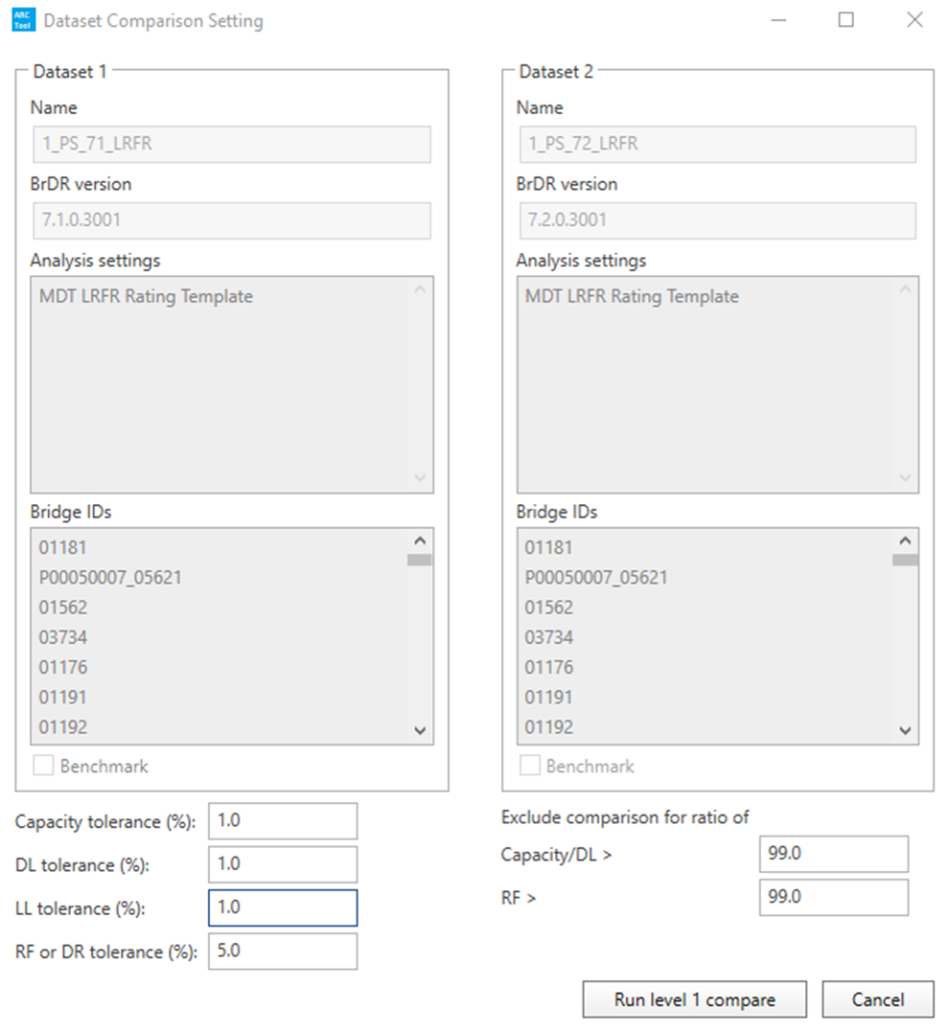
Using the ARC Tool – 7.1-7.2 Comparison Settings
Notes:
Once results were generated –
Ctr + Click to select/highlight both datasets (first selection is Dataset 1, second is Dataset 2) (did not set benchmark) – Compare
Set tolerance at 5% - still something we’ll be working on fine-tuning for state preference/sensitivity – may consider making smaller for SU7 ratings that barely squeeze by
Run Comparison Level 1
**RF or DR tolerance is used to flag Level 1 or 2 analysis- Capacity, DL, LL tolerances are only applicable to Level 3

Slide 16
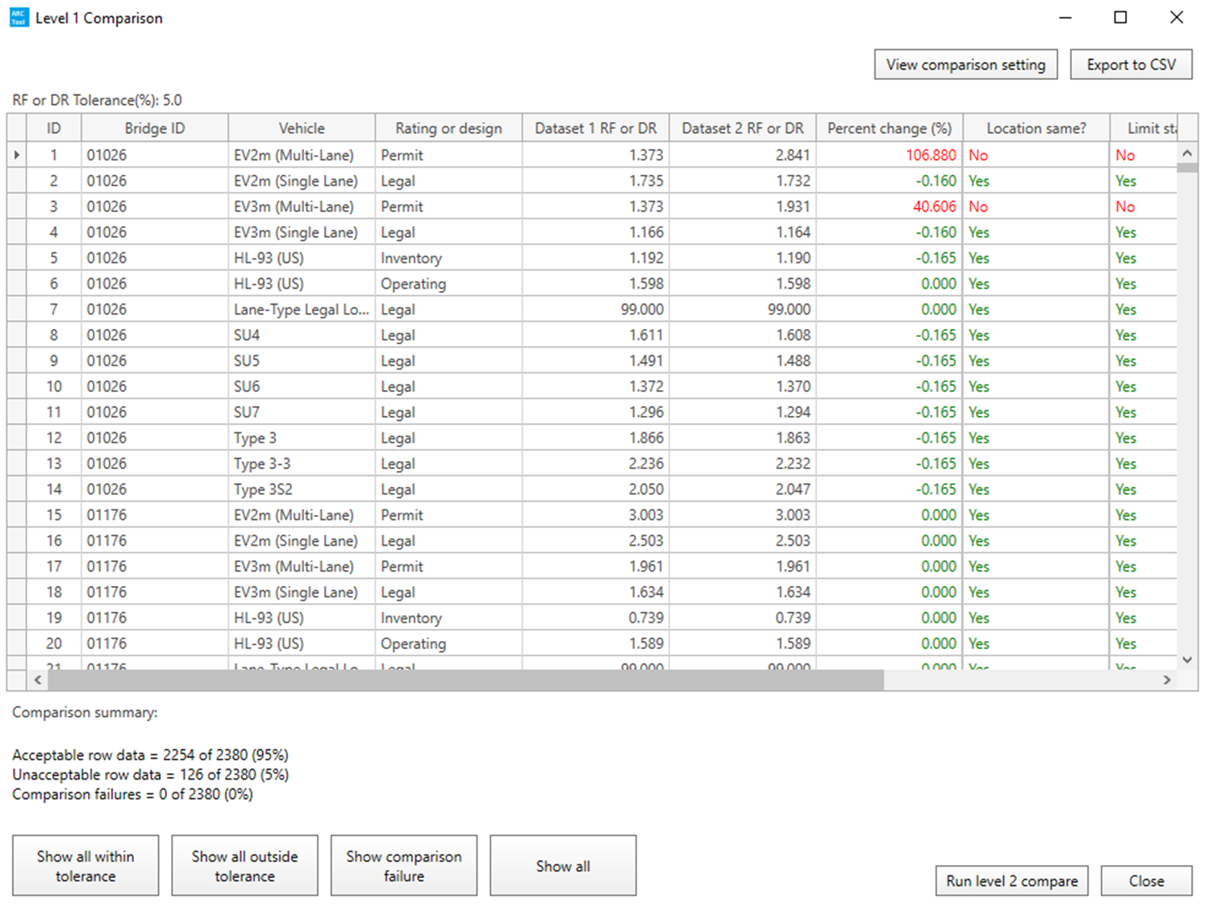
Using the ARC Tool – 7.1-7.2 Results Comparison
Level 1 – Controlling rating at bridge level (overall)
Level 2 – Controlling rating factor at member level
Level 3 – Controlling rating factor at point of interest level
Notes:
Quick rundown on Comparison Levels:
Level 1 – controlling rating at bridge level
Level 2 – controlling rating for each member alternative
Level 3 – point of interest; in-depth comparison (dead load, live load, capacity)
Notice Dataset 1 and 2
Can toggle filters to display all within, all outside, comparison failures, all
Can export display to SCV – caution that it will export what is displayed. For example…

Slide 17
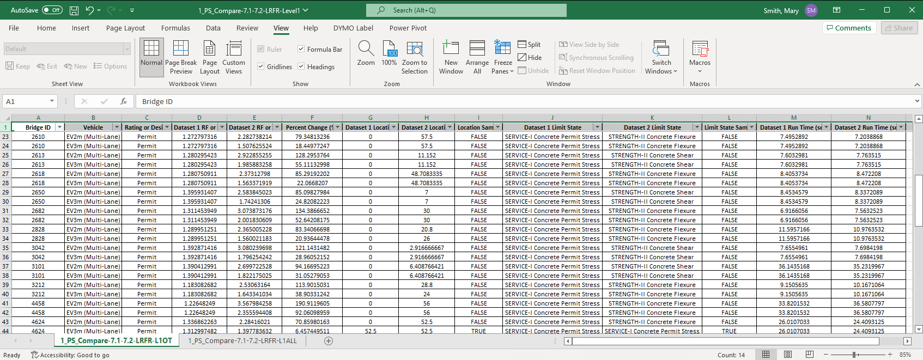
Using the ARC Tool – 7.1-7.2 Results Comparison
Level 1 – Overall controlling rating factor
Notes:
Notice two tabs on bottom – I like to export all for documentation purposes. Also like to narrow down and export out-of-tolerance results; combine into one excel spreadsheet and file in that file location that was set up earlier.
42 out of 171 bridges had out of tolerance level 1 results; all related to Service I Permit Stress for Evs
- additional 6 bridges with different controlling location, results not outside of tolerance
All Level 1 discrepancies were related to multi-lane Evs, noticed that all had different controlling limit states between versions, of which optional Service I was common link (permit stress). Service I is not evaluated/reported for routine ratings because Evs are actually a legal load (the limit state check is only for permit loads; is optional). This is something that we’ll probably want to follow-up with and dive into for permitting related impact (limited use of BrDR for permitting operations right now) – will not affect regular inventory routine ratings. No posting impact. Not of major concern to upgrade

Slide 18
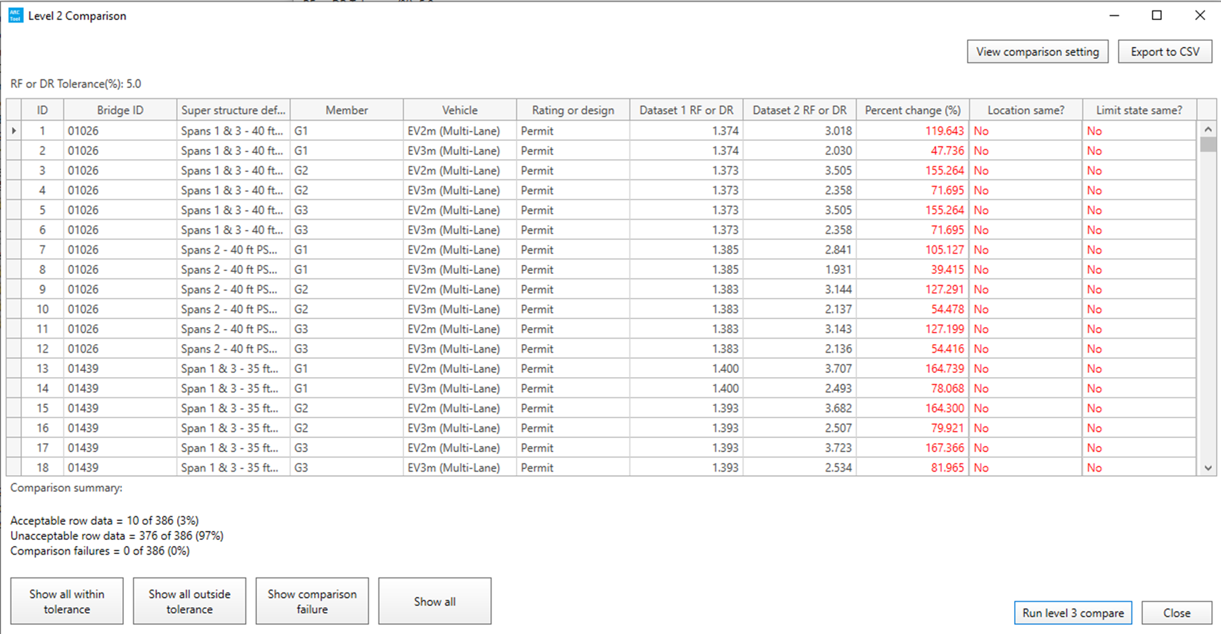
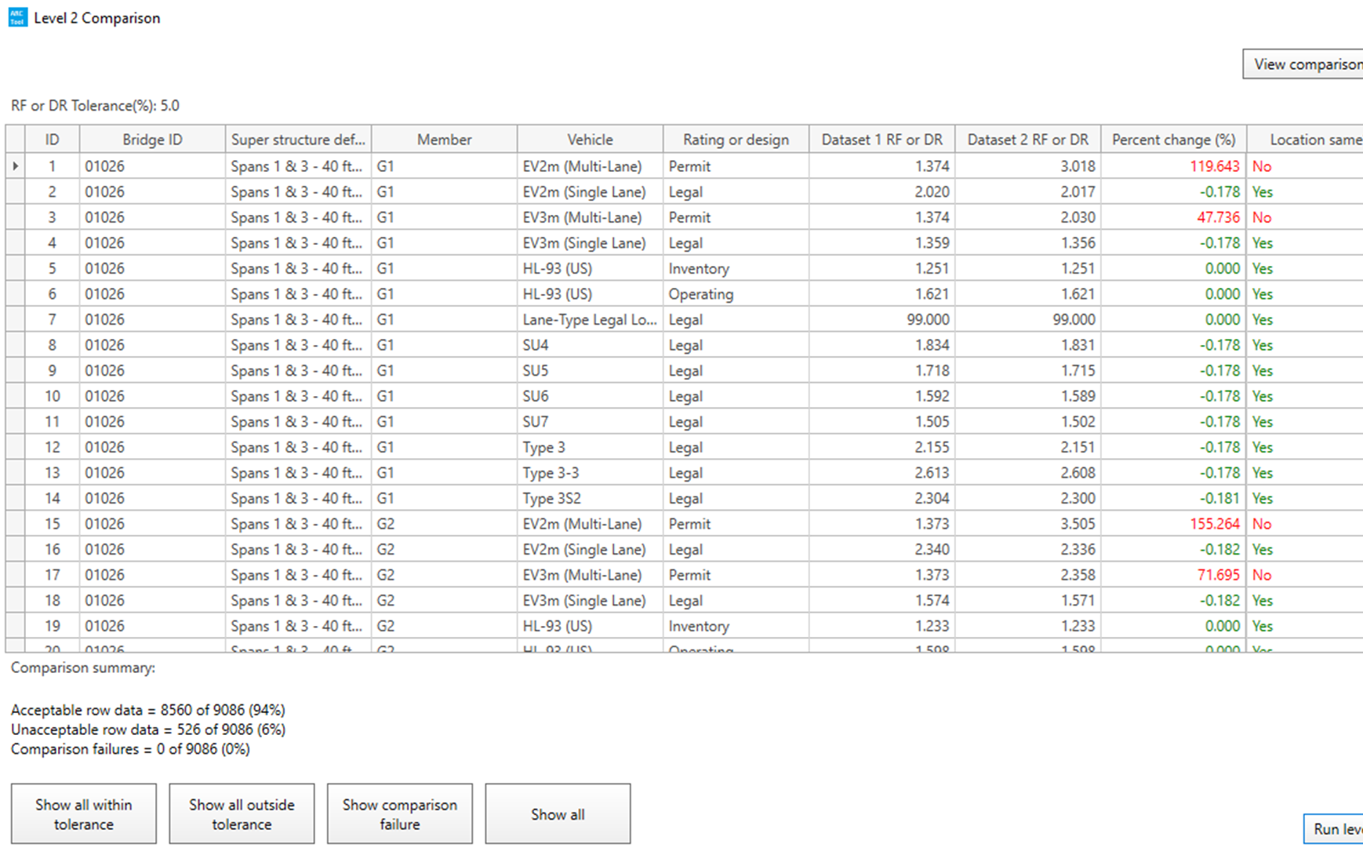
Using the ARC Tool – 7.1-7.2 Results Comparison
Based on Level 1 – Out of Tolerance
Level 1 – Controlling rating at bridge level (overall)
Level 2 – Controlling rating factor at member level
Level 3 – Controlling rating factor at point of interest level
Based on All
Notes:
Level 2 – this is member alternative level – notice that superstructure definition/member name is a column now
42 had out of tolerance level 2 results – as expected, most of those were related to Service I Permit Stress for multi-lane Evs. One bridge had different controlling shear locations for EVS (didn’t control overall bridge rating; didn’t show up in Level 1 results)
To note – Level 2 analysis/results depends on selection/display from Level 1 comparison – if only looking at out of tolerance, will limit to Level 2 comparison on those specific vehicles for that bridge.
*Note – can run level 2 analysis on all bridges, find members with rating factors out of tolerance even if they don’t control overall rating (or other vehicles). Notice difference in results
**Difference in number of unacceptable row data - many more member alternatives that don’t control overall rating but are out of tolerance.

Slide 19
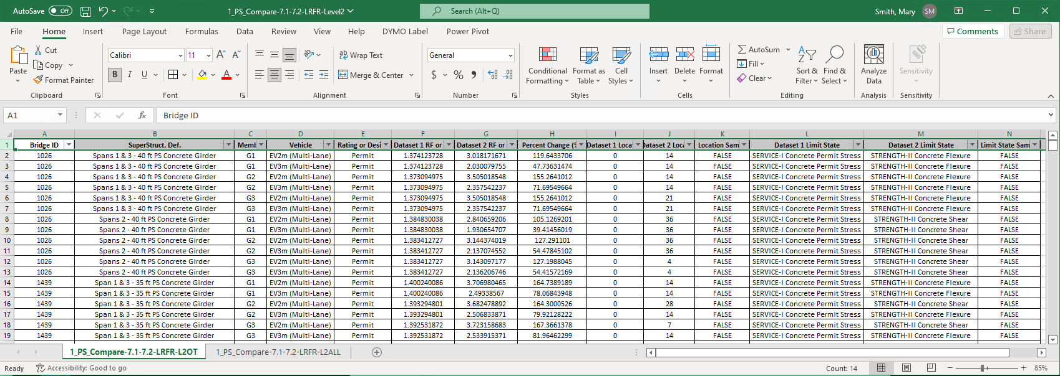
Using the ARC Tool – 7.1-7.2 Results Comparison
Level 2 – Controlling rating factor for each member
Notes:
These are exported results – again, exported all results, exported out of tolerance results, combined into one spreadsheet.

Slide 20
Using the ARC Tool – 7.1-7.2 Results Comparison
Structure Type | Bridges in Dataset | Bridges with out of tolerance results (Level 1 Comparison, 5%)
PS Concrete | 171 | 42
Steel Girder
Concrete Deck | 86 | 1
Corrugated Deck | 40 | 0
Timber Deck | 24 | 0
RC Tee Beam | 35 | 0
RC Slab | 19 | 0
Concrete Culvert | 7 | 0
Truss | 25 | 1
Girder Floorbeam | 14 | 1
Notes:
Our test case was for prestressed concrete – we felt that was adequate supporting data (in addition to our other approach) and made the decision to upgrade to 7.2.
We've been working on developing other datasets (still with 7.1 xmls) – this is still a work in progress, but I ran a comparison of 7.1 and 7.2 on what we have so far just to see. Here’s a summary – for Level 1 comparison (overall bridge rating/controlling rating factor)
From a standpoint of focusing on high level (bridge level) out of tolerance results to see what impact in overall ratings would be – this does a nice job. It also reinforces that we aren’t seeing any major issues or trends; gives reasonable confidence that the discrepancies are likely isolated and associated with the specific bridge/model. Not seeing a huge/alarming trend with the data we have – anticipate this will improve as we add to it. Next steps would be to start drilling down and understanding the reasoning behind different values – that’s something we’ll continue to flush out.

Slide 21
Summary
MDT plans to use ARC Tool to supplement testing approach; will still need to do some manual testing/comparison
  Timber, list of complex bridges, program functionality
ARC Tool is anticipated to address past testing challenges by helping to
  Efficiently perform comprehensive testing
  Identify trends or impacts associated with adopting a new version
  Improve confidence and timeliness of upgrade
Work in Progress – plan to continue developing datasets, fine-tune procedures for future upgrades
Notes:
In summary –
We plan to use the ARC Tool to supplement our current testing approach. It can’t completely replace it, but the hope is that it can take some of the simpler representative structure types off Dave’s list and allow him to better optimize his time and efforts on testing the more complex subset of bridges.
It addresses our current gaps –
- allows to efficiently perform more comprehensive testing with the same, limited resources
- increase

Slide 22


