Slide 1
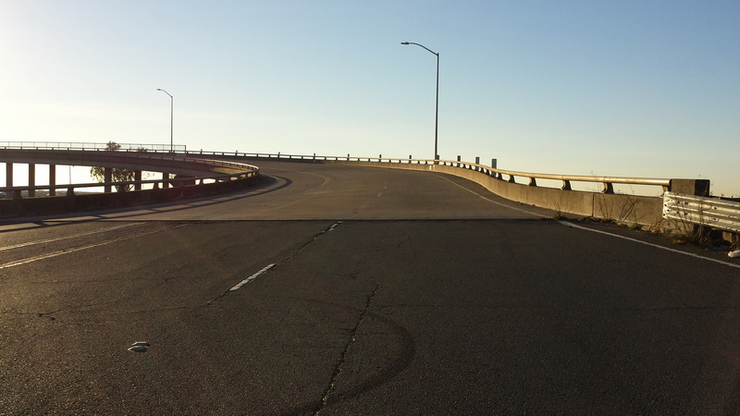
OPENING REMARKS
2019 Rating & Design Bridge User
Group (Radbug) meeting
July 30, 2019
South Lake Tahoe, CA
Dolores Valls, Caltrans State
Bridge Maintenance Engineer

Slide 2
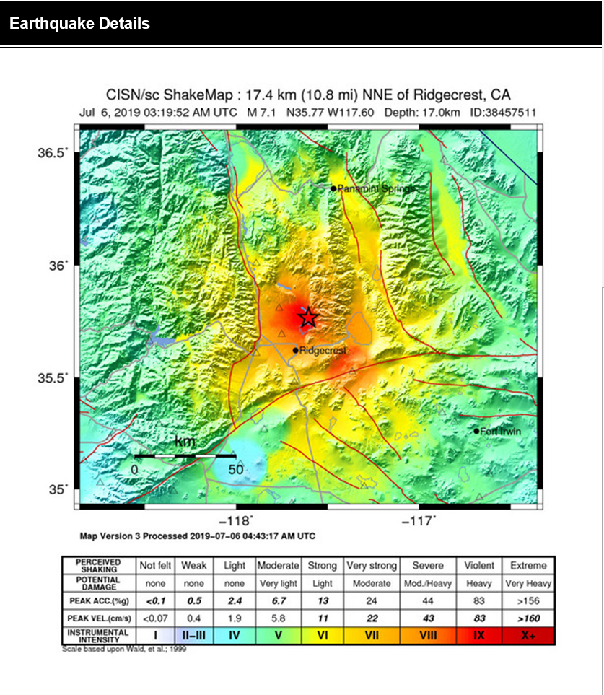
Welcome to California
South Lake Tahoe – Ski, hike, bike, boat, sunsets, etc…
California Department of Transportation (Caltrans)
Recent Events: Earthquakes of all magnitudes!
July 4, 2019 Ridgecrest, CA – 6.4 Magnitude
July 5, 2019 Ridgecrest, CA – 7.1 Magnitude
15,000+ Aftershocks
NO BRIDGE DAMAGE REPORTED TO DATE

Slide 3
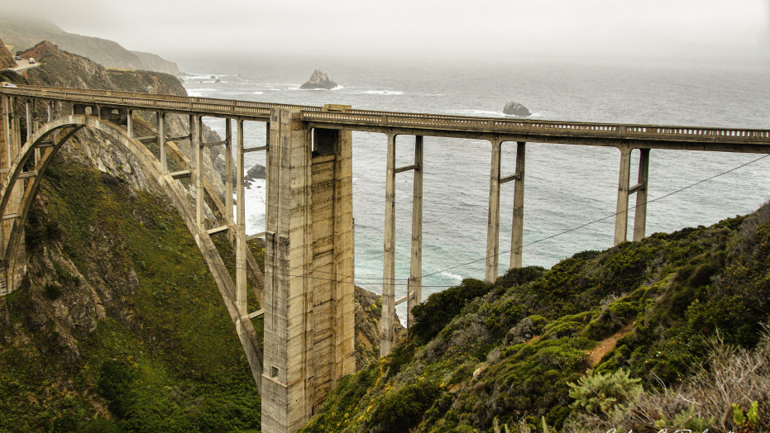
Introductions - Self
Dolores Valls, PE
“Titles”:
State Bridge Maintenance Engineer
Chief, Structure Maintenance & Investigations (SM&I)
Deputy Division Chief, Division of Maintenance
AASHTO Committee on Bridges & Structures
T-1 Bridge Security & Hazards
T-18 Bridge Management, Evaluation, and Rehabilitation
T-20 Tunnels

Slide 4
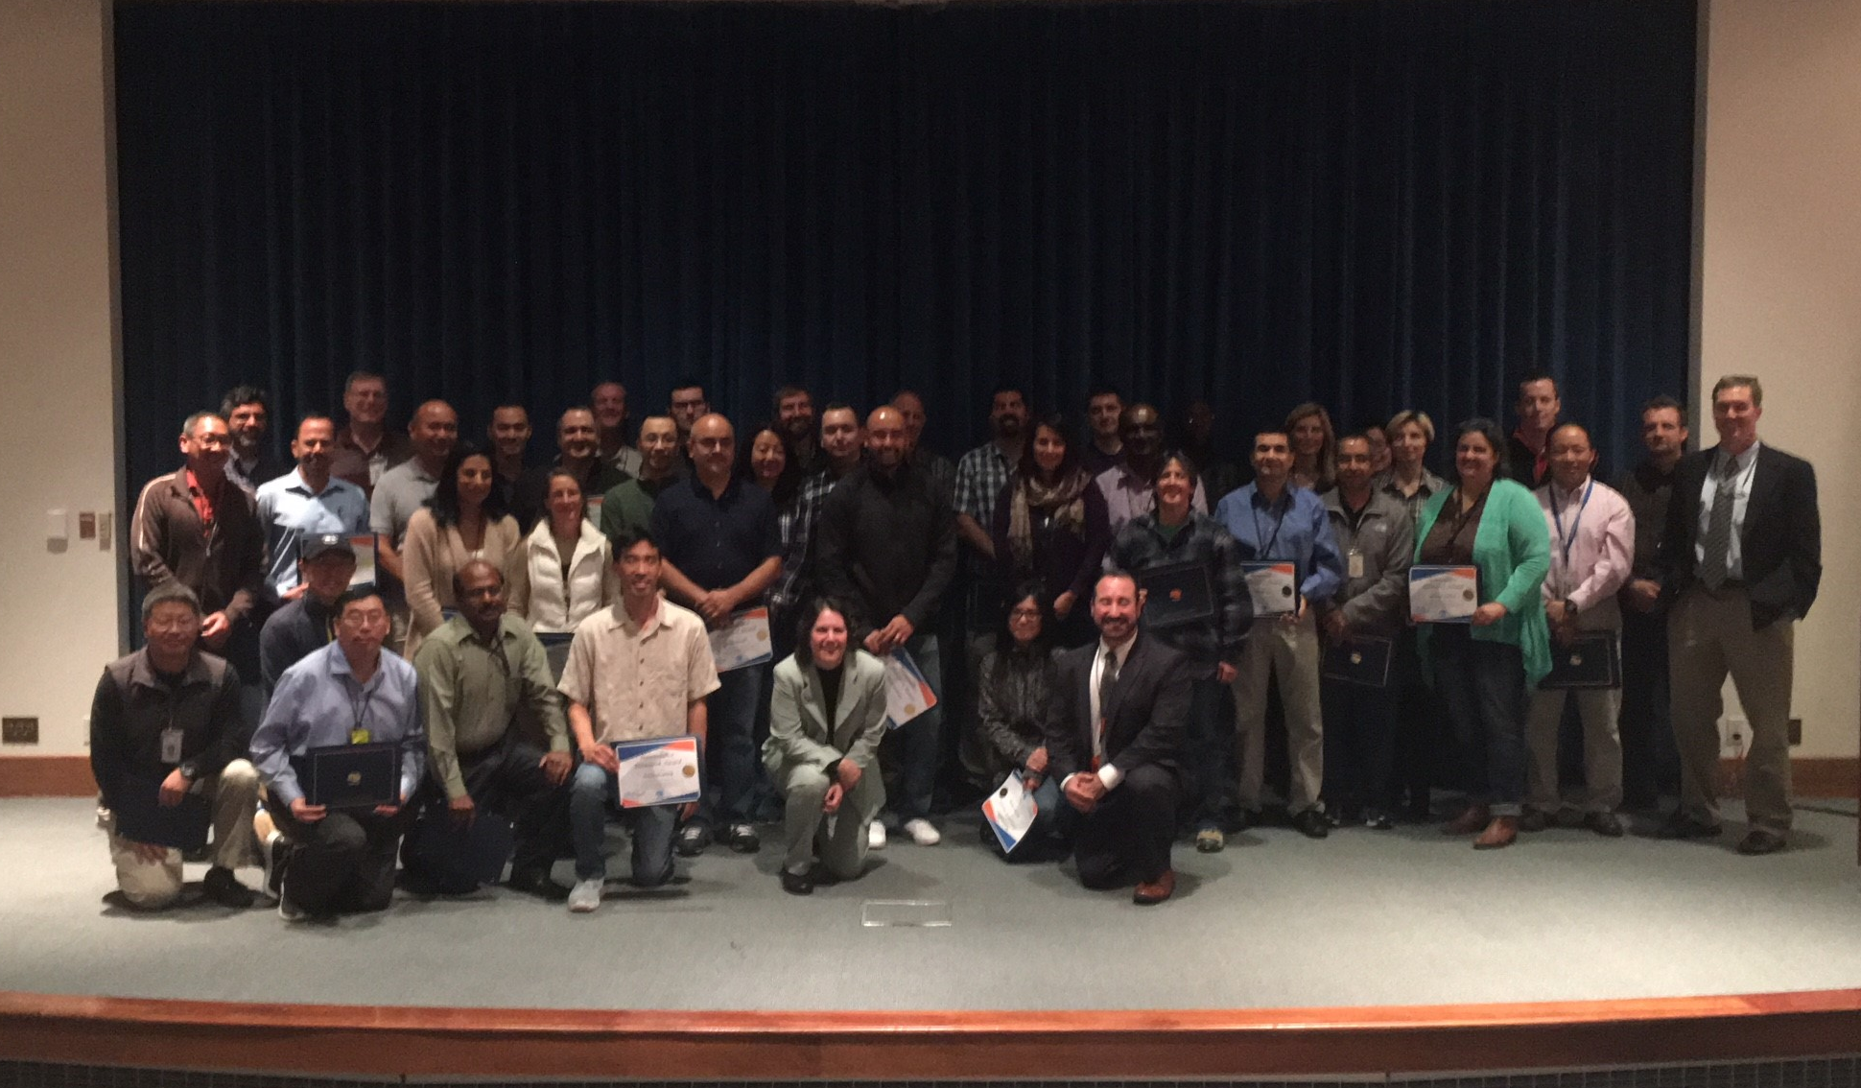
Introductions of Caltrans Staff
Gudmund Setberg
State Bridge Design Engineer
Kevin Keady
State Bridge Load Rating Engineer
Vinacs (Murugesu Vinayagamoorthy) Senior Bridge Engineer Specialist
George Huang
Senior Bridge Engineer, Supervisory
Dave Ward
Senior Bridge Engineer, Supervisory
Darren Stauts
Senior Bridge Engineer, Supervisory
Jun Jung
Senior Bridge Engineer, Supervisory

Slide 5
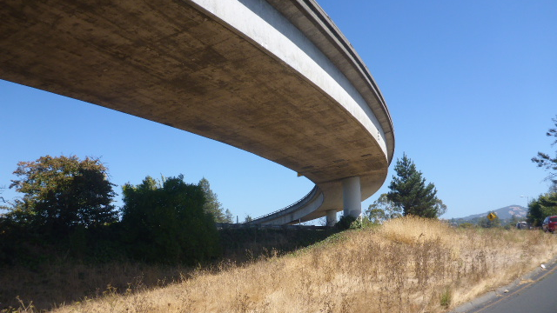
Overview – Caltrans Structure Design
Division of Engineering Services
Headquarters in Sacramento, satellite office in Diamond Bar, CA
205 Bridge Designers
Additional 10% consultant resources
Bridge Design Software Technical Team
(20 BrD licenses under evaluation)
Question: May we extend time of 90 days trial ???

Slide 6
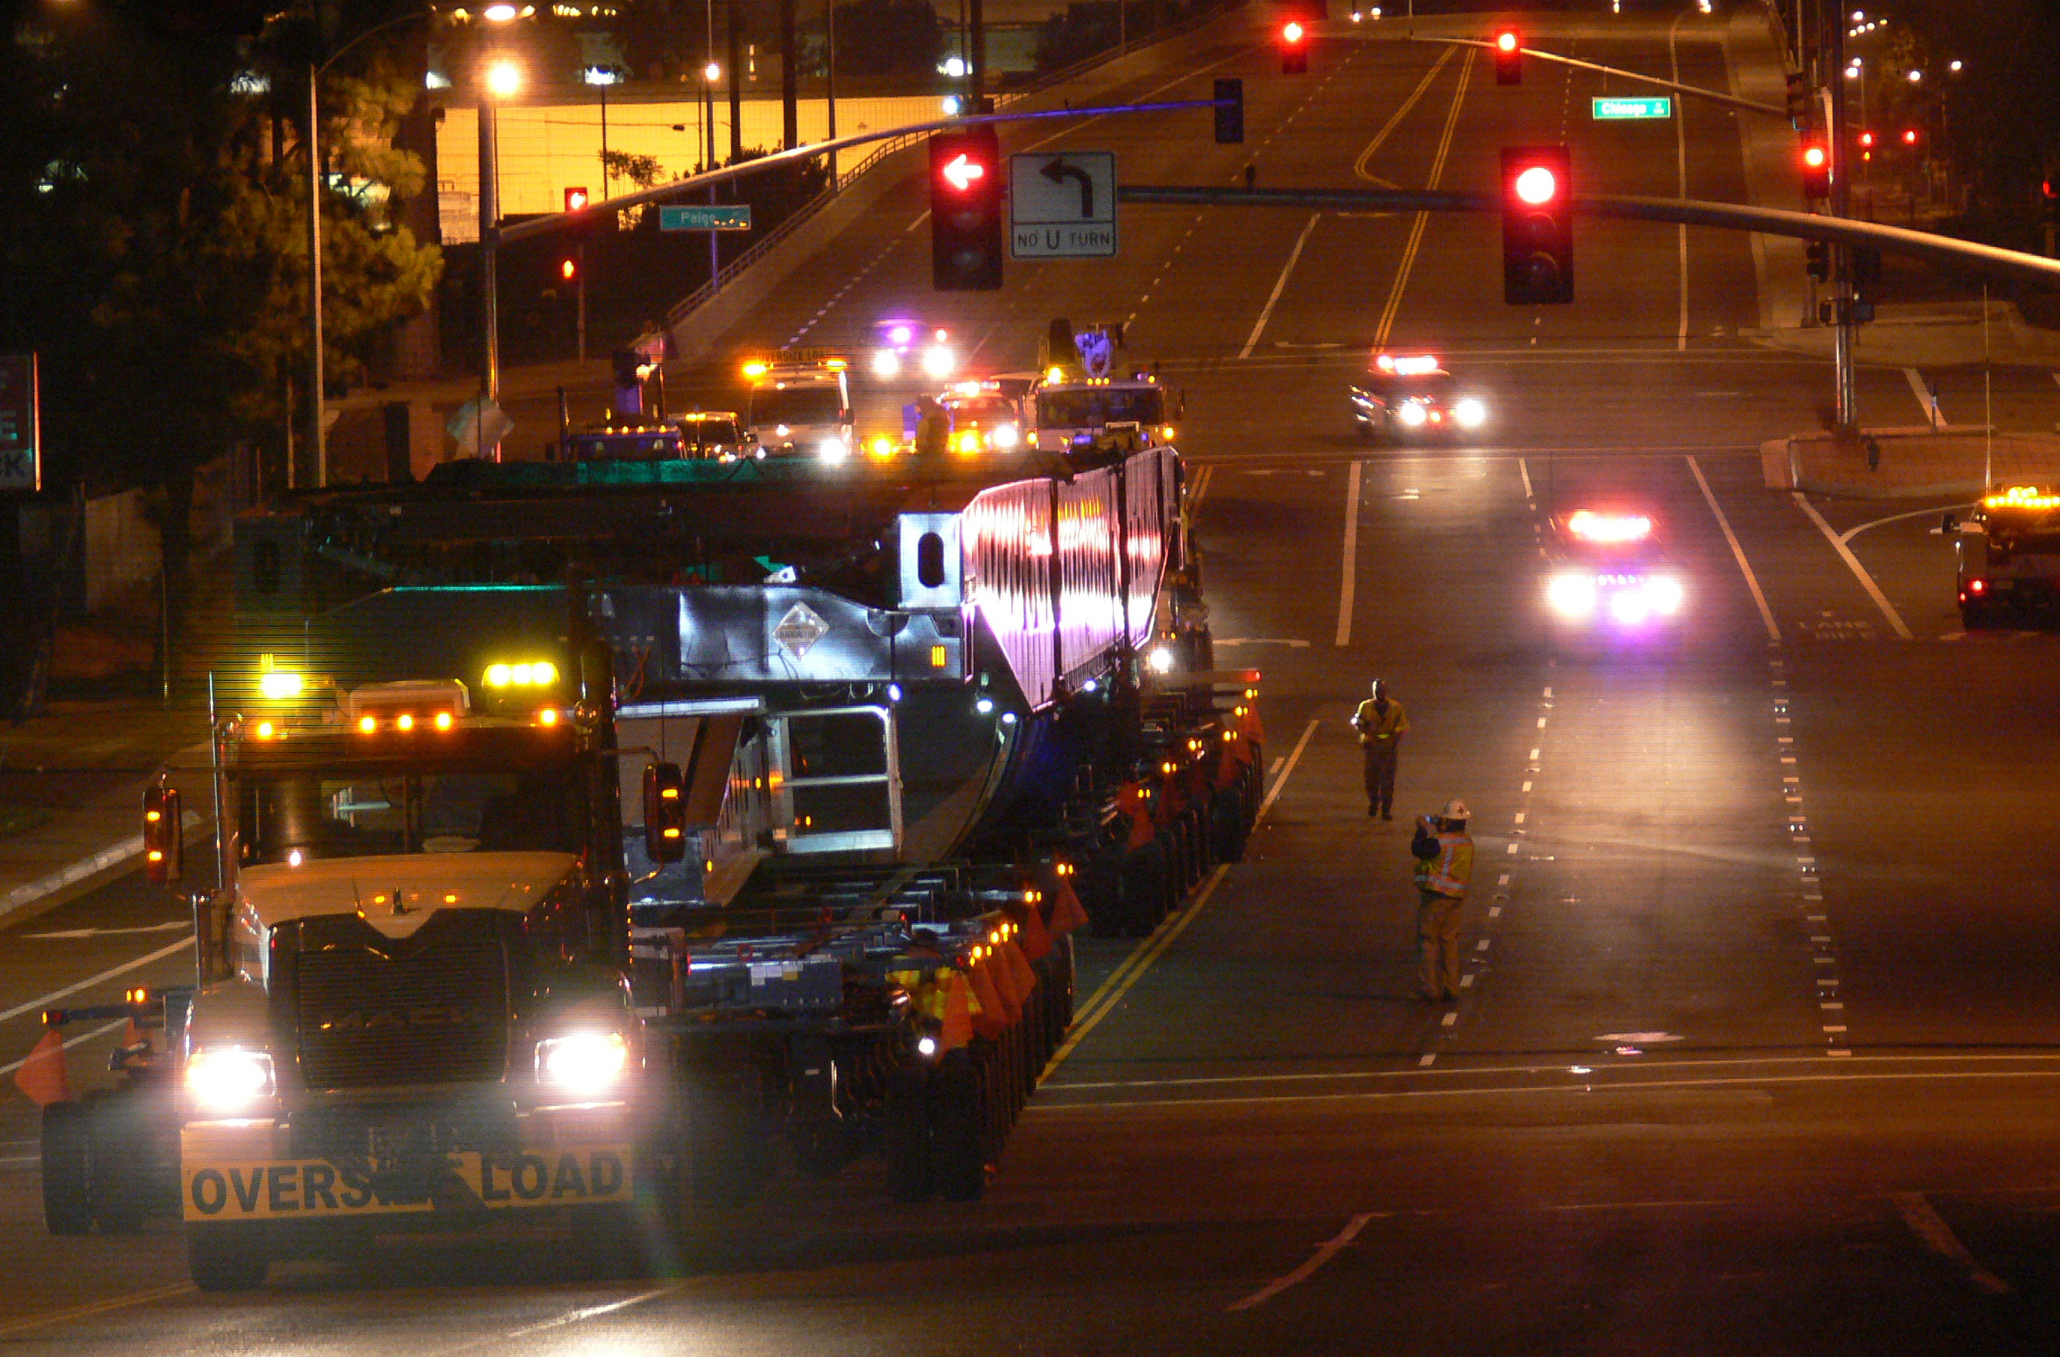
Overview – Caltrans Bridge Load Rating
Performed in Structure Maintenance & Investigations
Currently 32 full-time Bridge Load Rating Engineers (has been 8 to 40+ engineers)
Consultant Contracts (in process)
Expansion after 2008 FHWA Program Review
Finding: Caltrans has electronic files with “moment only” ratings but original software is no longer available. Also, no backup calcs on file and ratings were not updated or maintained.
Metric 13 PCA’s (since 2011)

Slide 7
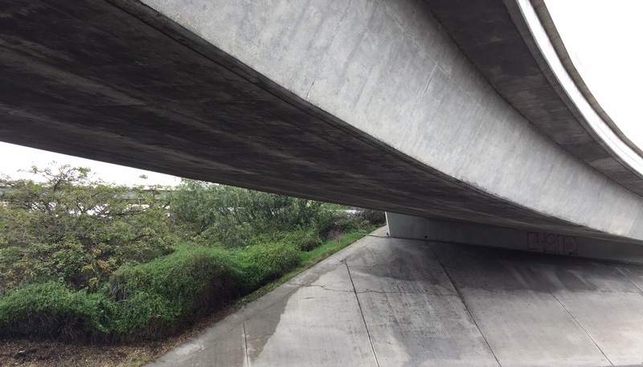
Caltrans & Radbug
Started using AASHTOWare (“BrR”) in 1994
Over $1 Mil investment in service units for Modernization and Enhancements
Thank YOU for your patience with state accounting process!
Primary software used for load rating
6762 bridges load rated using AASHTOWare BrR product

Slide 8
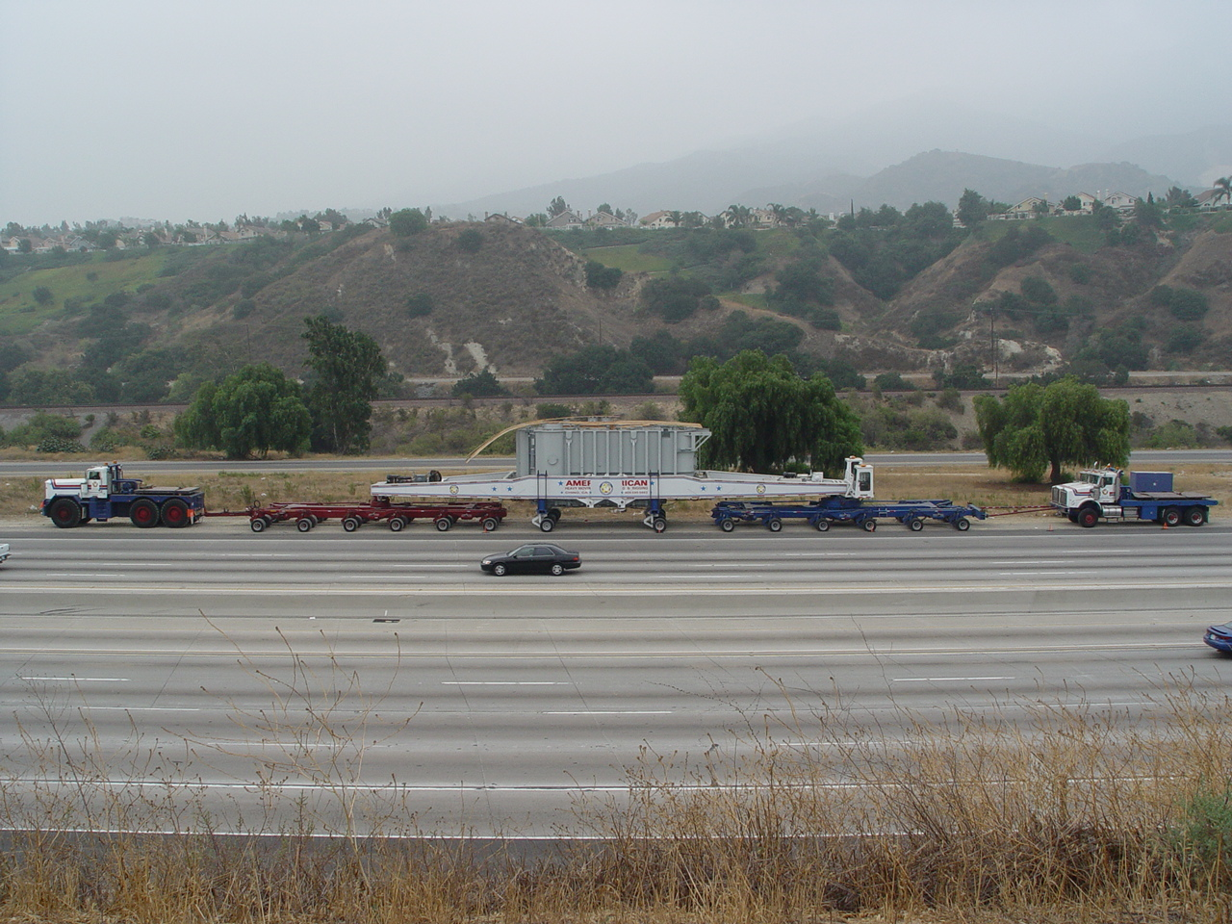
Caltrans Bridge load rating factoids
24955 California NBI Bridges:
53% Bridges have a “CALCULATED” Rating
21% Bridges have “Assigned by Design” Rating
12% Culverts have “Assigned by Design” Rating
6% Bridges have “Assigned NO PLANS Available” Rating
8% Bridges are under review/rerating

Slide 9
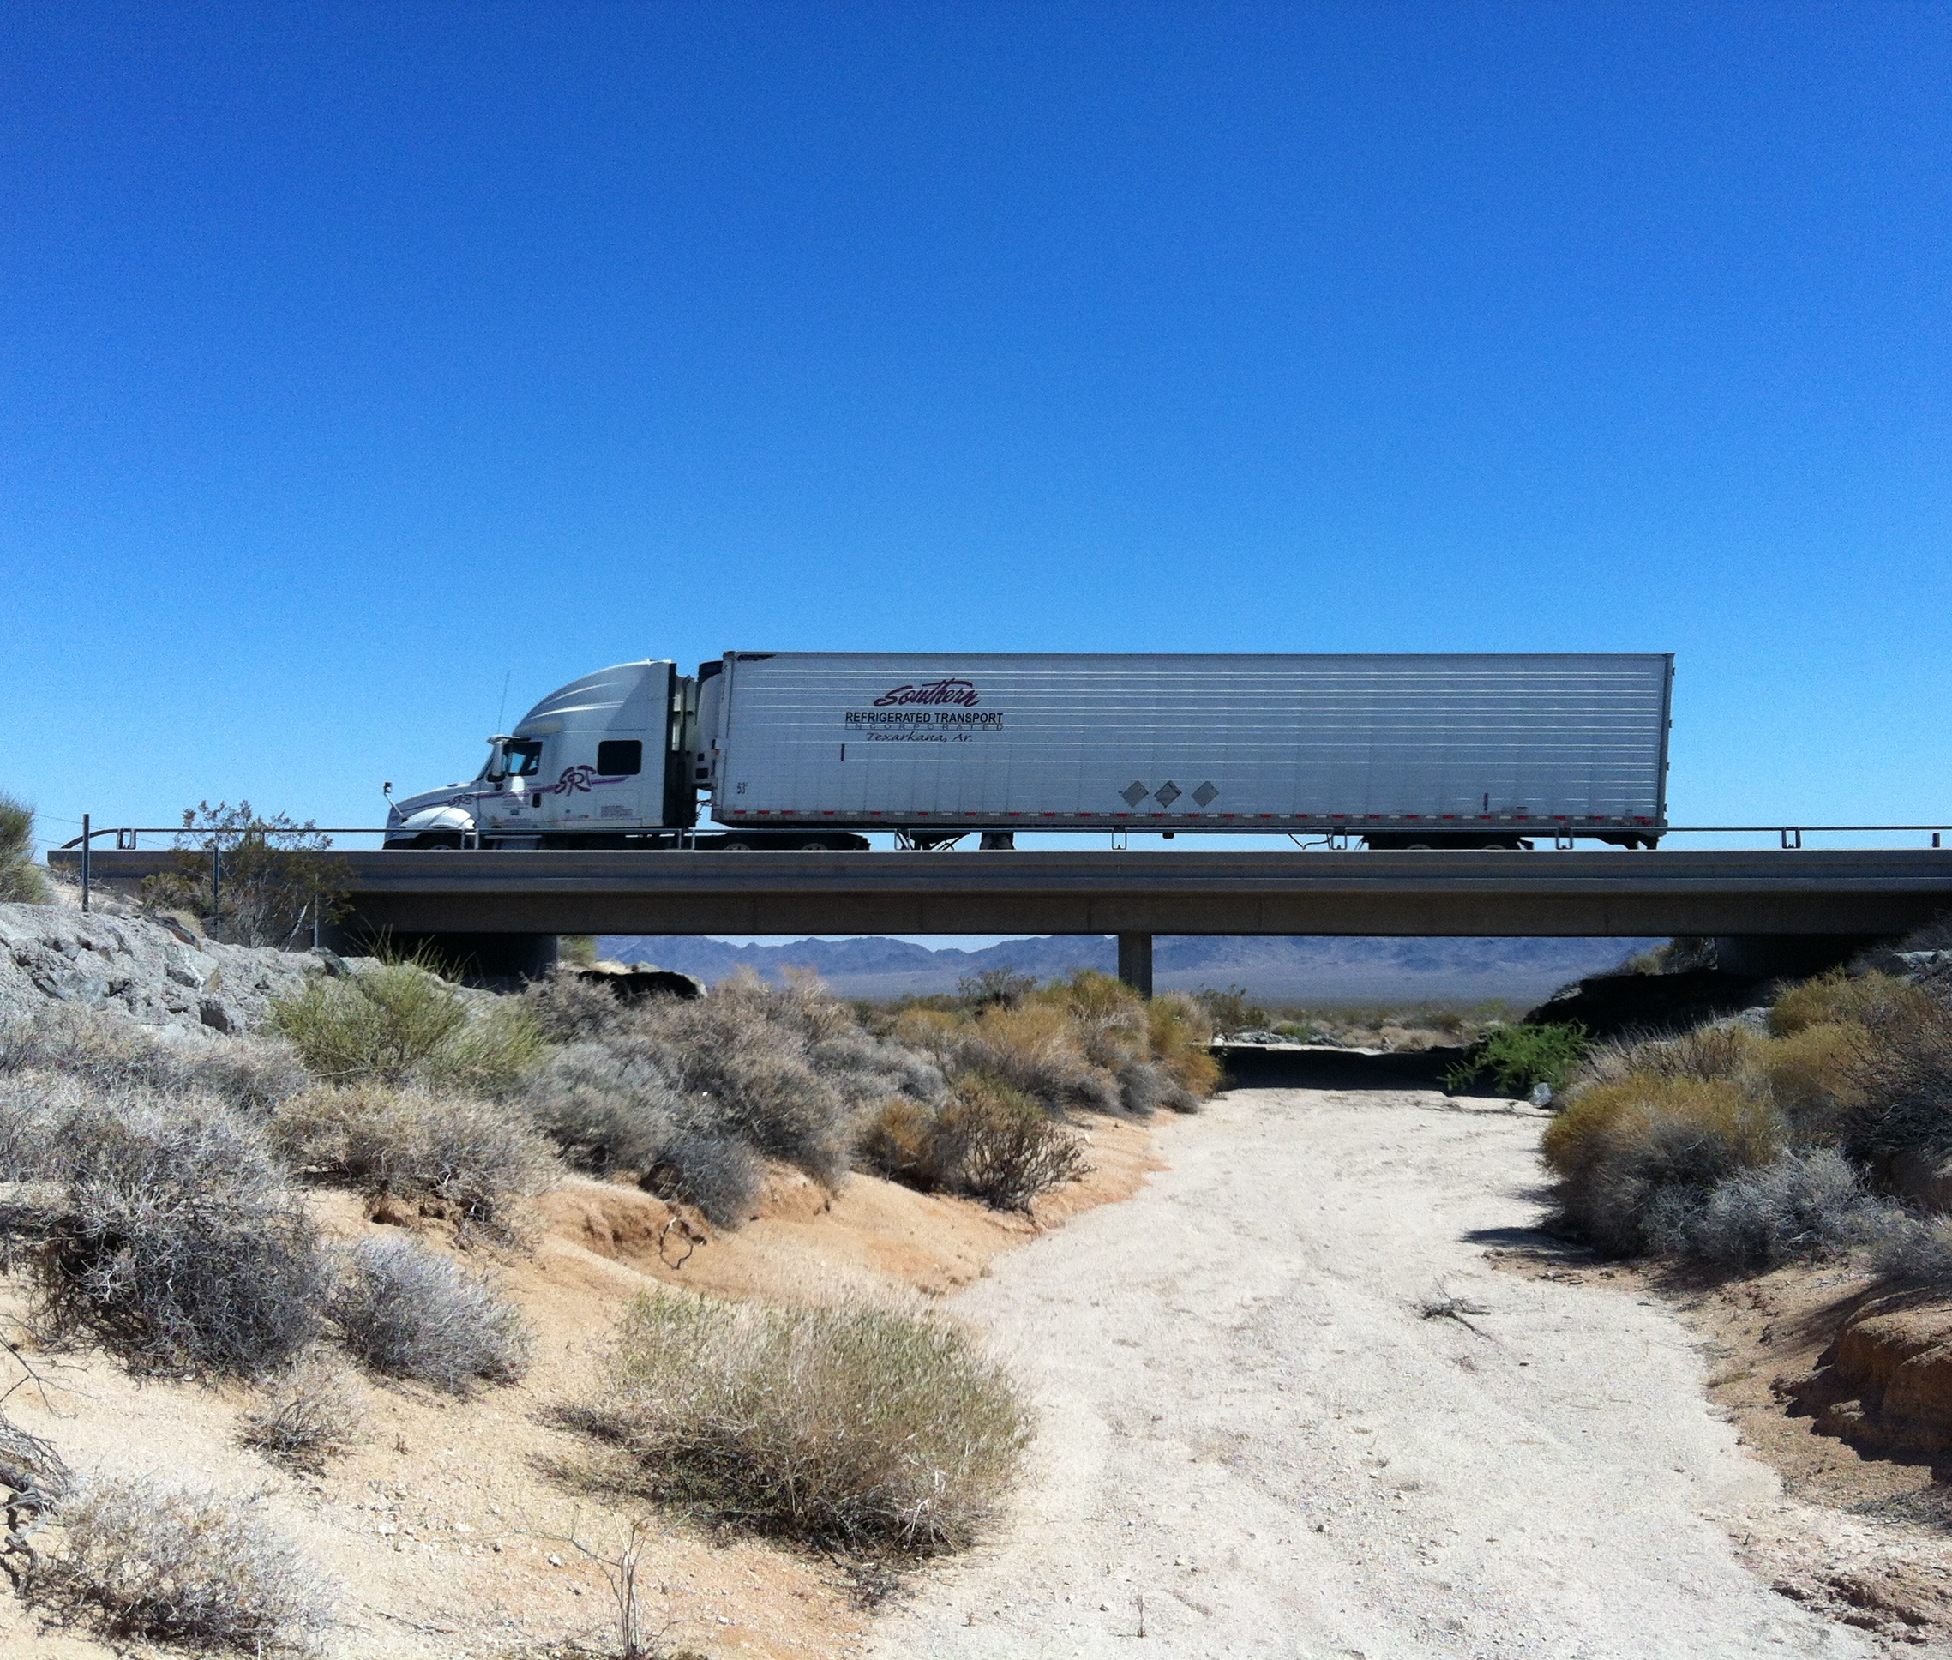
Caltrans load rating Factoids
Of the 13,900 Bridges that have a “Calculated Rating”:
40% of bridges were load rated using LRFR
55% bridges were load rated using LFR
5% bridges were load rated using ASR

Slide 10
Caltrans Load rating Priorities
Not just “California Issues”:
Calculation of Shear (CIP PT box girder bridges)
Curved girders
Influence of differential skews (variable skew, variable widths)
Speed/ Efficiency of the Software engine
Long Lead time for software enhancements
Load Rating for Tunnels
Load Rating for RC Culverts (improvements) and Metal Culverts

Slide 11
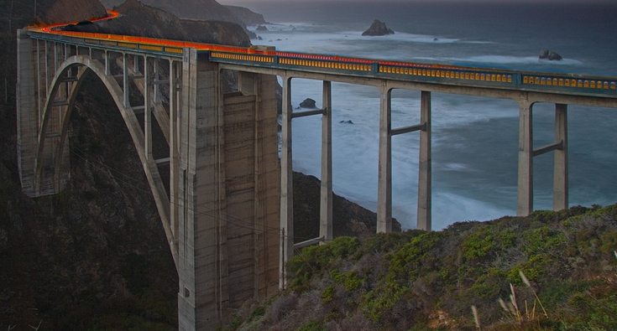
Thank you!!!
Thanks to all of you for your time commitment to this important work.
Get outdoors while you are here!

