Slide 1
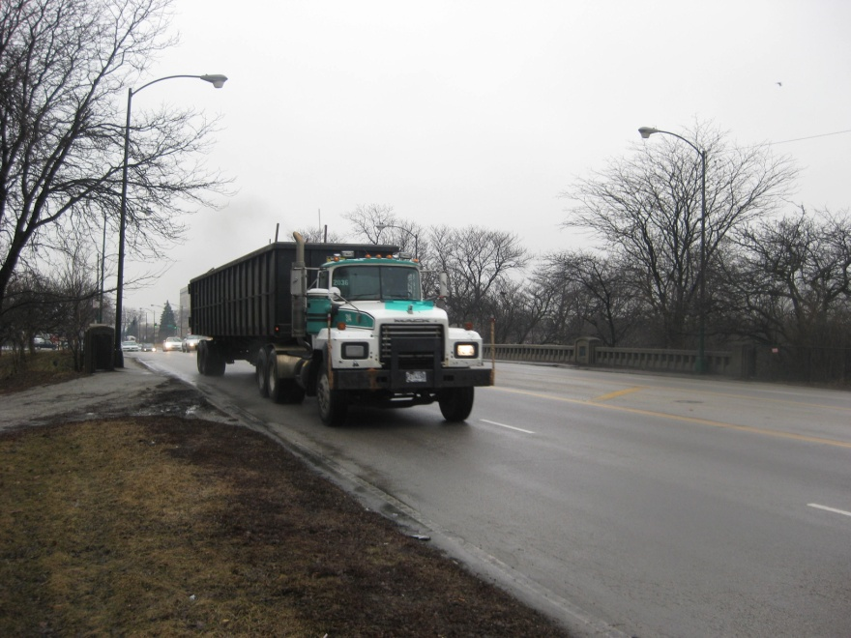
Illinois Department of Transportation Weigh In Motion Study
August 4, 2010
Tim Armbrecht, IDOT
Dave Thompson, AECOM

Slide 2
IDOT WIM Study Agenda
Bridge Description Tim
Reason for Posting Tim
Equipment Used Dave
Installation of Equipment Dave
Software \ Reports Dave
Draft Policy Recommendations Tim
Questions Tim & Dave

Slide 3
Bridge Description
Structure Number: 016-0760
Facility Carried: Kedzie Avenue
Feature Crossed: South Lagoon Marquette Park
Year Constructed: 1933
Structure Length: 54.0 ft
Bridge Roadway Width: 66.0 ft
ADT / ADTT: 24,600 / 4,428
Main Span Matl / Type: Concrete / Tee Beam
NBI Deck / Super / Sub Rating: 3 / 2 / 5
Inventory / Operating Rating: HS 7.4 / 12.3
Posted for 20 Tons

Slide 4
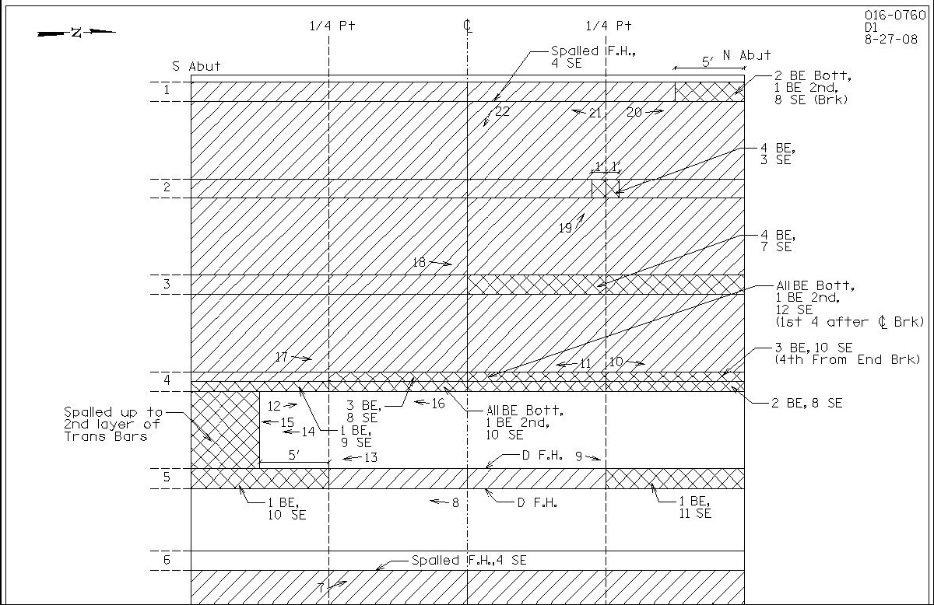
Reason for Posting

Slide 5
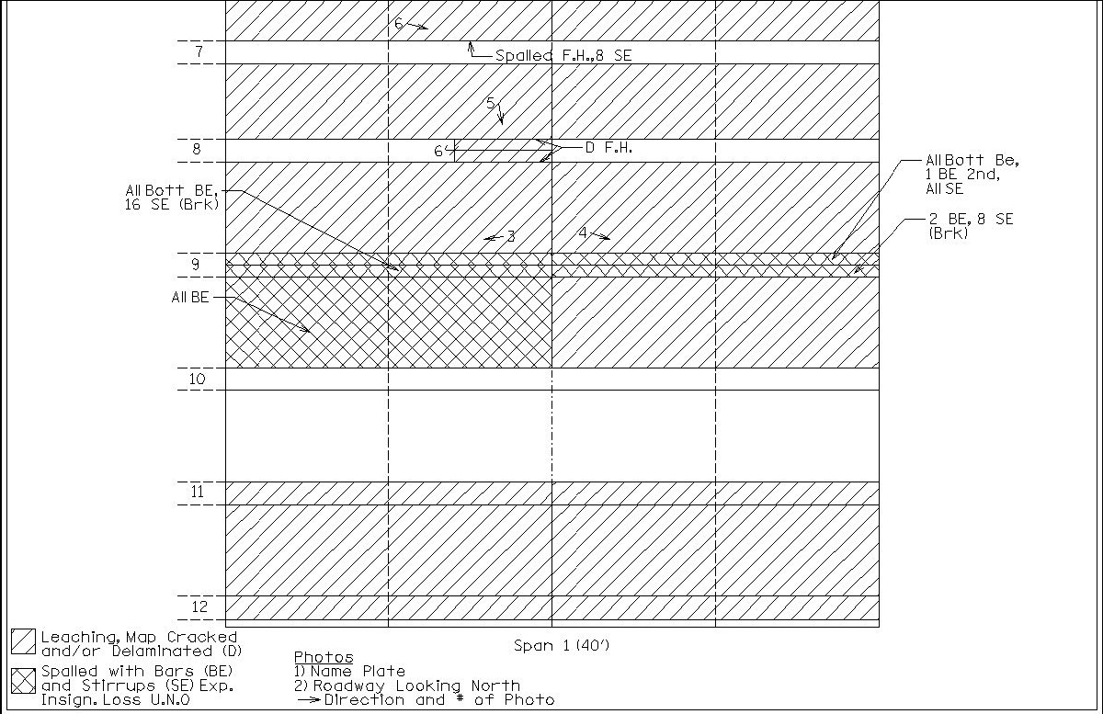
Reason for Posting

Slide 6
Reason for Posting
20 Tons
Concrete in some areas of the deck, i.e. beam flange determined to be ineffective due to loss of compressive strength.
Broken stirrups at beam ends reduces shear capacity.

Slide 7
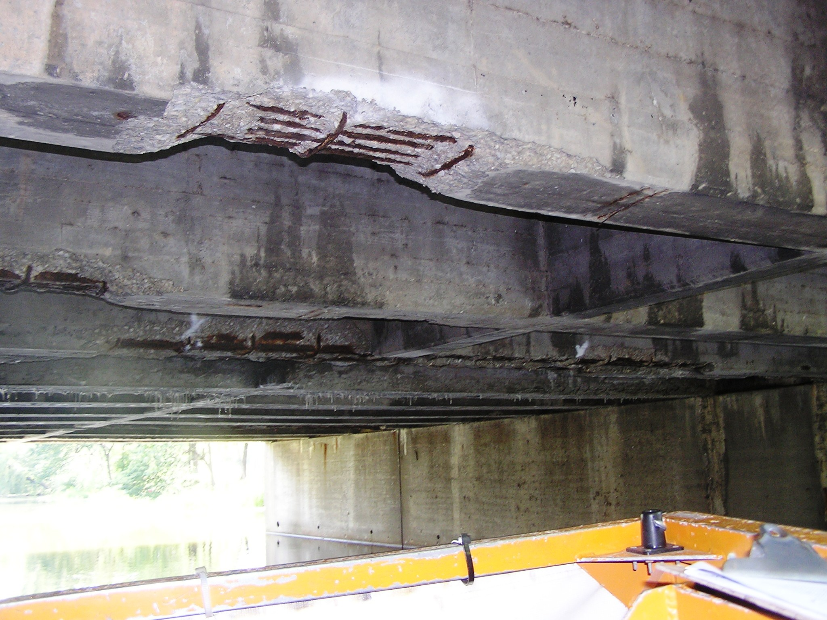
Reason for Posting

Slide 8
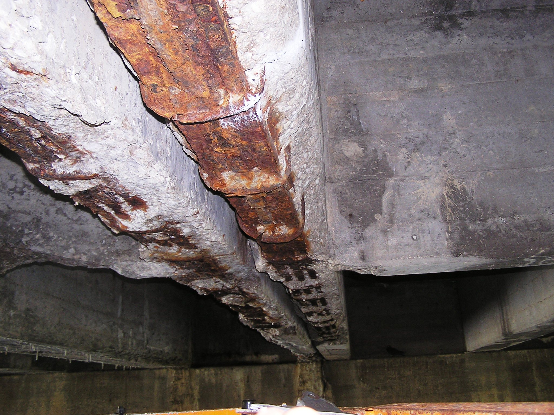
Reason for Posting

Slide 9
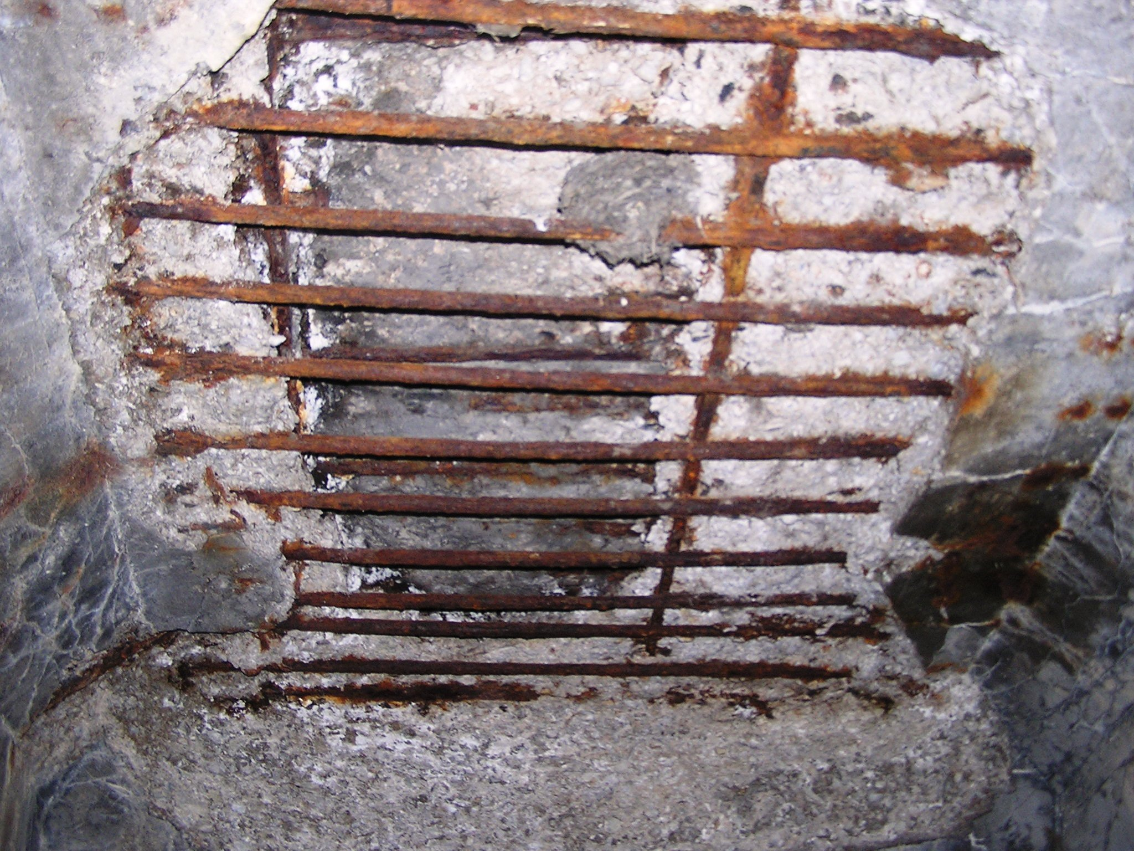
Reason for Posting

Slide 10
Equipment Used
Invitation for Bid
Shall provide a WIM system cable of providing the weight of each truck (within 10% of the actual weight) and allow the use of a cellular modem to transfer data.
The system shall operate on a combination of solar panel and battery power.
Provide onsite installation supervision / calibration.

Slide 11
Equipment Used
International Road Dynamics (IRD)
8 Class 1 BL-Piezo Sensors
T.R.S. Classifier WIM
32 MB Data Card
Cellular Modem
Solar Panel / Battery System
Road Reporter Software

Slide 12
Installation of Equipment
WIM Layout.pdf

Slide 13
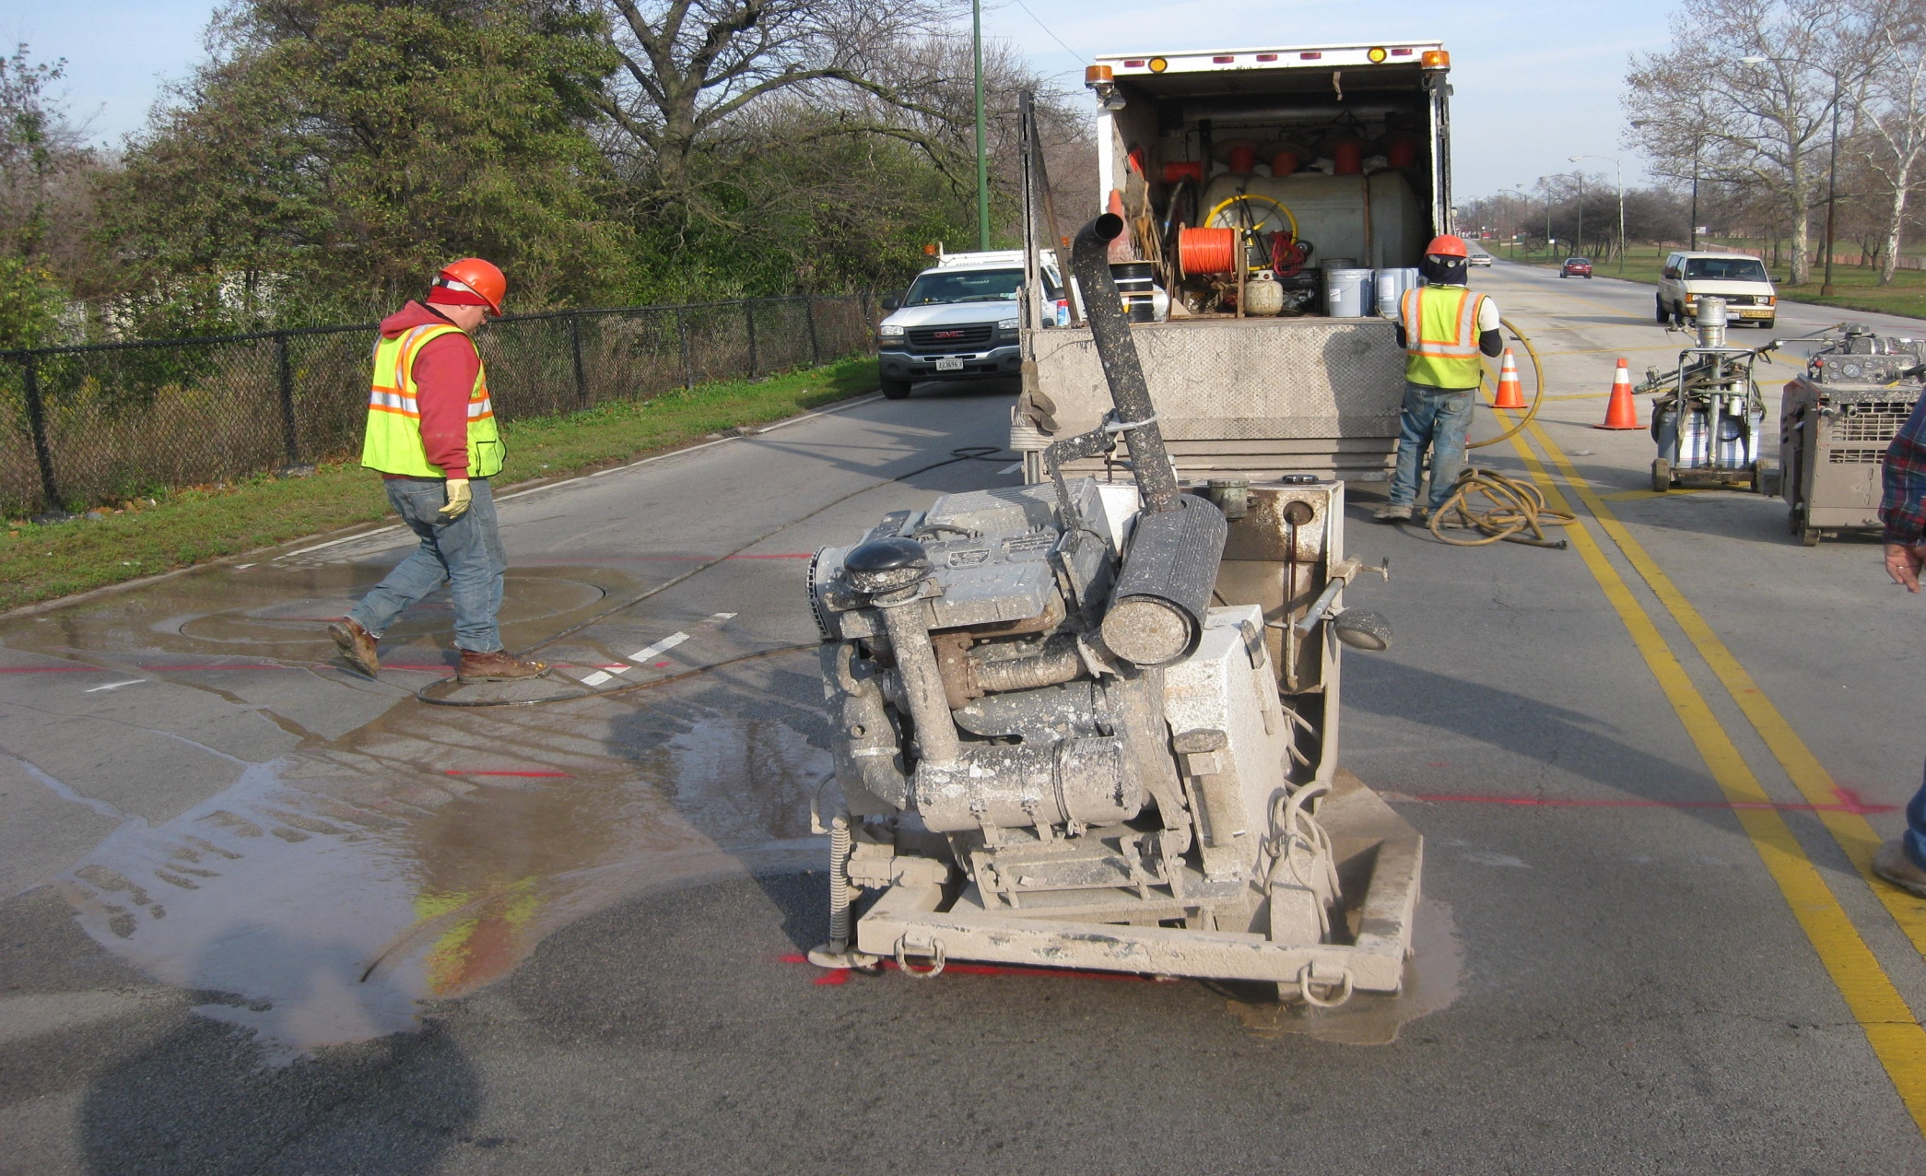
Installation of Equipment

Slide 14
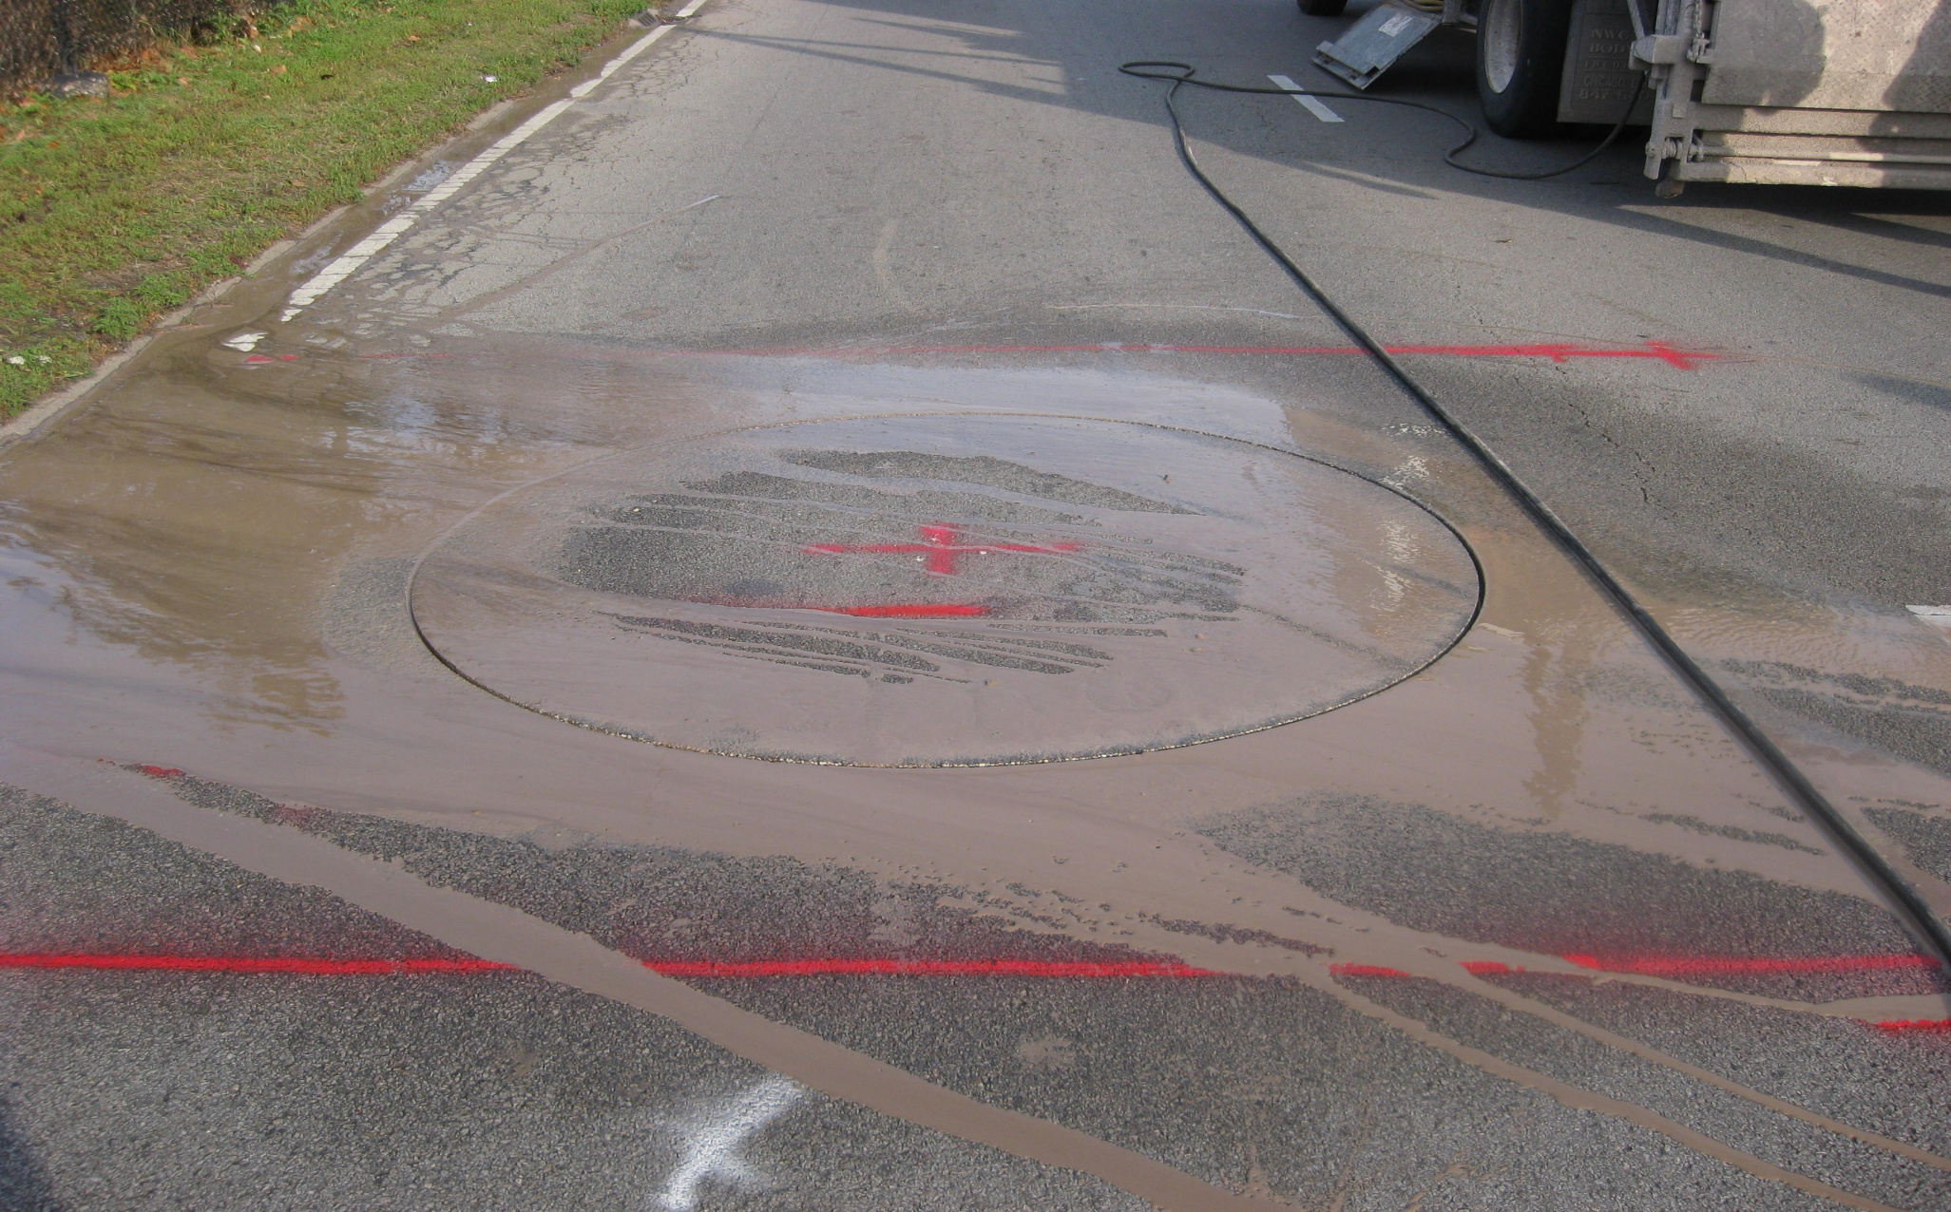
Installation of Equipment

Slide 15
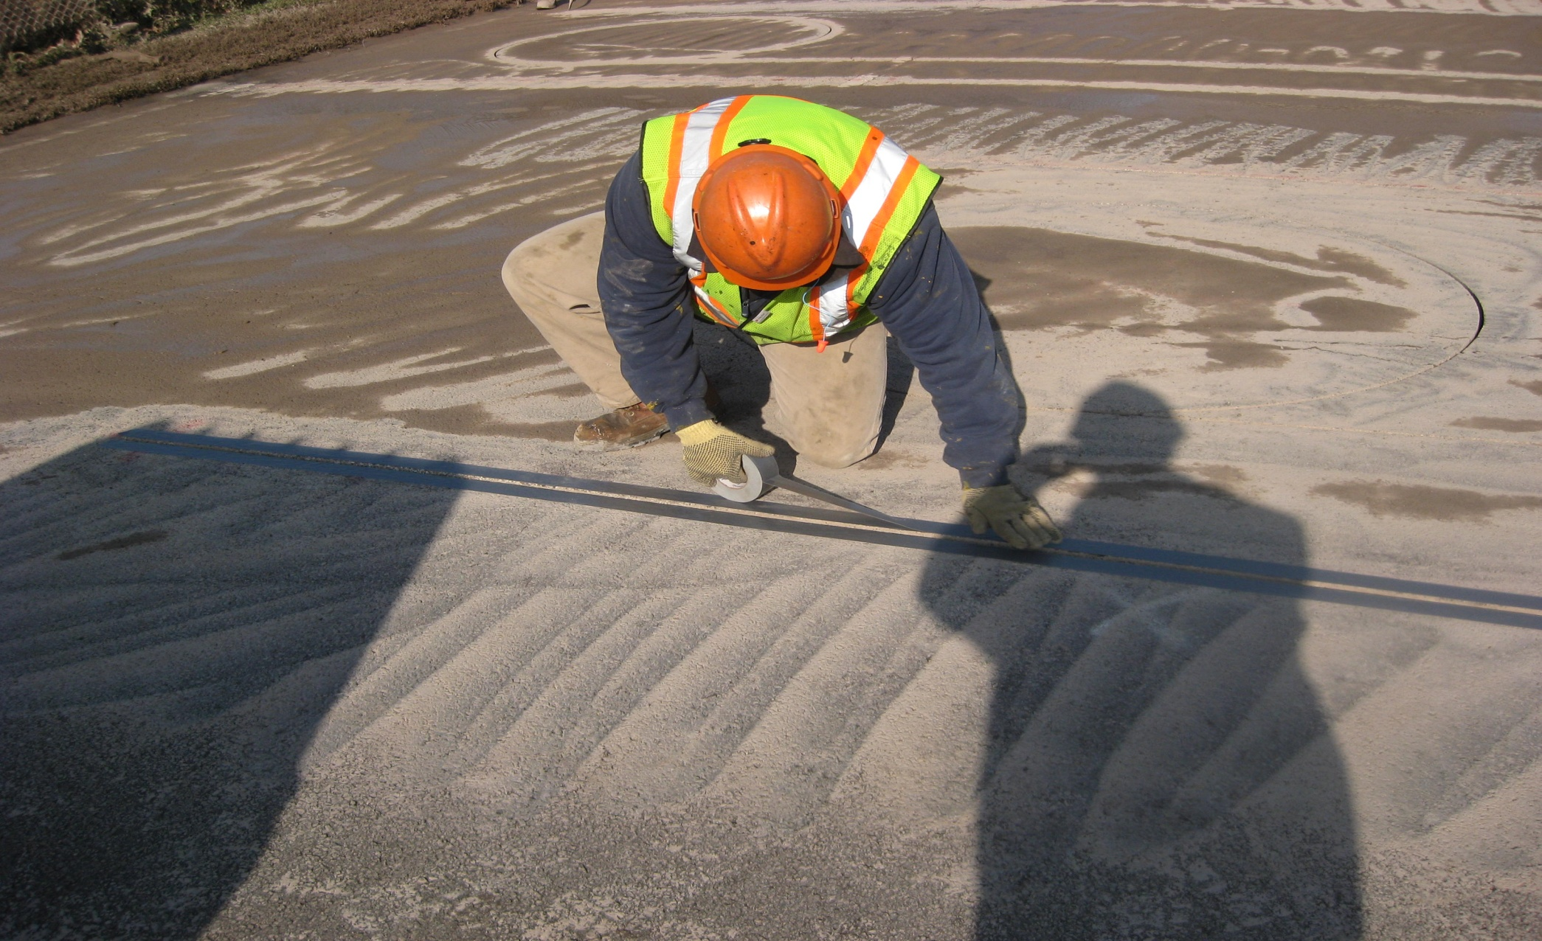
Installation of Equipment

Slide 16
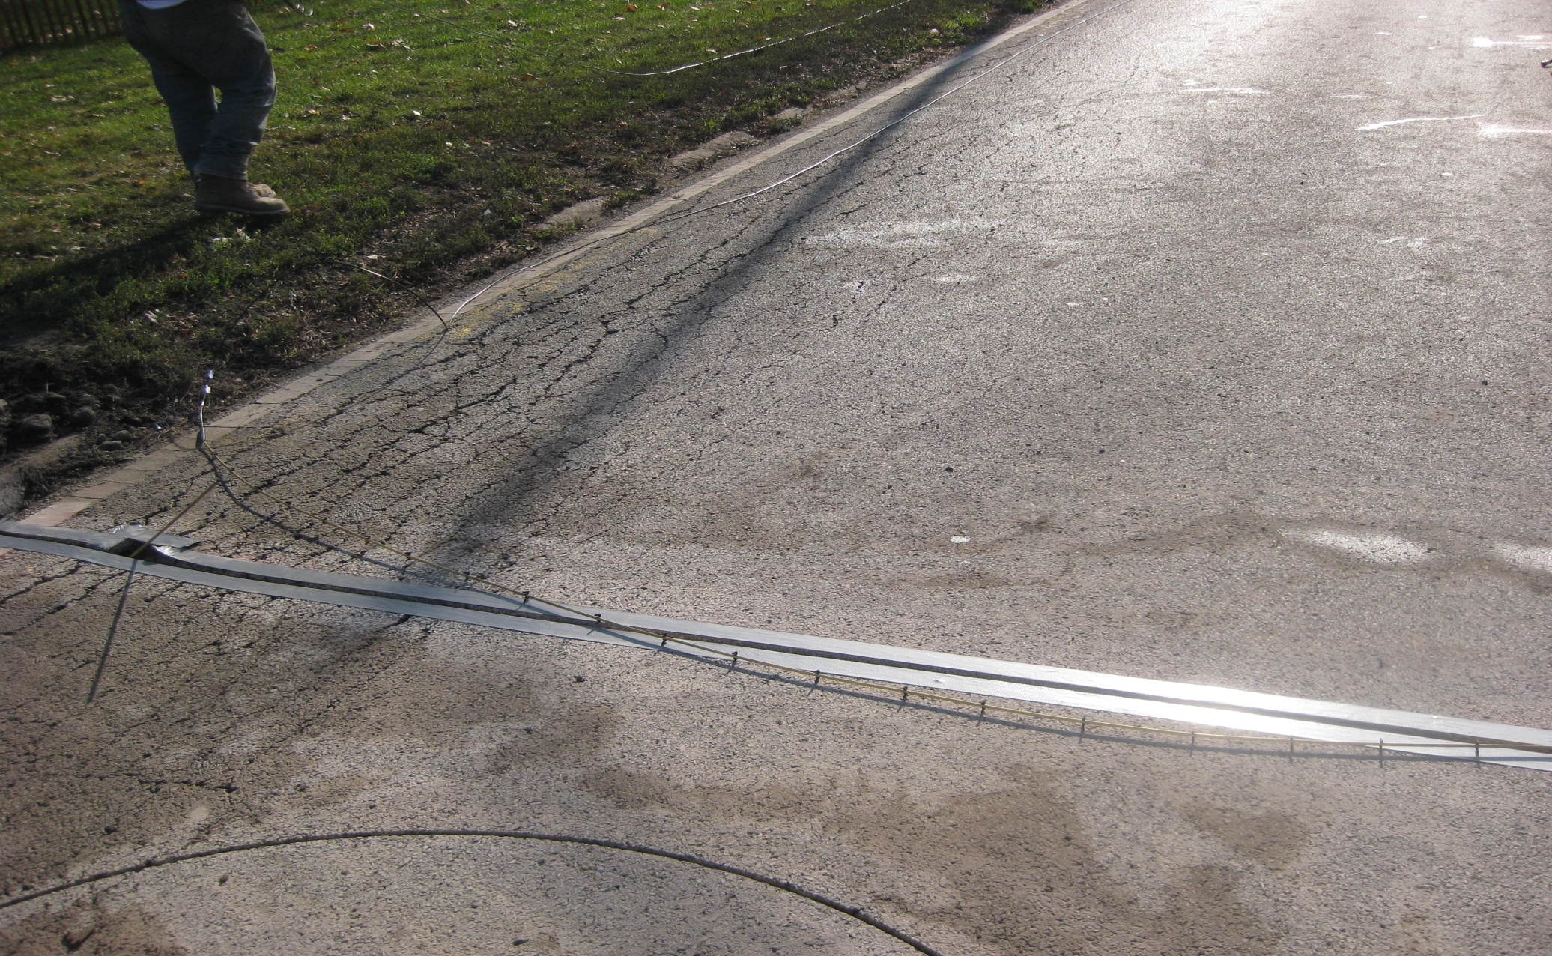
Installation of Equipment

Slide 17
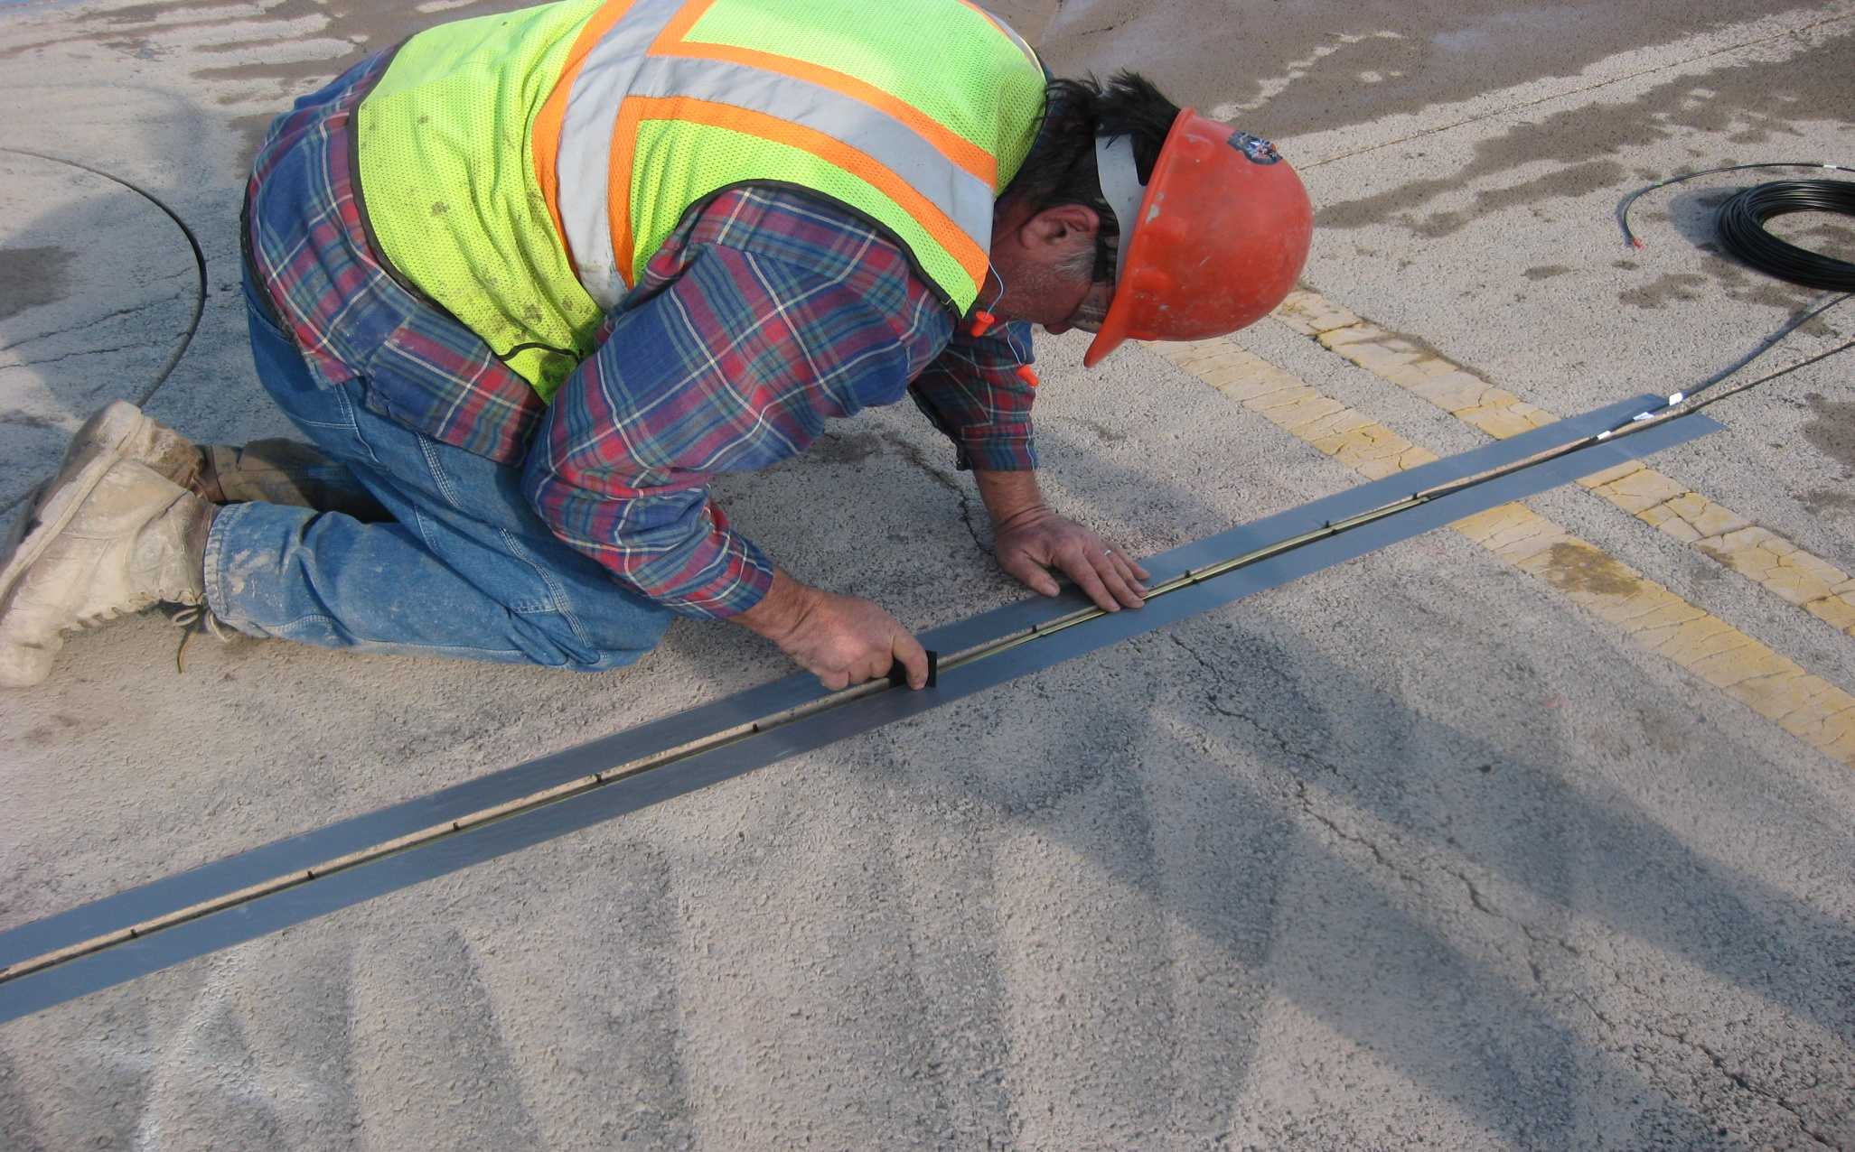
Installation of Equipment

Slide 18
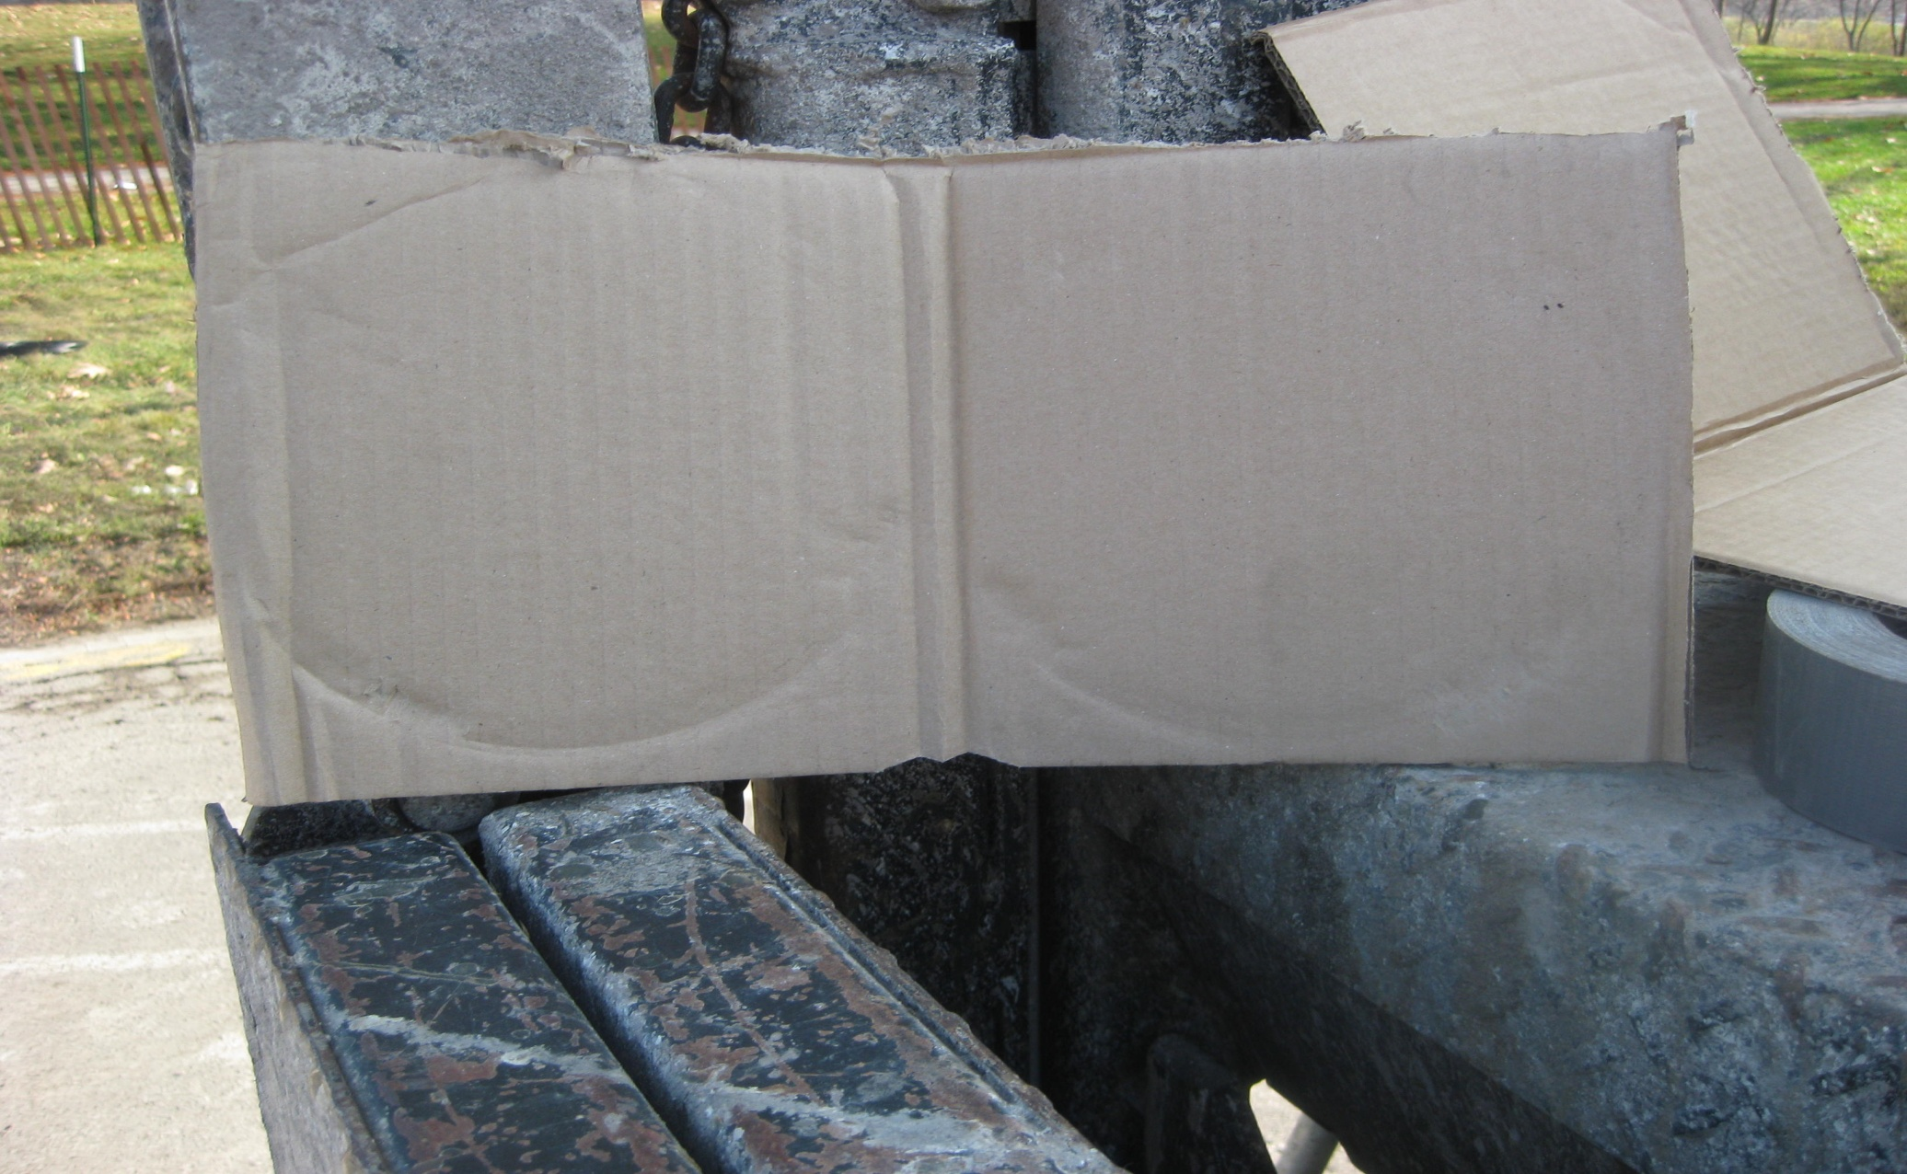
Installation of Equipment

Slide 19
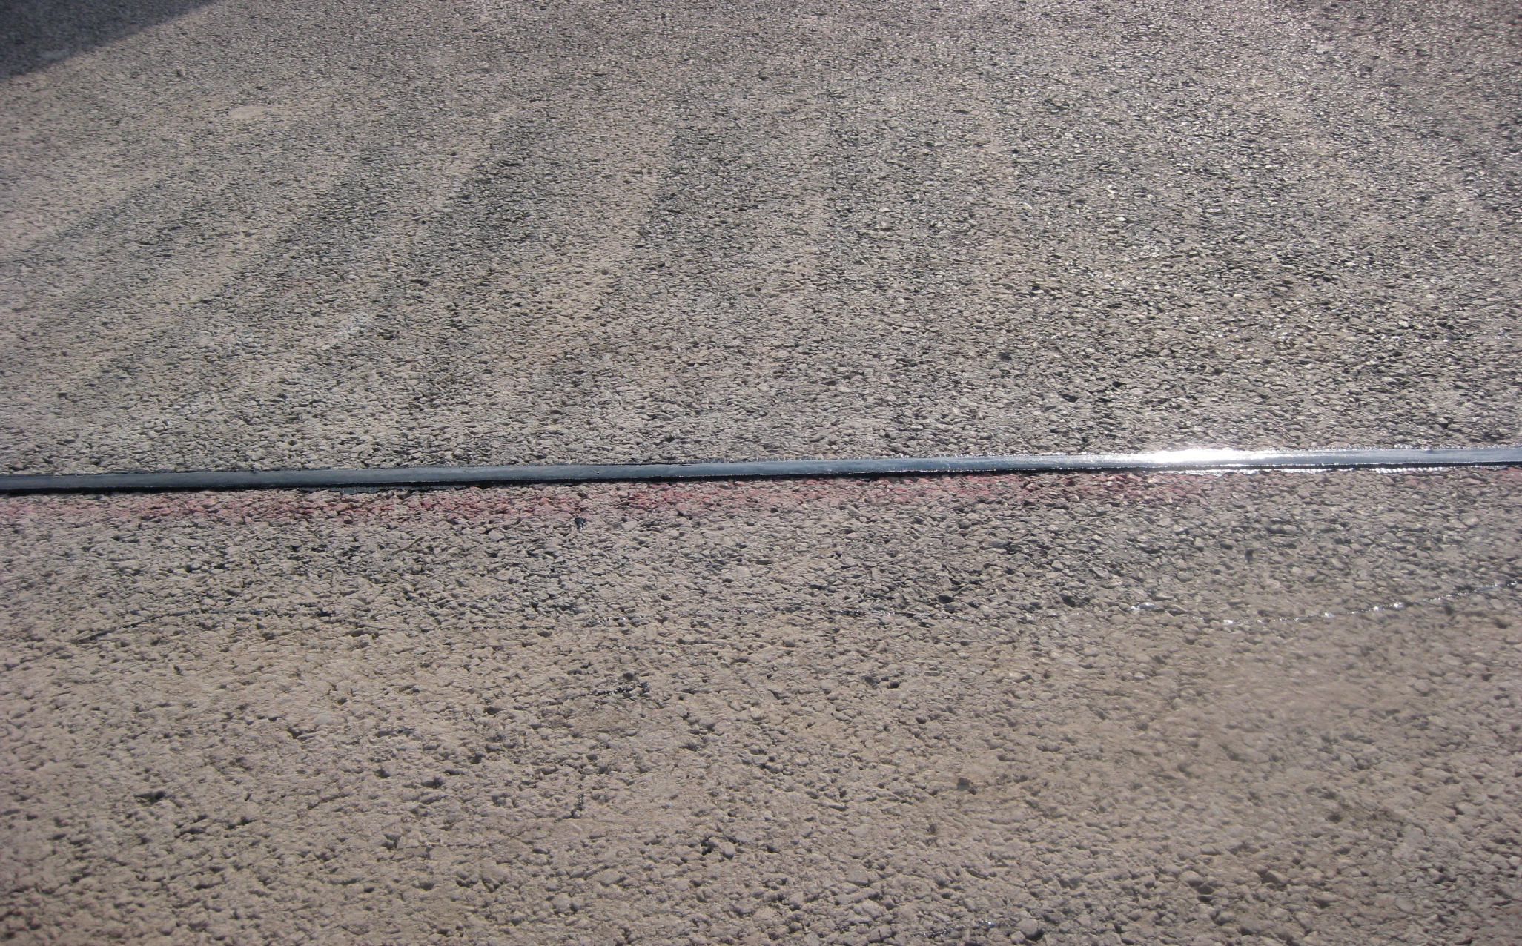
Installation of Equipment

Slide 20
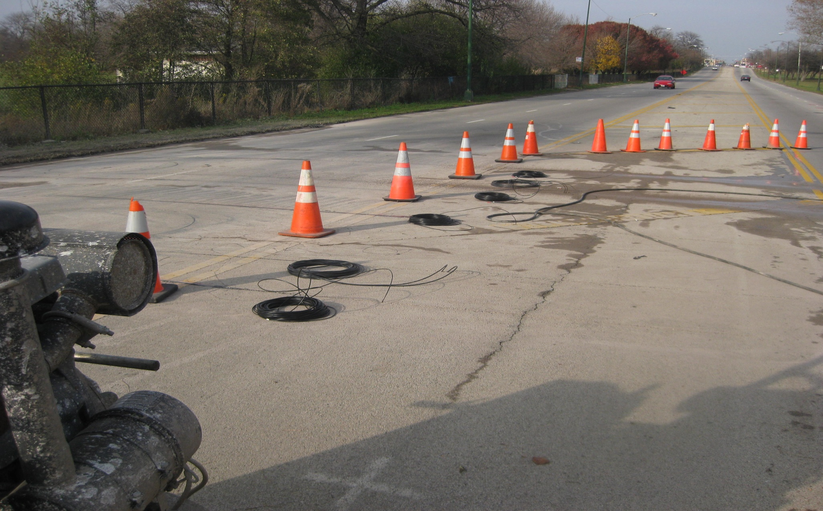
Installation of Equipment

Slide 21
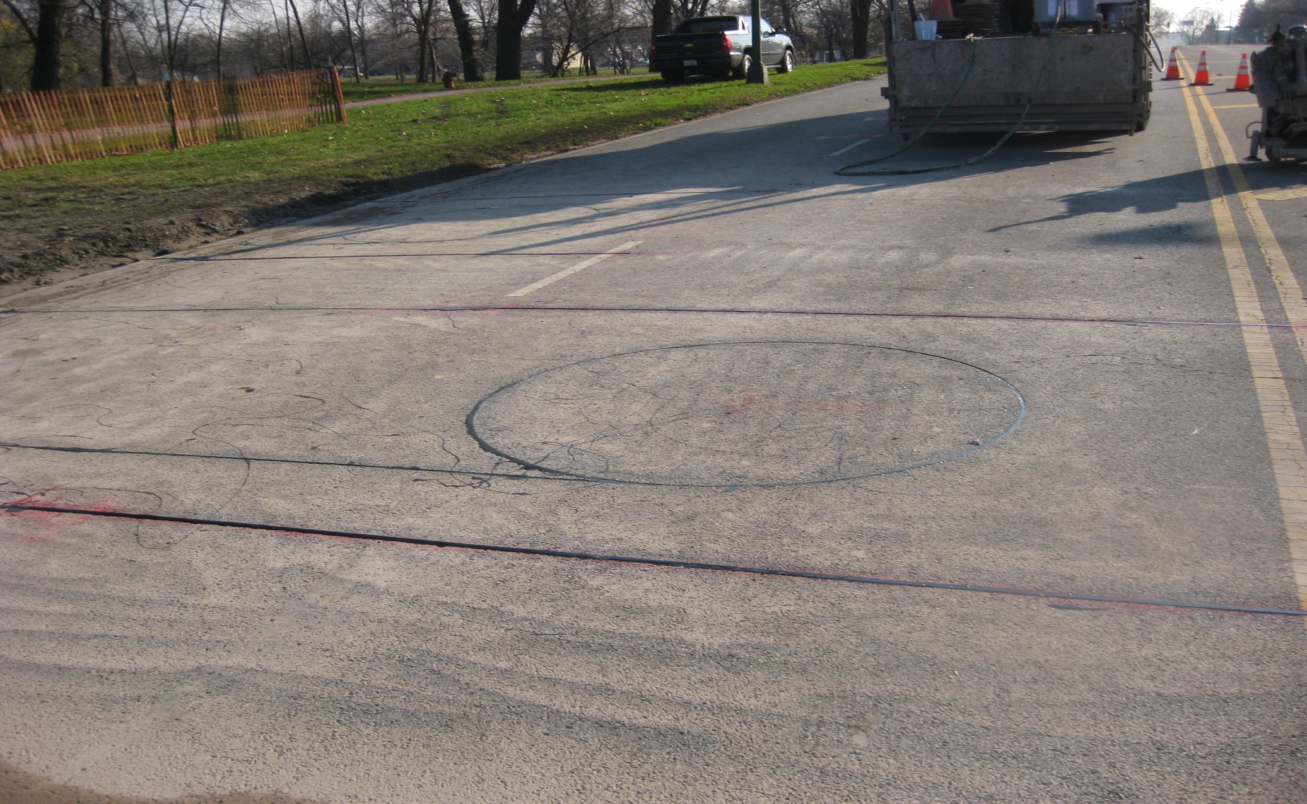
Installation of Equipment

Slide 22
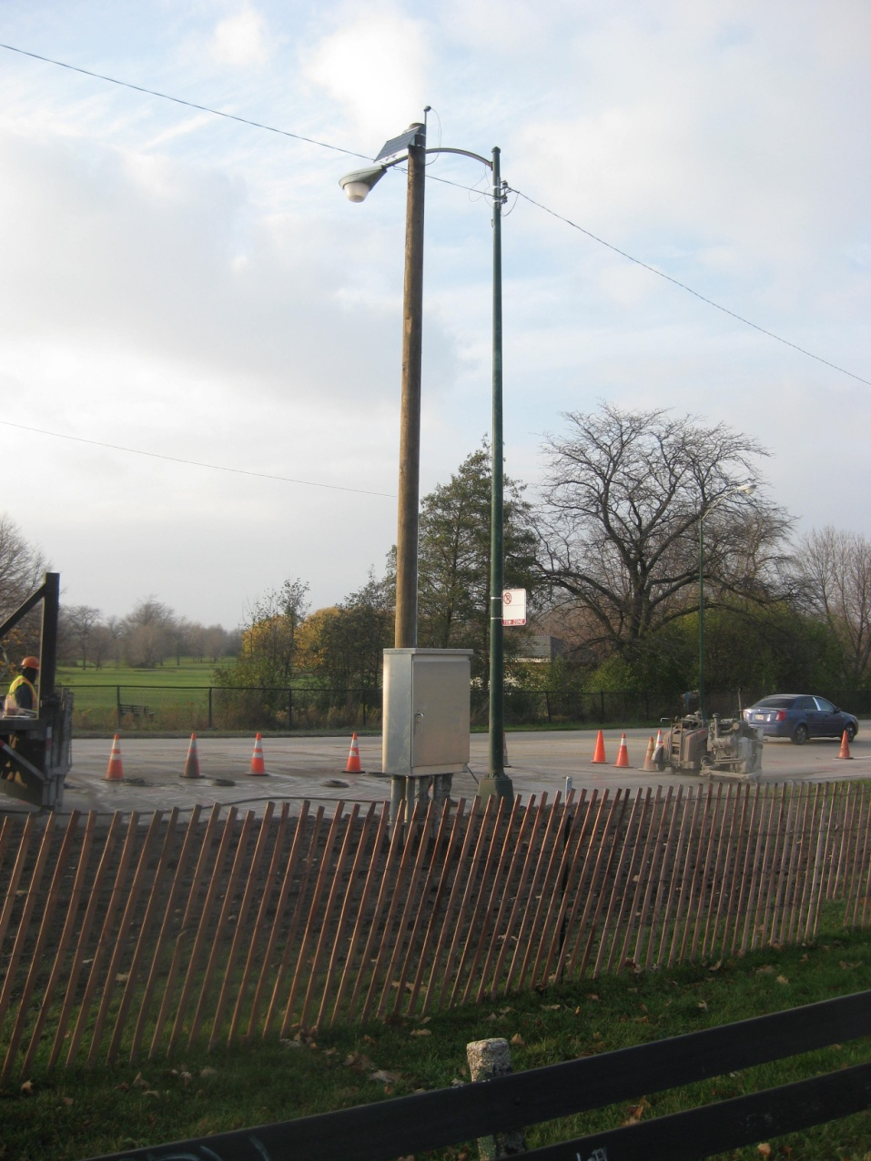
Installation of Equipment

Slide 23
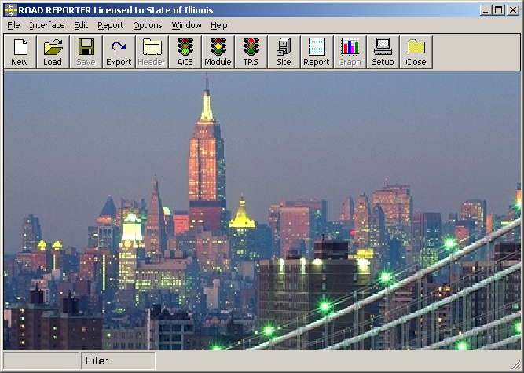
Software \ Reports

Slide 24
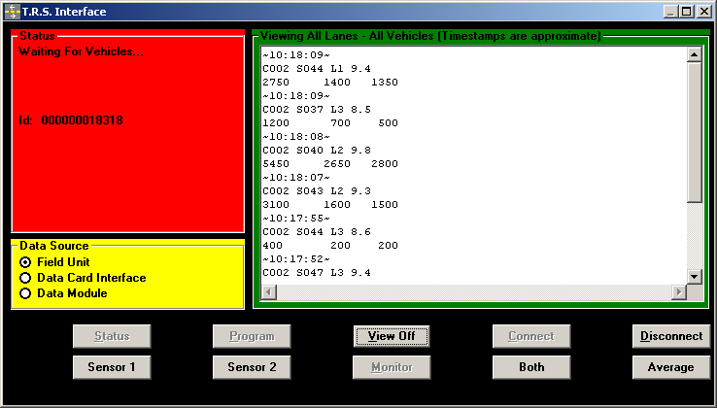
Software \ Reports

Slide 25
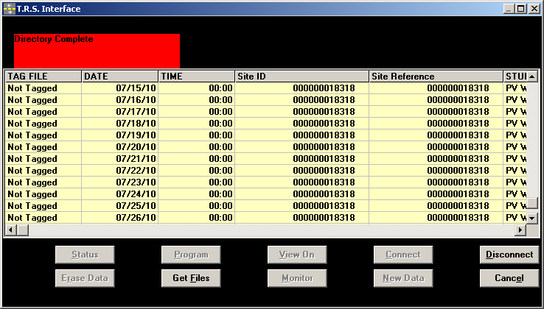
Software \ Reports

Slide 26
Software \ Reports
Summary 7-15-10 - 7-22-10.xlsx

Slide 27
Draft Policy Recommendations
Load restriction < 36 Tons
ADTT > 1000
WIM setup to monitor truck traffic
Require signed detour
Significant violations result in enhanced enforcement
Continued violations result in evaluating closer to the Inventory Level = lower posting, possible closure

Slide 28
Current Status
Posting recently reduced to 10 Tons to remove trucks, easier for law enforcement to identify
Notified District of intent to close if violations continue in interest of public safety

Slide 29
Questions?
Tim Armbrecht: IDOT
217-782-6266
Tim.Armbrecht@illinois.gov
Dave Thompson: AECOM
312-351-4274
Dave.Thompson@aecom.com

