Slide 1
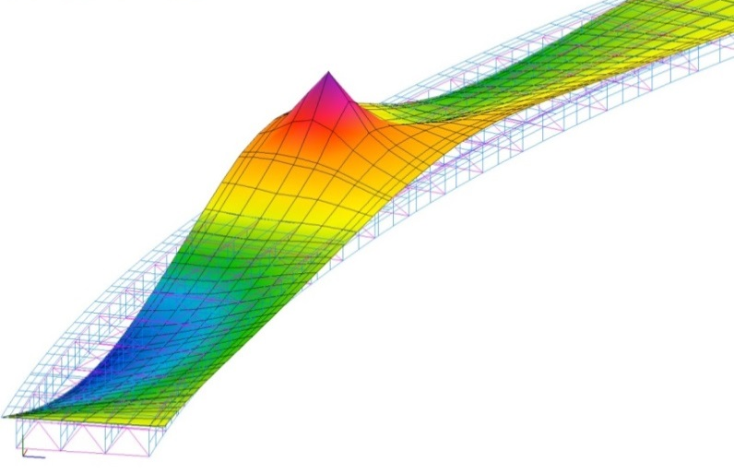
3D Analysis with AASHTOWare Bridge Design and Rating

Slide 2
3D Analysis with AASHTOWare Bridge Design and Rating
Here’s what you’ll learn in this presentation:
Review of finite element modeling basics
Review of generated model
Review of the user-interface for steel multi-girder superstructure
Review of how the analysis is performed
Review of available output

Slide 3
3D Analysis with AASHTOWare Bridge Design and Rating
Here’s what you’ll learn in this presentation:
Review of finite element modeling basics
Review of generated model
Review of the user-interface for steel multi-girder superstructure
Review of how the analysis is performed
Review of available output

Slide 4
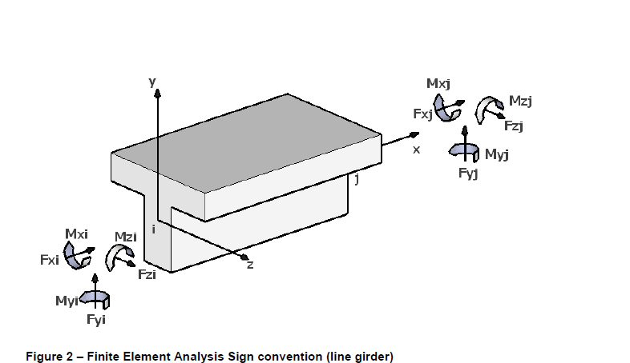
Review of Finite Element Modeling Basics
Beam elements:
Are used for concrete beams, steel girder flanges, and diaphragms
Have six degrees of freedom (DOFs) at each node

Slide 5
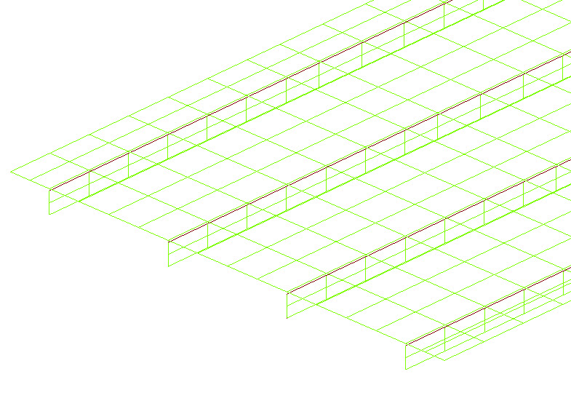
Review of Finite Element Modeling Basics
Shell elements:
Are used for the steel girder web and the deck
Have four nodes with six DOFs at each node
Girder Web
(Shell Element)
(Typ.)

Slide 6
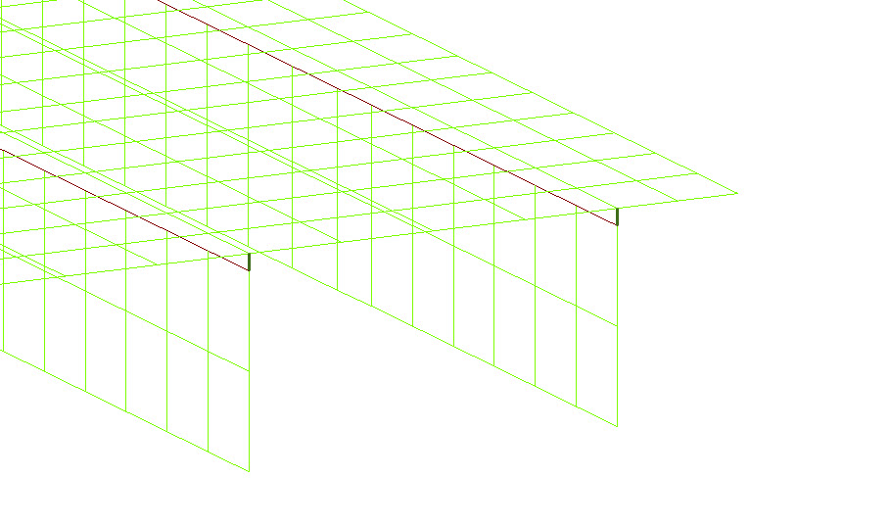
Review of Finite Element Modeling Basics
Deck-to-beam connection:
Master-slave constraint – used for 3D curved girder systems
Rigid link connection – used for 3D straight girder systems
Connects center of gravity of deck to girder top flange
Deck-to-beam Connection (Typ.)

Slide 7
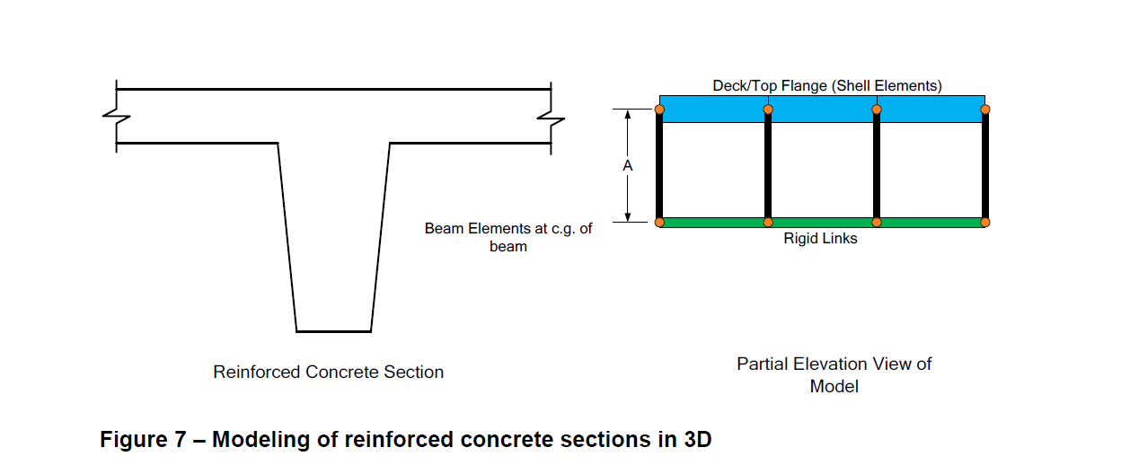
Review of Finite Element Modeling Basics
Modeling of reinforced concrete sections in 3D:
Beam elements used for reinforced concrete beam
Shell elements used for deck/top flange
Rigid links used for connection (straight girder)

Slide 8
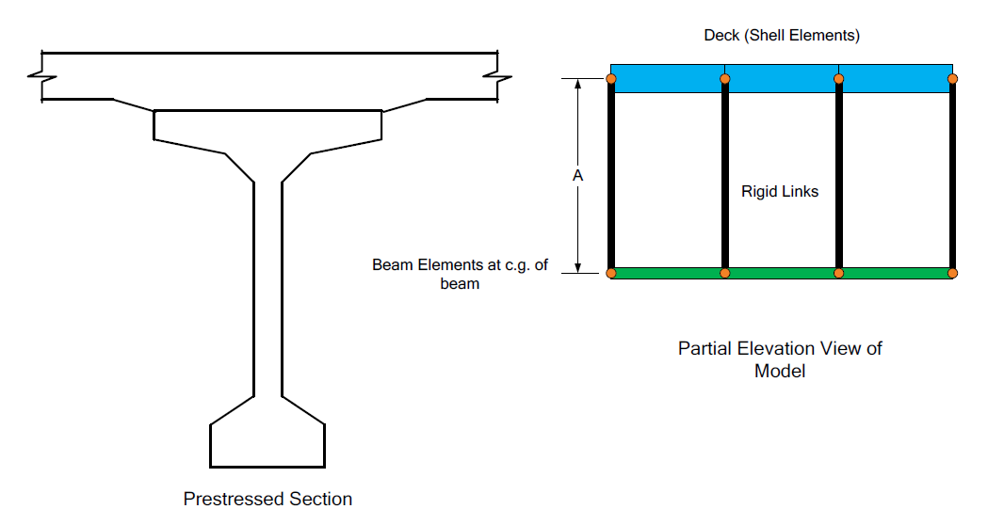
Review of Finite Element Modeling Basics
Modeling of prestressed concrete sections in 3D:
Beam elements used for prestressed concrete beam
Shell elements used for deck
Rigid links used for connection (straight girder)

Slide 9
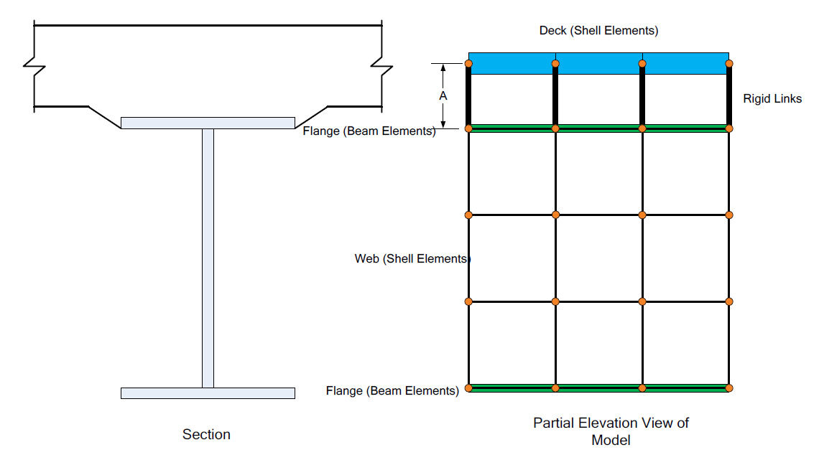
Review of Finite Element Modeling Basics
Modeling of steel beam with concrete deck in 3D:
Beam elements used for steel girder flanges
Shell elements used for deck and steel girder web
Rigid links used for connection (if straight girder)

Slide 10
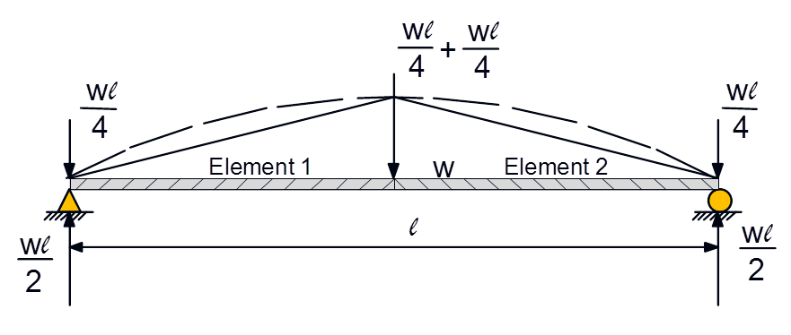
Review of Finite Element Modeling Basics
Dead loads:
Stage 1 – non-composite dead loads
Stage 2 – composite dead loads
Distributed loads are converted to nodal forces
Discretization of model must be sufficient to ensure series of nodal loads accurately represents distributed load

Slide 11
Review of Finite Element Modeling Basics
Live loads:
Stage 3 – live loads
Applied to influence surface
Location of vehicle selected to produce maximum of desired effect

Slide 12
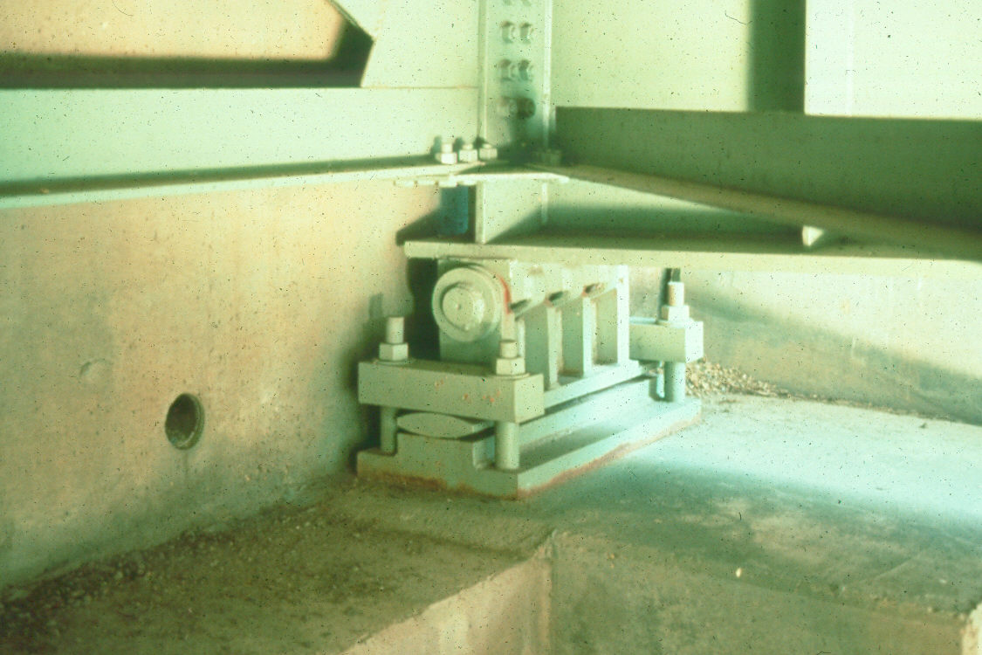
Review of Finite Element Modeling Basics
Support conditions:
Free bearings – permit translation in all directions
Guided bearings – permit translation in only one direction, usually either longitudinal or transverse
Fixed bearings – do not permit translation in any direction
For each of these three support conditions, rotation can be provided or limited in many different combinations

Slide 13
3D Analysis with AASHTOWare Bridge Design and Rating
Here’s what you’ll learn in this presentation:
Review of finite element modeling basics
Review of generated model
Review of the user-interface for steel multi-girder superstructure
Review of how the analysis is performed
Review of available output

Slide 14
Review of the Generated Model
Definition of elements for curved structures:
Curvature is represented by straight elements with small kinks at node points
Elements are not curved
Actual Curve
Elements in the model

Slide 15
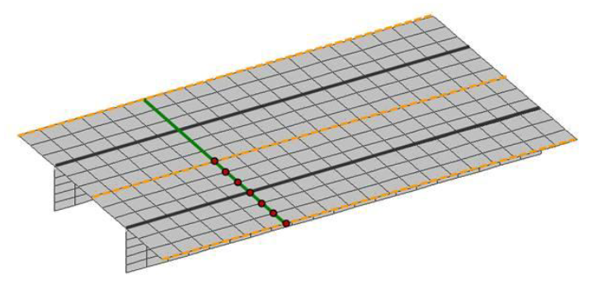
Review of the Generated Model
Non-skewed model:
Deck and beam are divided into elements
The software allows user to adjust number of shell elements and target aspect ratio for shell elements

Slide 16
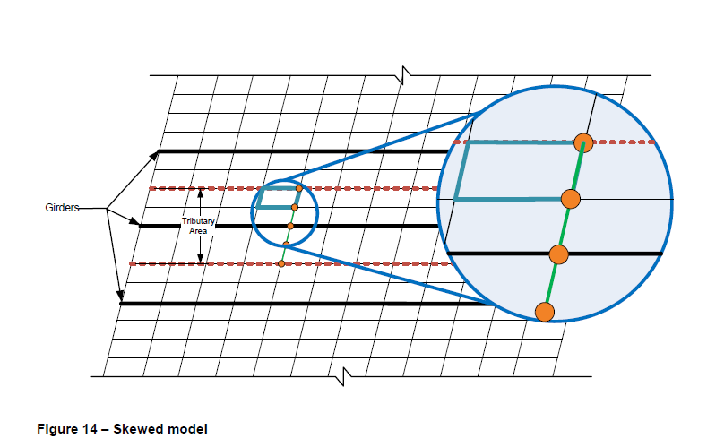
Review of the Generated Model
Skewed model:
Nodes are defined along the skew

Slide 17
Review of the Generated Model
Nodes:
Numbers each node of generated model
Defines X, Y, and Z coordinates for each node
The tables on this and the following slides define the model generated based on data entered by the user

Slide 18
Review of the Generated Model
Master Slave Node Pairs:
Used to define connection between girder and deck for steel curved girders
Master node is in deck
Slave node is along girder top flange
One-to-one correlation between master node and slave node

Slide 19
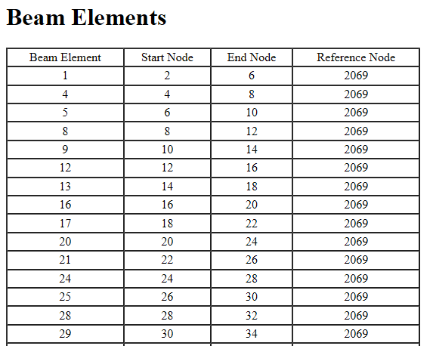
Review of the Generated Model
Beam Elements:
Numbers each beam element in the generated model
Defines start node and end node
Also defines reference node
Sta. Ahead

Slide 20
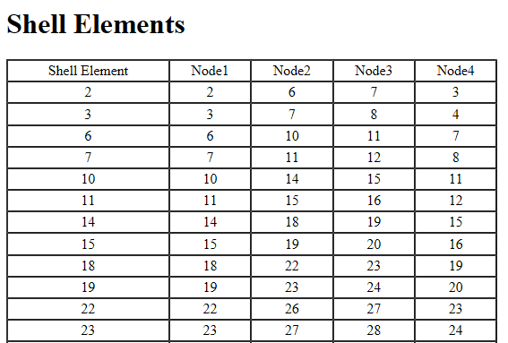
Review of the Generated Model
Shell Elements:
Numbers each shell element in generated model
Defines Node1 through Node4 for each shell element

Slide 21
Review of the Generated Model
Supports:
Identifies all support nodes
Defines the following in X, Y, Z directions
Translation state (fixed or free)
Translation spring constant (kip/in)
Rotation state (fixed or free)
Rotation spring constant (in-kip/Deg)

Slide 22
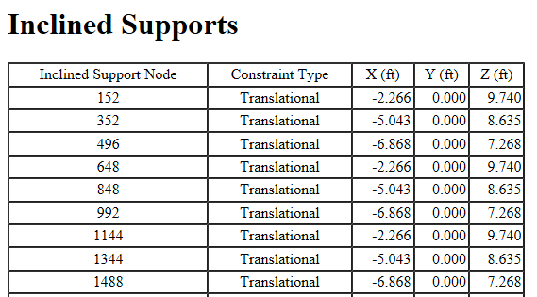
Review of the Generated Model
Inclined Supports:
Defines constraint type – translational or rotational
Defines X, Y, and Z components of a 10’ line oriented in the direction of constraint (i.e., oriented perpendicular to the direction of allowable movement)

Slide 23
Review of the Generated Model
Inclined Supports:
Constraints specified in local coordinate system at support
User defines orientation of local coordinate system as either:
Parallel to tangent of member reference line at support
Parallel to specified chord angle from the tangent

Slide 24
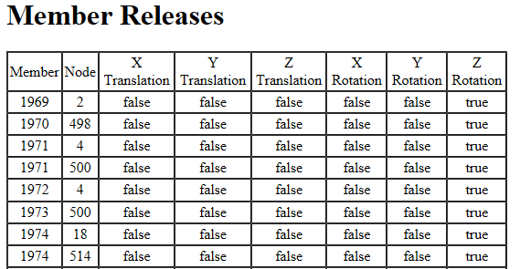
Review of the Generated Model
Member Releases:
Generated to model hinges and pinned diaphragm connections
Provides the following in X, Y, Z directions
Translation release (false or true)
Rotation release (false or true)

Slide 25
Review of the Generated Model
Load Case:
Each load is identified by load case and load ID
Loads are applied at nodes
Provides the following in X, Y, Z directions
Force (kips)
Moment (kip-ft)

Slide 26
3D Analysis with AASHTOWare Bridge Design and Rating
Here’s what you’ll learn in this presentation:
Review of finite element modeling basics
Review of generated model
Review of the user-interface for steel multi-girder superstructure
Review of how the analysis is performed
Review of available output

Slide 27
Review of the User-Interface for Steel Multi-Girder Superstructure
Superstructure Definitions:
Provides tree structure
Includes each Member and each Member Alternative
Provides navigational tool to access each window
The following slides highlight data that is specific to 3D finite element models

Slide 28
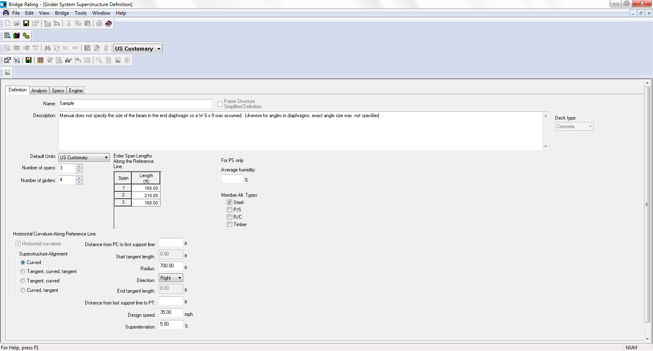
Review of the User-Interface for Steel Multi-Girder Superstructure
Girder System Superstructure Definition – Definition Tab
Sta. Ahead
Right
Define Horizontal Curvature Along Reference Line
Left

Slide 29
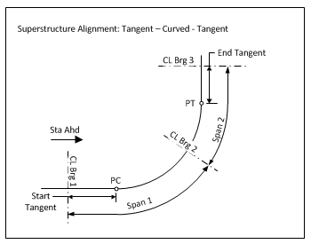
Review of the User-Interface for Steel Multi-Girder Superstructure
Girder System Superstructure Definition – Definition Tab

Slide 30
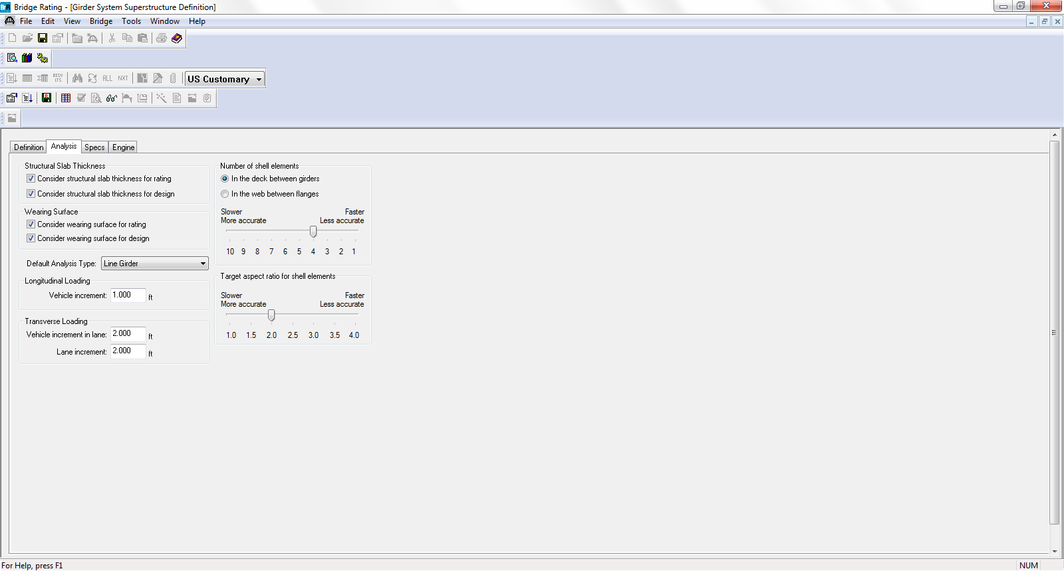
Review of the User-Interface for Steel Multi-Girder Superstructure
Girder System Superstructure Definition – Analysis Tab
Define refined vs. speed
Define Longitudinal Loading and Transverse Loading

Slide 31
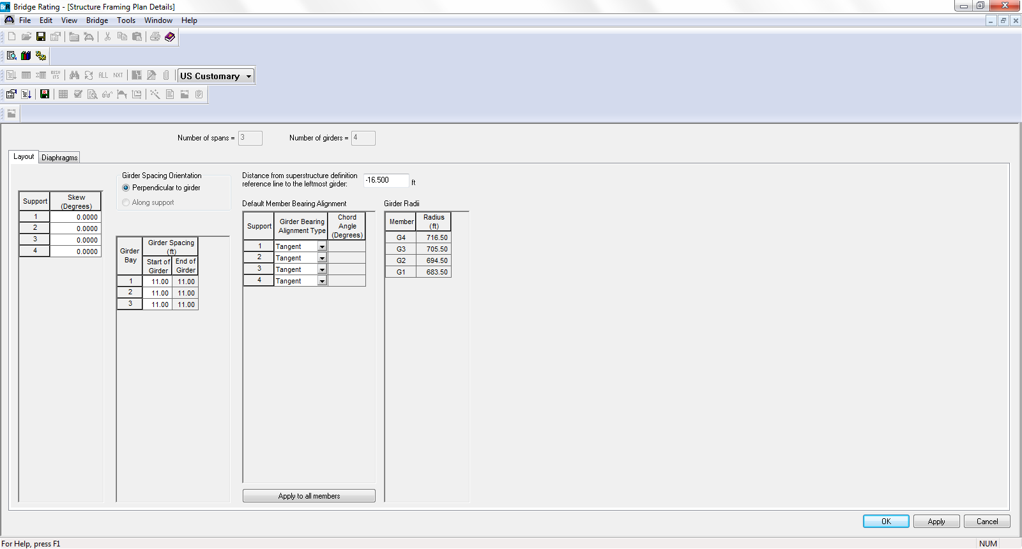
Review of the User-Interface for Steel Multi-Girder Superstructure
Structure Framing Plan Details – Layout Tab
Enter Distance from Reference Line to Leftmost Girder
Summary of Girder Radii
Define Bearing Alignments (Tangent or Chord with Chord Angle)
Applies Bearing Alignment Properties to All Members

Slide 32
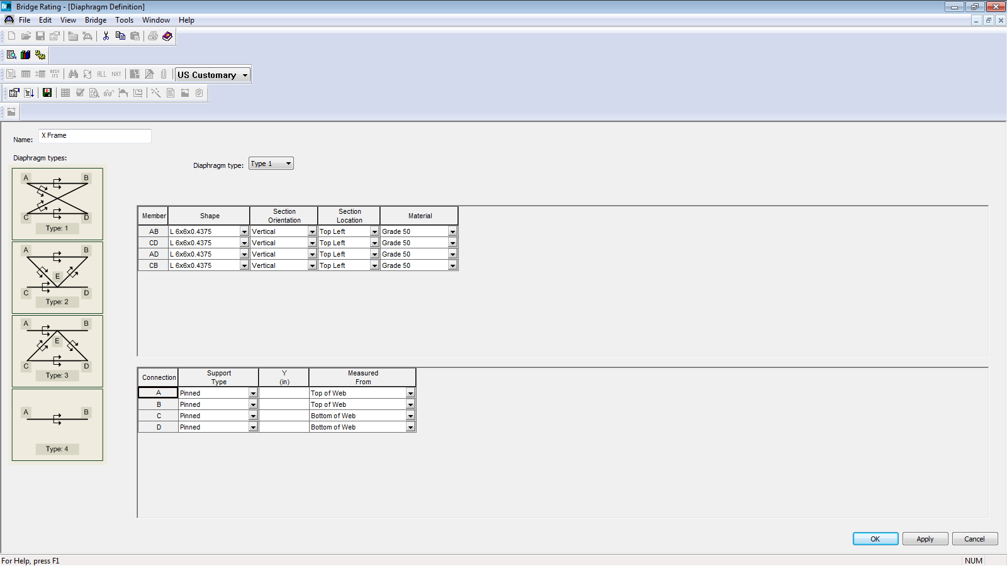
Review of the User-Interface for Steel Multi-Girder Superstructure
Diaphragm Definition
Provide all required diaphragm information

Slide 33
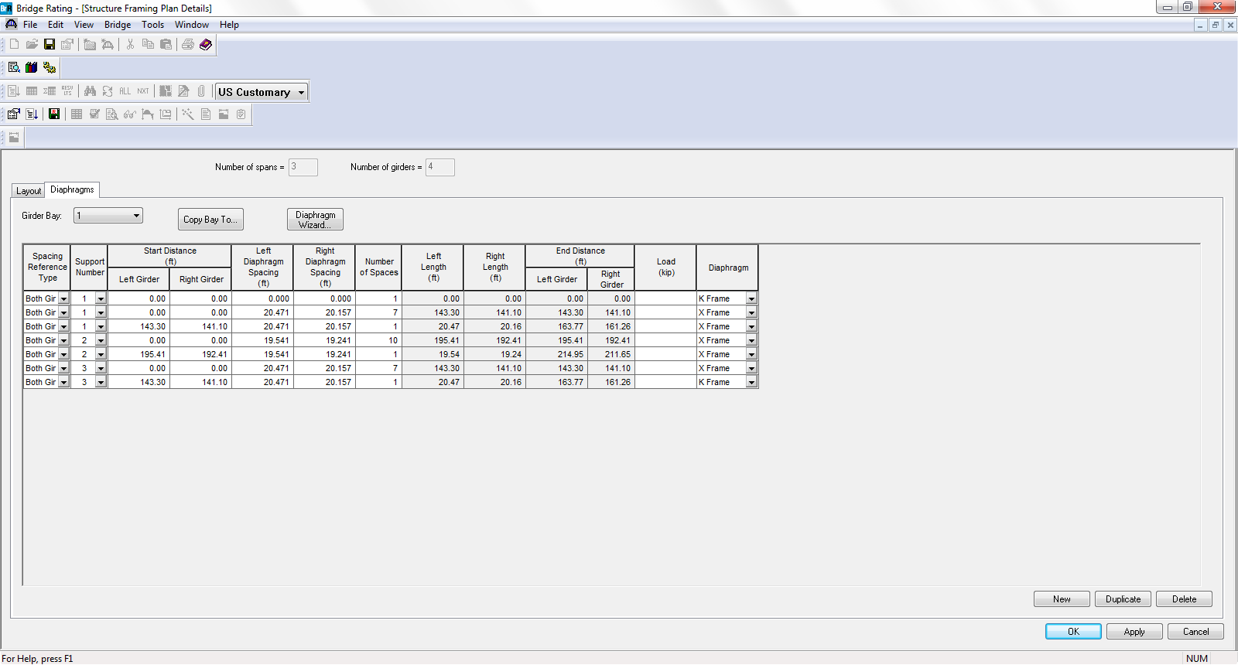
Review of the User-Interface for Steel Multi-Girder Superstructure
Structure Framing Plan Details – Diaphragms Tab
For a 3D analysis, this load is used only if it is entered, and if it is not entered, the software will determine the dead load based on the Diaphragm Definition

Slide 34
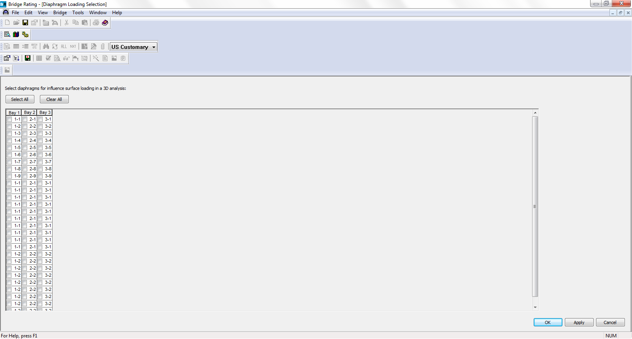
Review of the User-Interface for Steel Multi-Girder Superstructure
Diaphragm Loading Selection
Select diaphragms for influence surface loading in the 3D analysis

Slide 35
3D Analysis with AASHTOWare Bridge Design and Rating
Here’s what you’ll learn in this presentation:
Review of finite element modeling basics
Review of generated model
Review of the user-interface for steel multi-girder superstructure
Review of how the analysis is performed
Review of available output

Slide 36
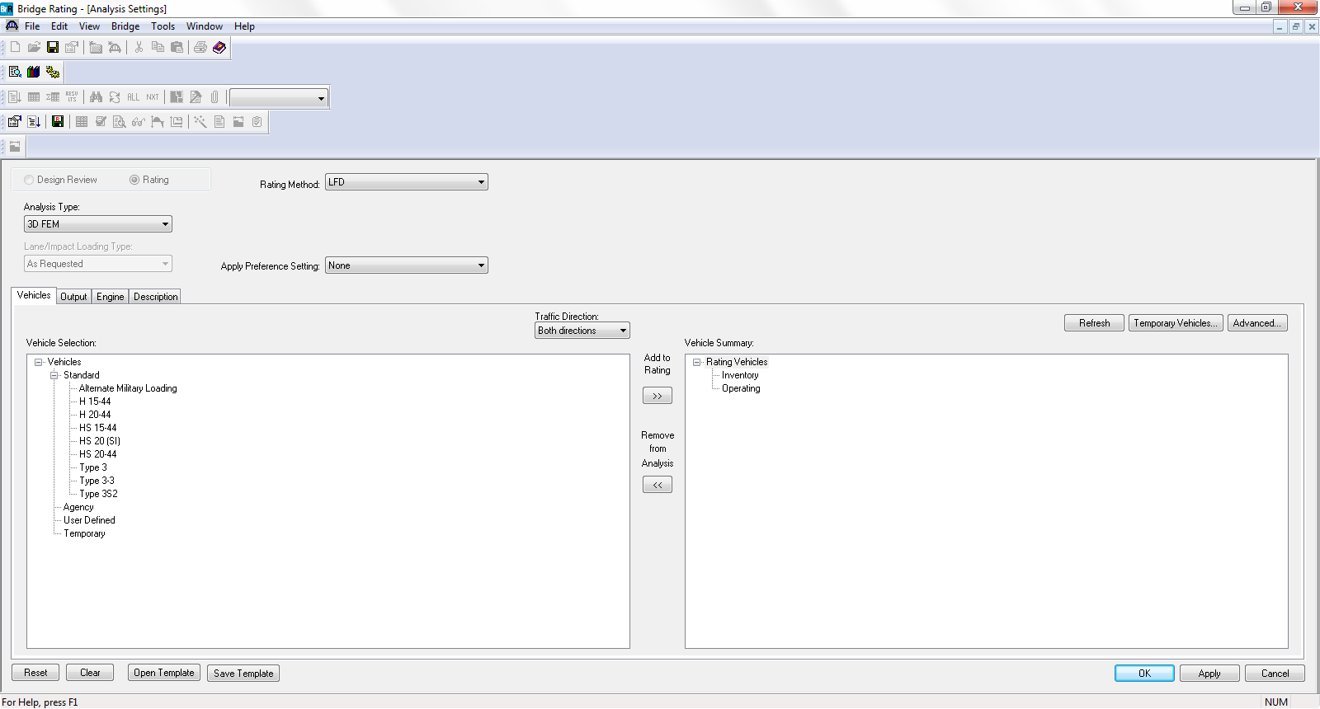
Review of How the Analysis is Performed
Analysis Settings
Select 3D FEM (for Design Review or Rating) or 3D FEM-Vehicle Path (for Rating only)

Slide 37
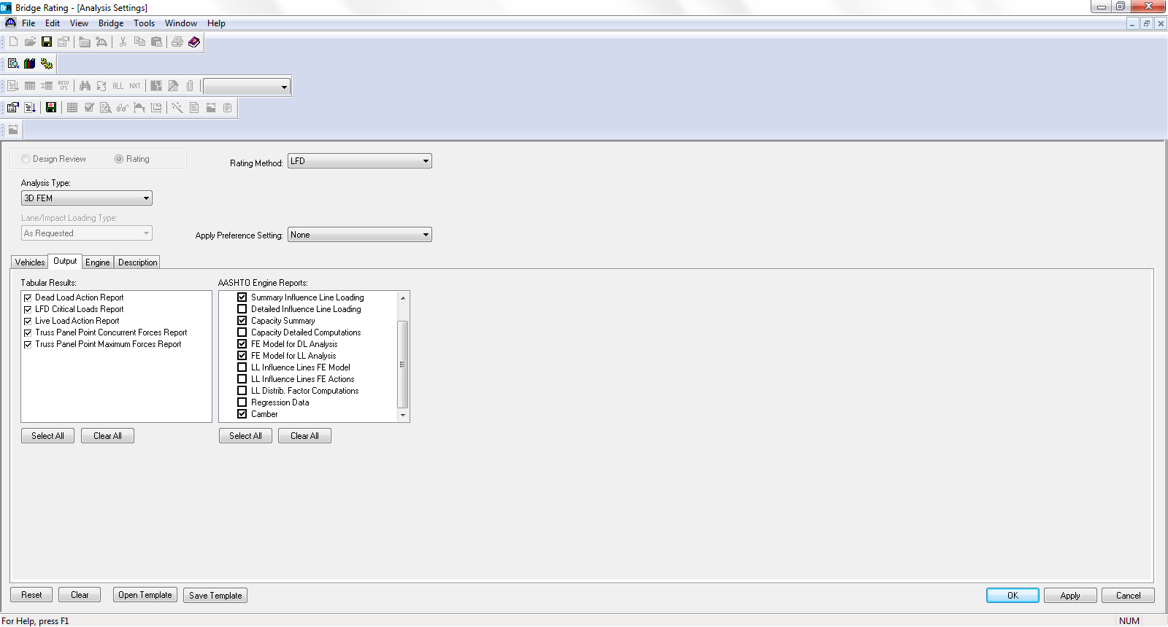
Review of How the Analysis is Performed
Analysis Settings – Output Tab
Select AASHTO Engine Reports

Slide 38
3D Analysis with AASHTOWare Bridge Design and Rating
Here’s what you’ll learn in this presentation:
Review of finite element modeling basics
Review of generated model
Review of the user-interface for steel multi-girder superstructure
Review of how the analysis is performed
Review of available output

Slide 39
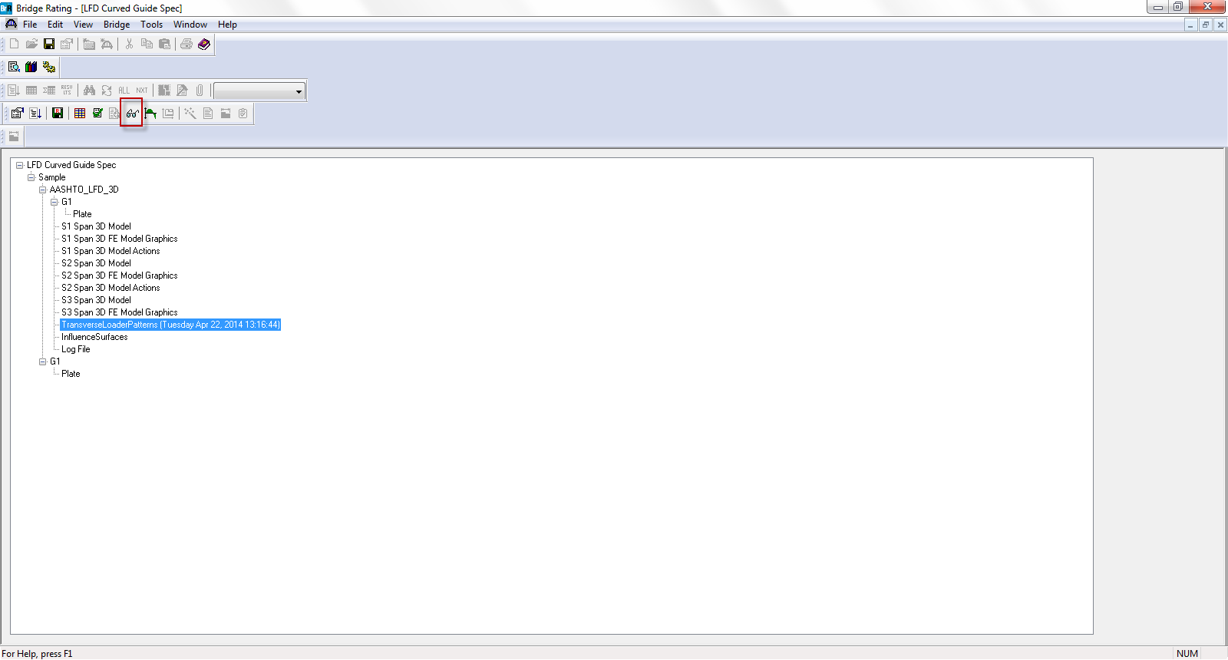
Review of Available Output
List of major sections of output
Model Actions report provides moments and shears
Model, FE Model Graphics, Transverse Loader Patterns available
Select for list of major sections of output

Slide 40
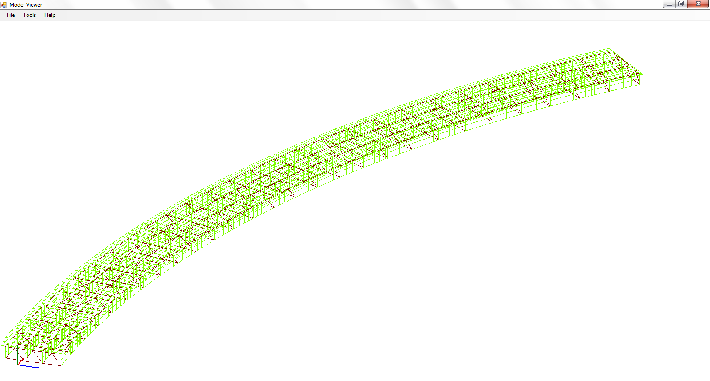
Review of Available Output
Model Viewer:
Model can be viewed graphically
Model Viewer permits view from many different vantages
Ability to select what portions of model are viewed
Ability to view influence surfaces

Slide 41
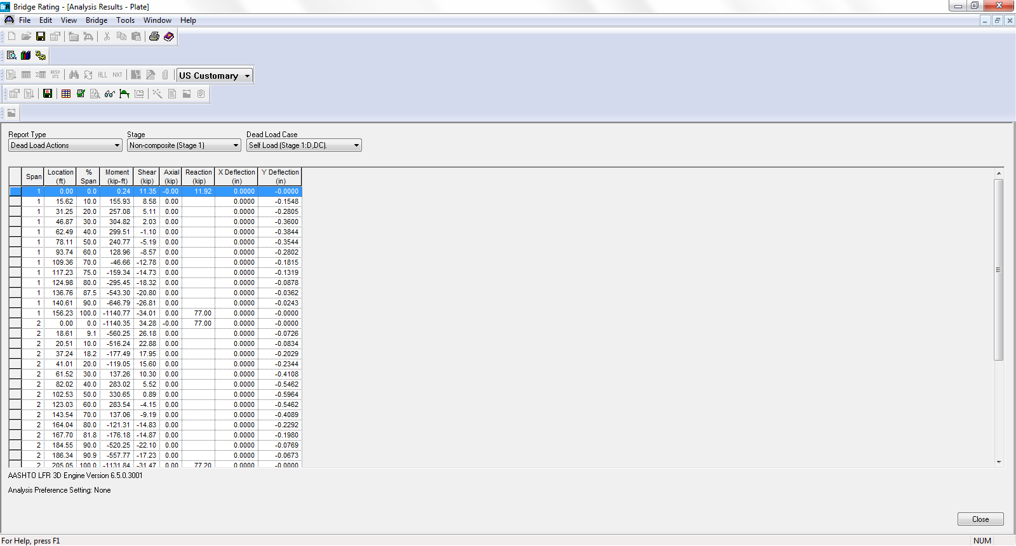
Review of Available Output
User-interface tabular reports:
Output can be viewed in tabular reports
This example presents dead load analysis results
Select for tabular results for dead load effects, live load effects, and ratings

Slide 42
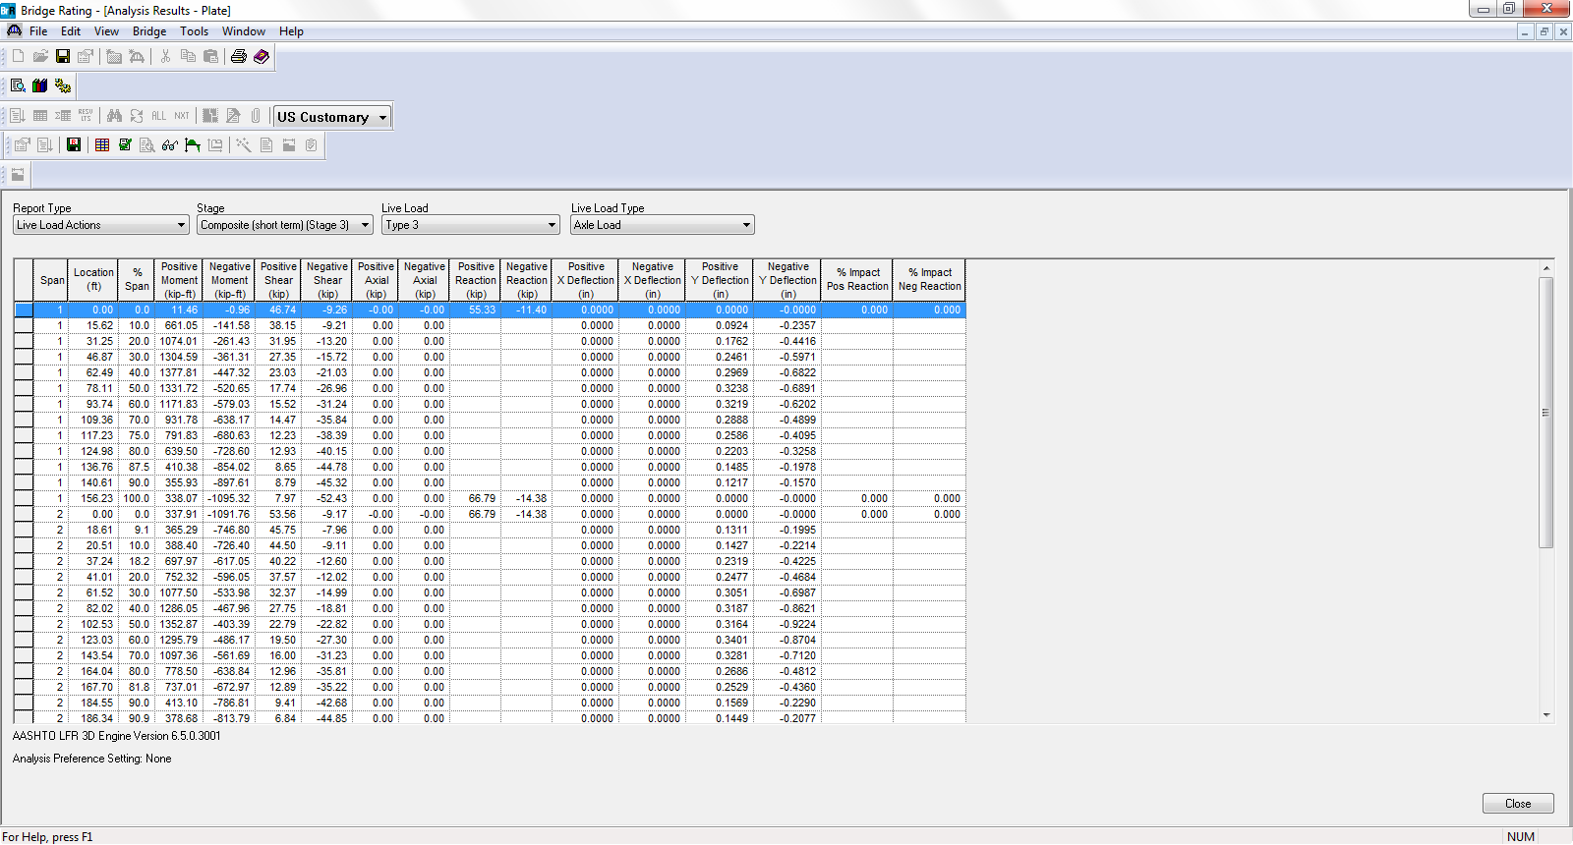
Review of Available Output
User-interface tabular reports:
This example presents live load analysis results

Slide 43
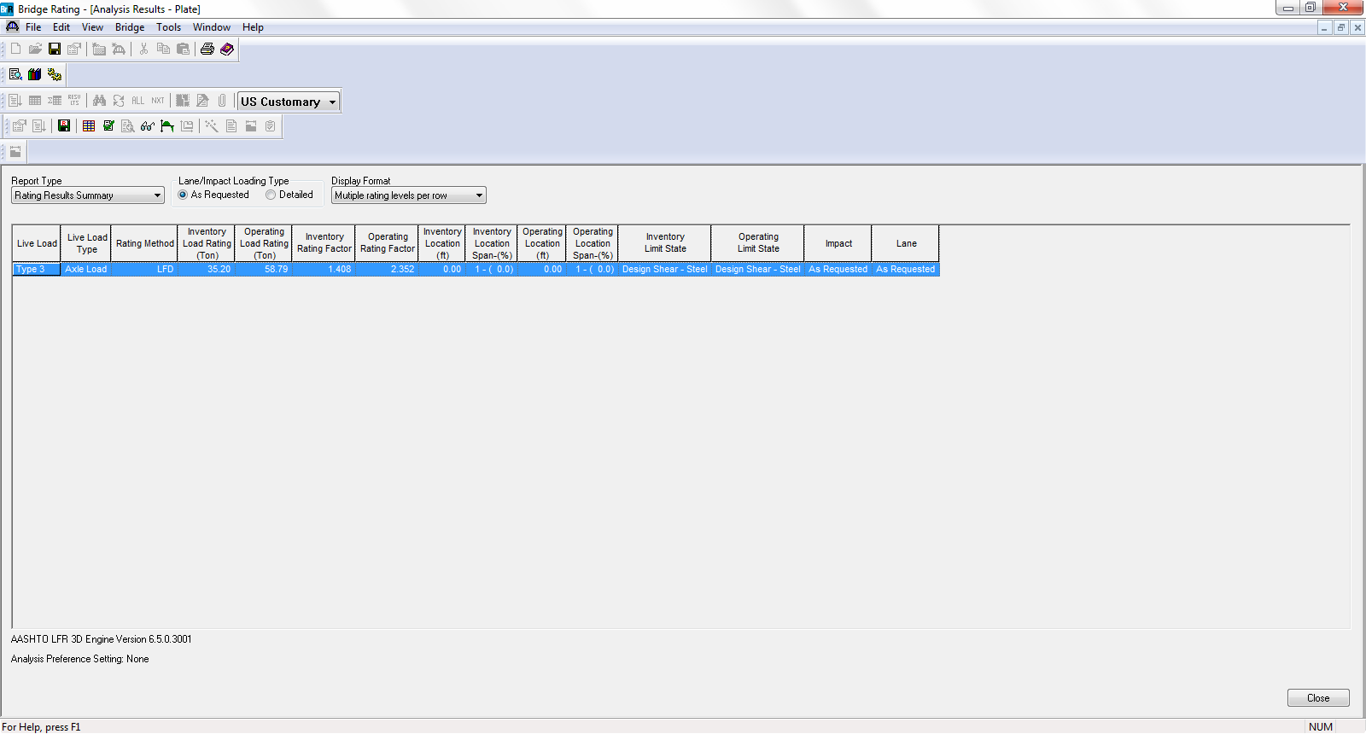
Review of Available Output
User-interface tabular reports:
This example presents load rating results

Slide 44
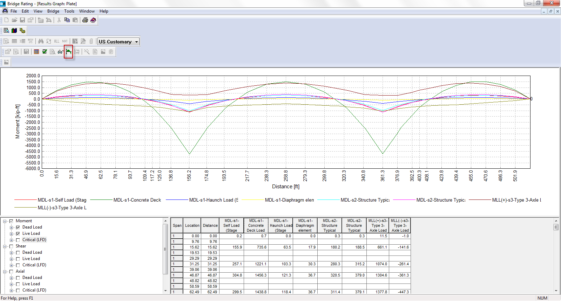
Review of Available Output
User-interface graphs:
Output can also be viewed as graphs
This example presents dead load and live load moments
Select for graphical results for dead load and live load effects

Slide 45
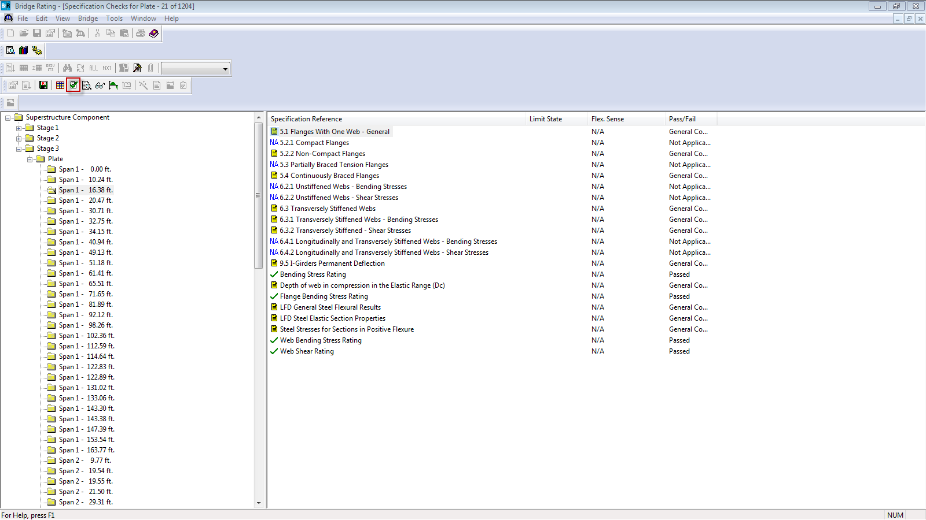
Review of Available Output
Specification checks:
Stages 1, 2, and 3 spec checks can be selected at each node
Available for selected method (LFR/LFD or LRFR/LRFD)
Detailed calculations available for each spec check
Select for specification checks for plate

Slide 46
3D Analysis with AASHTOWare Bridge Design and Rating
Here’s what you’ve learned in this presentation :
Review of finite element modeling basics
Review of generated model
Review of the user-interface for steel multi-girder superstructure
Review of how the analysis is performed
Review of available output

Slide 47
3D Analysis with AASHTOWare Bridge Design and Rating
Thank you

