Slide 1
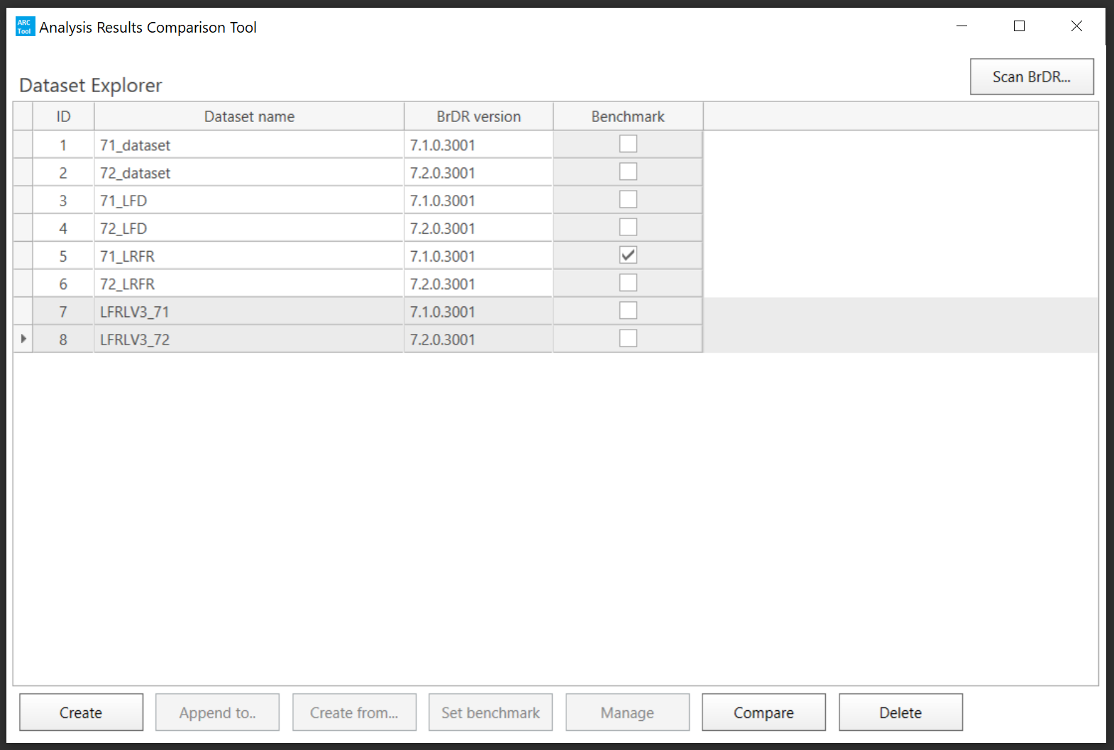
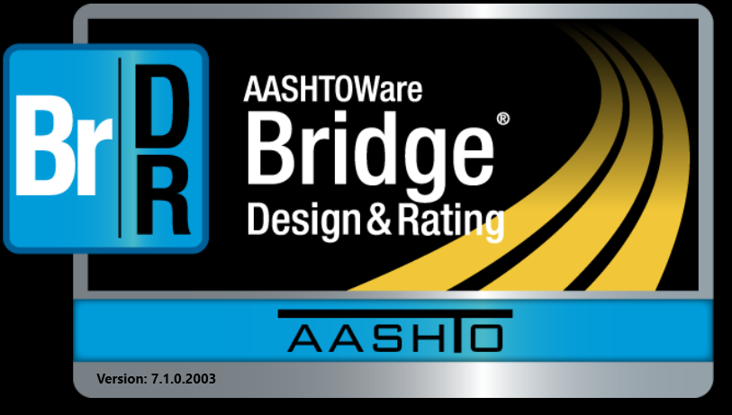
BrDR 7.2
Testing BrDR 7.2 Using the ARC Tool in Idaho
BrDR 7.1
Mike Johnson, P.E.
Idaho Transportation Department

Slide 2
Testing BrDR 7.2 Using the ARC Tool in Idaho
Why Test Upgrades?

Slide 3
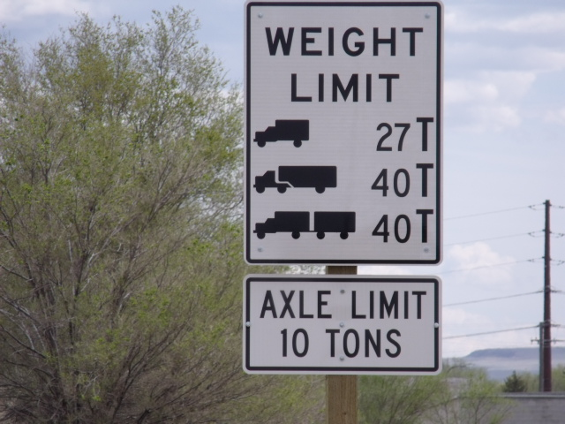
Testing BrDR 7.2 Using the ARC Tool in Idaho
Why Test Upgrades?
Agencies Conduct Different Levels Of Testing Of New Releases
Objective - Identify How New Versions Impact Ratings
Need To Explain Decrease / Increase In Route Capacity

Slide 4
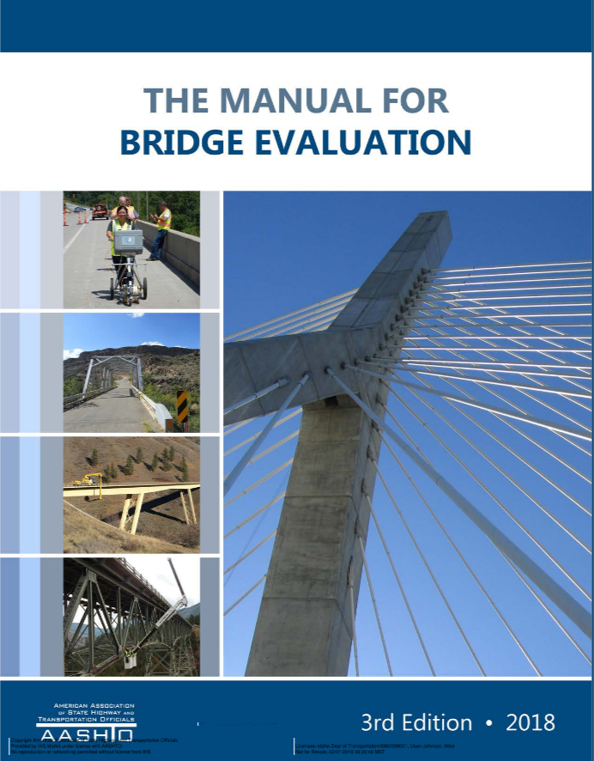
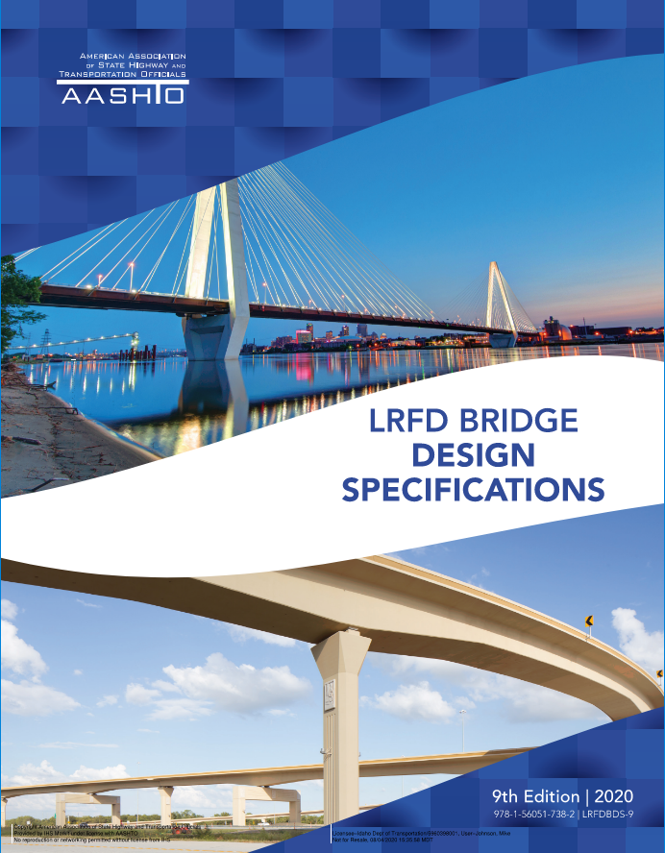
Testing BrDR 7.2 Using the ARC Tool in Idaho
Why Test Upgrades?
Reasons Behind Rating Changes
Change In AASHTO Codes
Bug Fixed From Previous Version
New Bug / Issue
Model Change (Condition/Loading)
Change in Bridge Condition/Loading
Accidental Model Change

Slide 5
Testing BrDR 7.2 Using the ARC Tool in Idaho
Idaho’s History of Testing

Slide 6
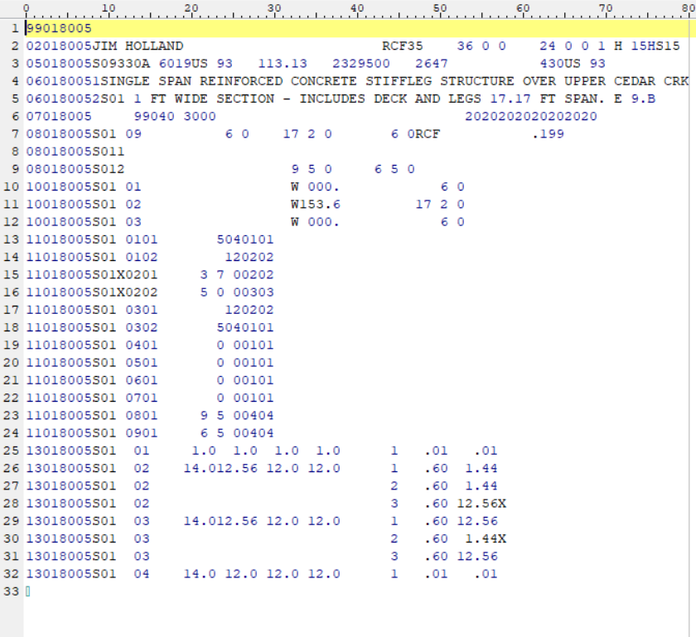
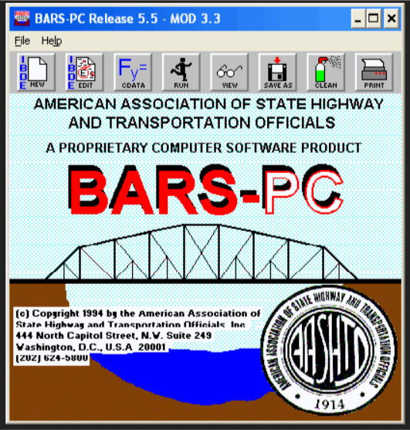
Testing BrDR 7.2 Using the ARC Tool in Idaho
Idaho’s History of Testing
BARS to Virtis (Now BrR) – 2004
Compared 30 Bridges
Results Were Different
ITD Verified Virtis
ITD Started Inputting Bridge Virtis - 2008
Testing Comprised Mainly Of Program Function

Slide 7
Testing BrDR 7.2 Using the ARC Tool in Idaho
Idaho’s History of Testing
Idaho Expanded Testing – 2011
Began Modeling More Complicated Bridges With Virtis
Tested Program Functions
Tested Results of 30 Bridges of Various Types
Started Seeing Some Differences Between Versions

Slide 8
Testing BrDR 7.2 Using the ARC Tool in Idaho
Idaho’s History of Testing
ITD Used Internal Resources – 2012 to 2016
Compared Results Of All Bridges In Database
In-Depth Review Of A Representative Sample
All Testing Was Completed After The Release
Joined The Beta Testing TAG
Able To Find Issues Before New Version Releases
Still Completed Same Review Process Prior To Upgrading

Slide 9
Testing BrDR 7.2 Using the ARC Tool in Idaho
Idaho’s History of Testing
ITD Used Internal Resources – 2012 to 2016
Compared Results Of All Bridges In Database
In-Depth Review Of A Representative Sample
All Testing Was Completed After The Release
Joined The Beta Testing TAG
Able To Find Issues Before New Version Releases
Still Completed Same Review Process Prior To Upgrading

Slide 10
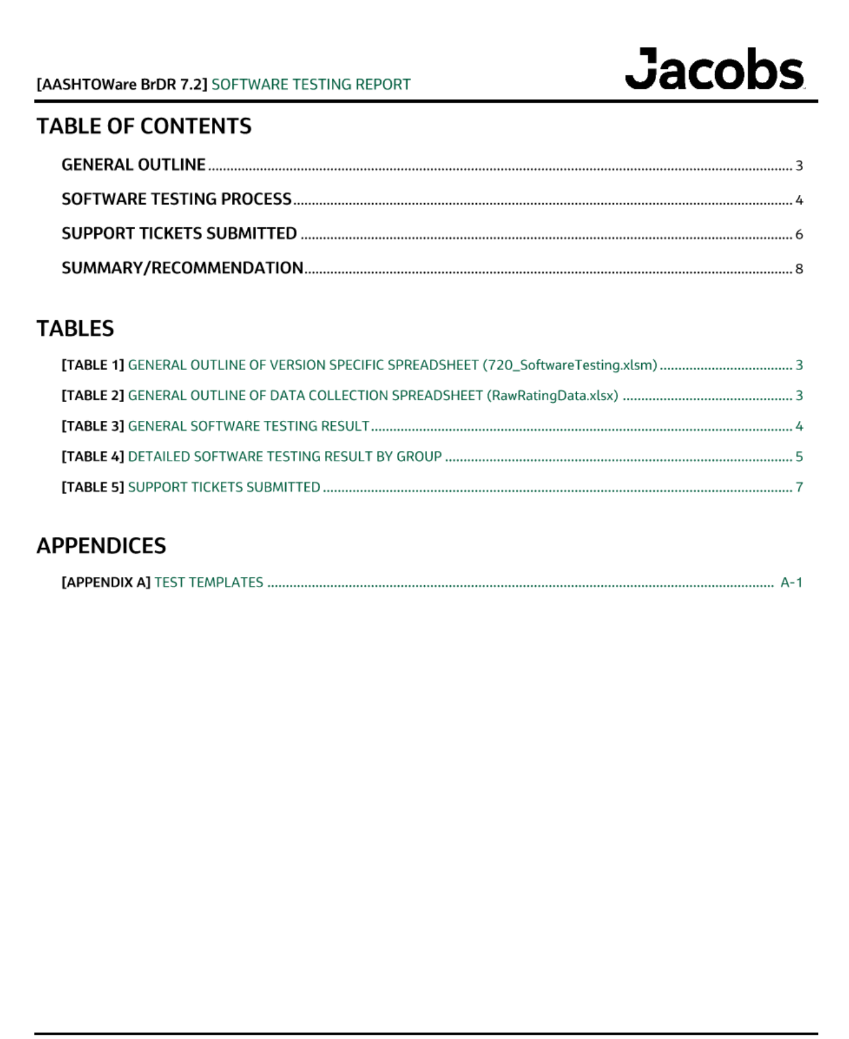
Testing BrDR 7.2 Using the ARC Tool in Idaho
Idaho’s History of Testing
ITD Hired Jacobs For Testing – 2017
Database Had Over 2000 Bridges
Compared The Controlling Ratings Of All Bridges
Compared Results of Multiple Vehicles
Developed Procedures For
Testing
Upgrading
Documenting Results

Slide 11
Testing BrDR 7.2 Using the ARC Tool in Idaho
ITD’s Testing Prior To ARC Tool

Slide 12
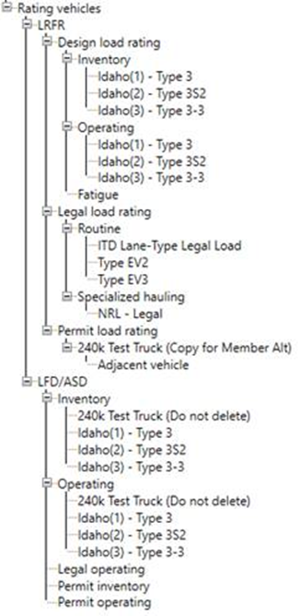
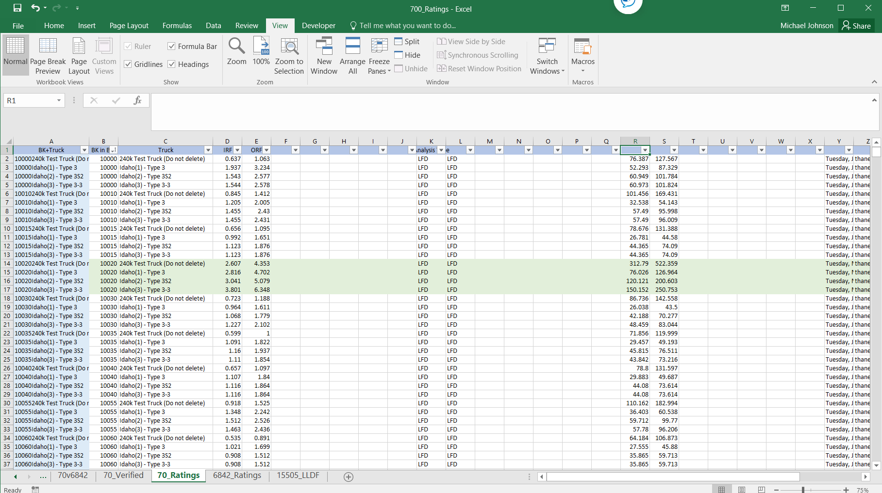
Testing BrDR 7.2 Using the ARC Tool in Idaho
ITD’s Testing Prior To ARC Tool
Run All The Completely Defined Bridges
Results Copied Into MS Excel

Slide 13
Testing BrDR 7.2 Using the ARC Tool in Idaho
ITD’s Testing Prior To ARC Tool
Compare Overall Controlling Ratings For Each Bridge
Flag / Review Models With ≥ 5% Difference

Slide 14
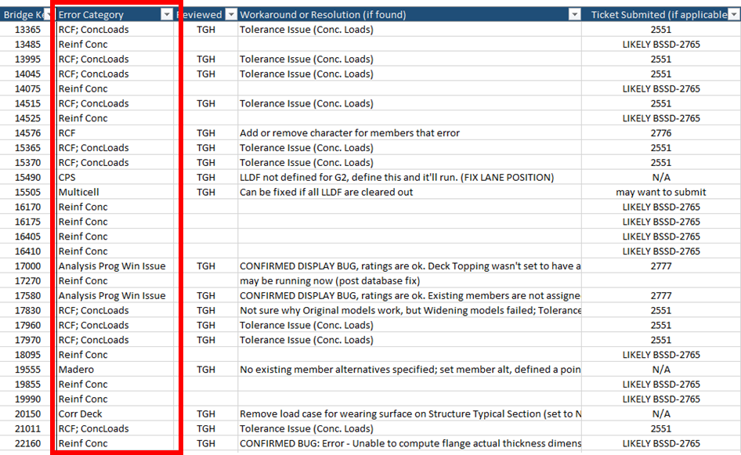
Testing BrDR 7.2 Using the ARC Tool in Idaho
ITD’s Testing Prior To ARC Tool
Identify Groupings For Flagged Bridges
Similar Bridge Types / Errors

Slide 15
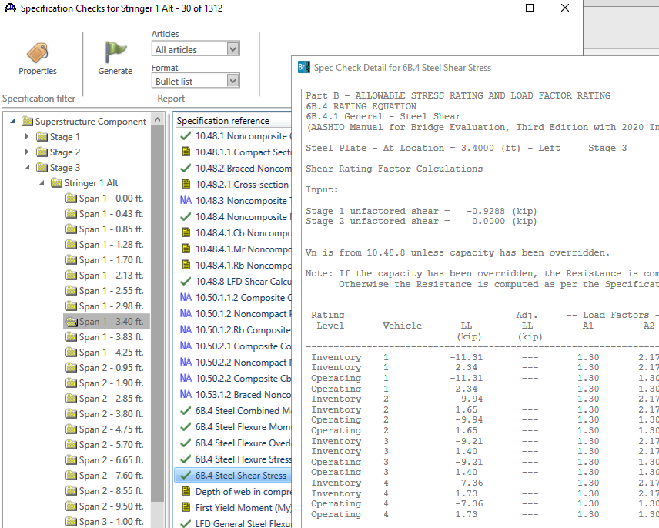
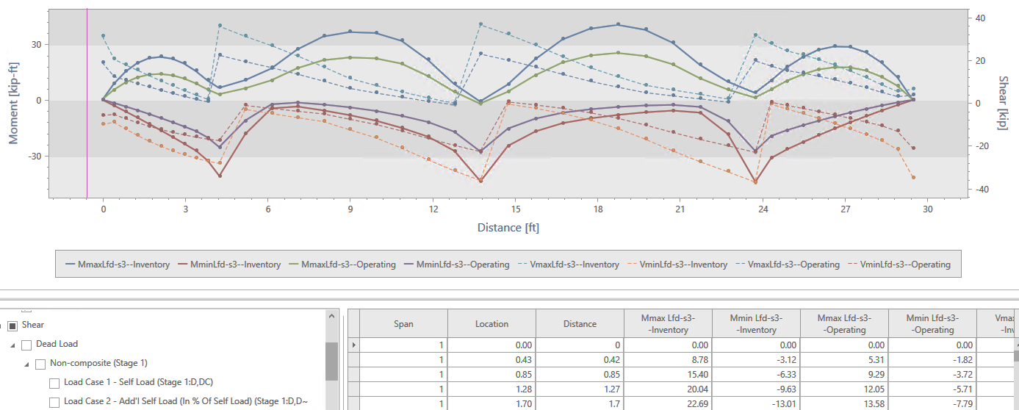
Testing BrDR 7.2 Using the ARC Tool in Idaho
ITD’s Testing Prior To ARC Tool
Run Bridges In Both Versions and Compare
Controlling Location and Limit State
Dead Loads and Live Loads
Review The Specification Checks

Slide 16
Testing BrDR 7.2 Using the ARC Tool in Idaho
Procedure With ARC Tool

Slide 17
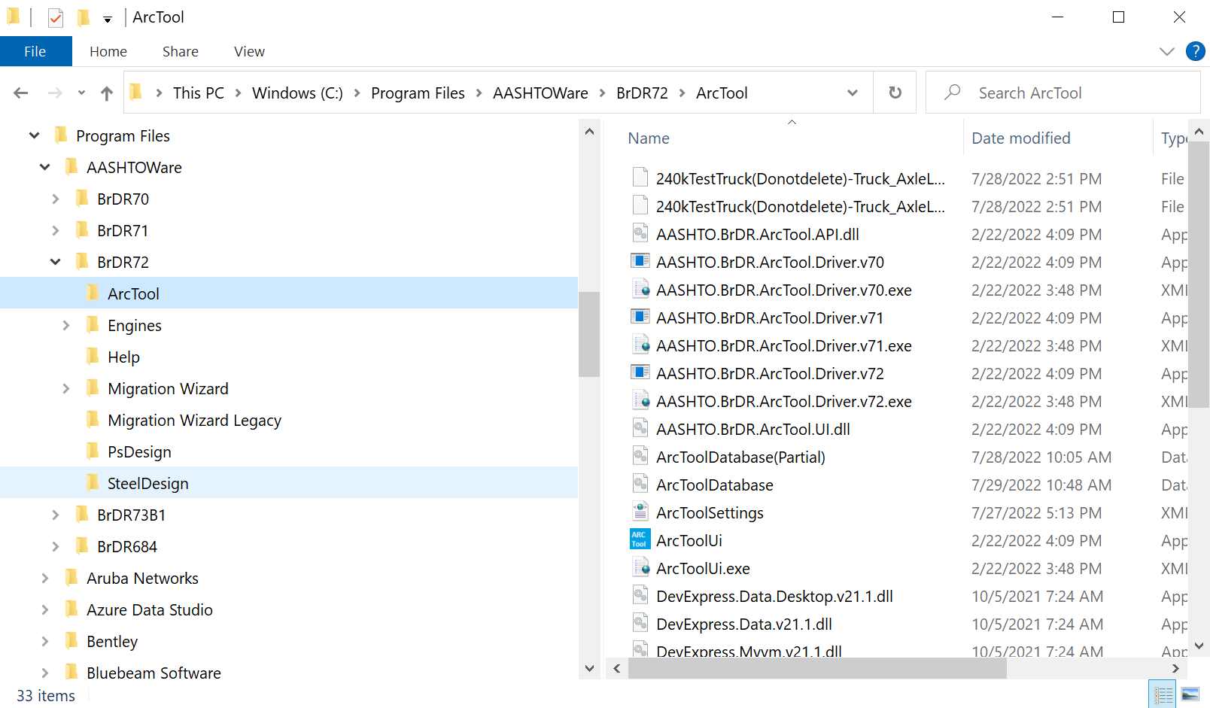
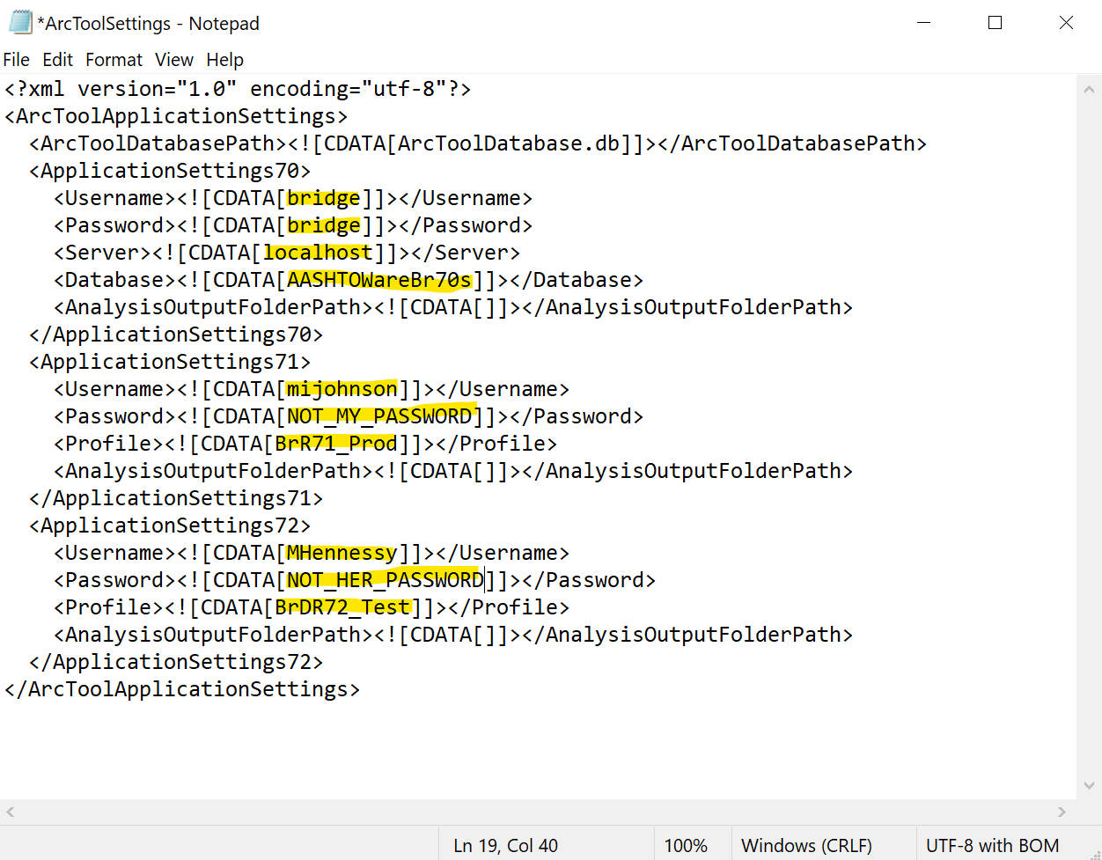
Testing BrDR 7.2 Using the ARC Tool in Idaho
Procedure With ARC Tool
Similar Approach Will Be Used
Results Stored and Organized In ARC Tool Database
Set Up The ARC Tool Settings

Slide 18
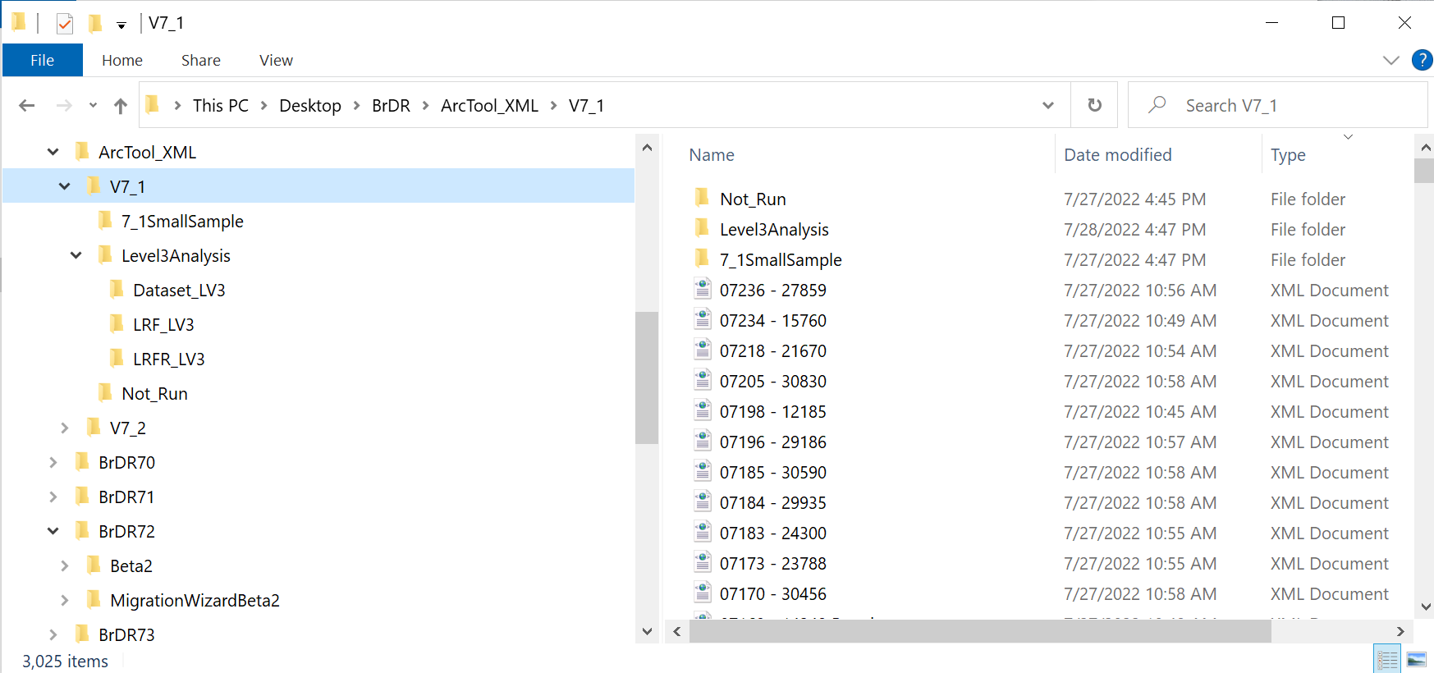
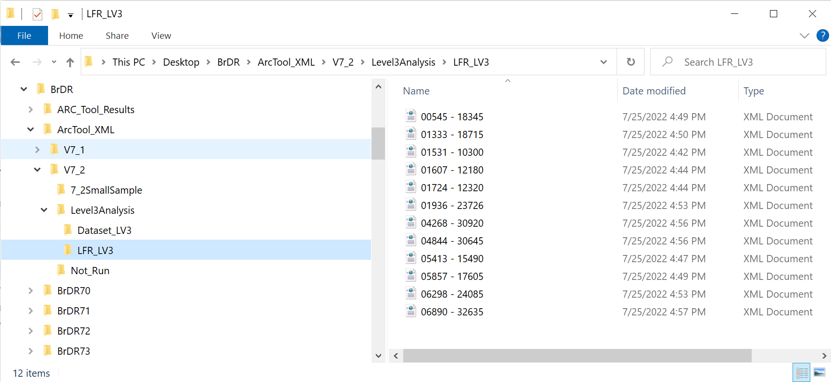
Testing BrDR 7.2 Using the ARC Tool in Idaho
Procedure With ARC Tool
Copying Bridge .xml Files
Work From Separate Group Of .xml Files or Same
If Use Same Group, Use Older Version Files
Can Make Different Sets To Run from Old And New Versions

Slide 19
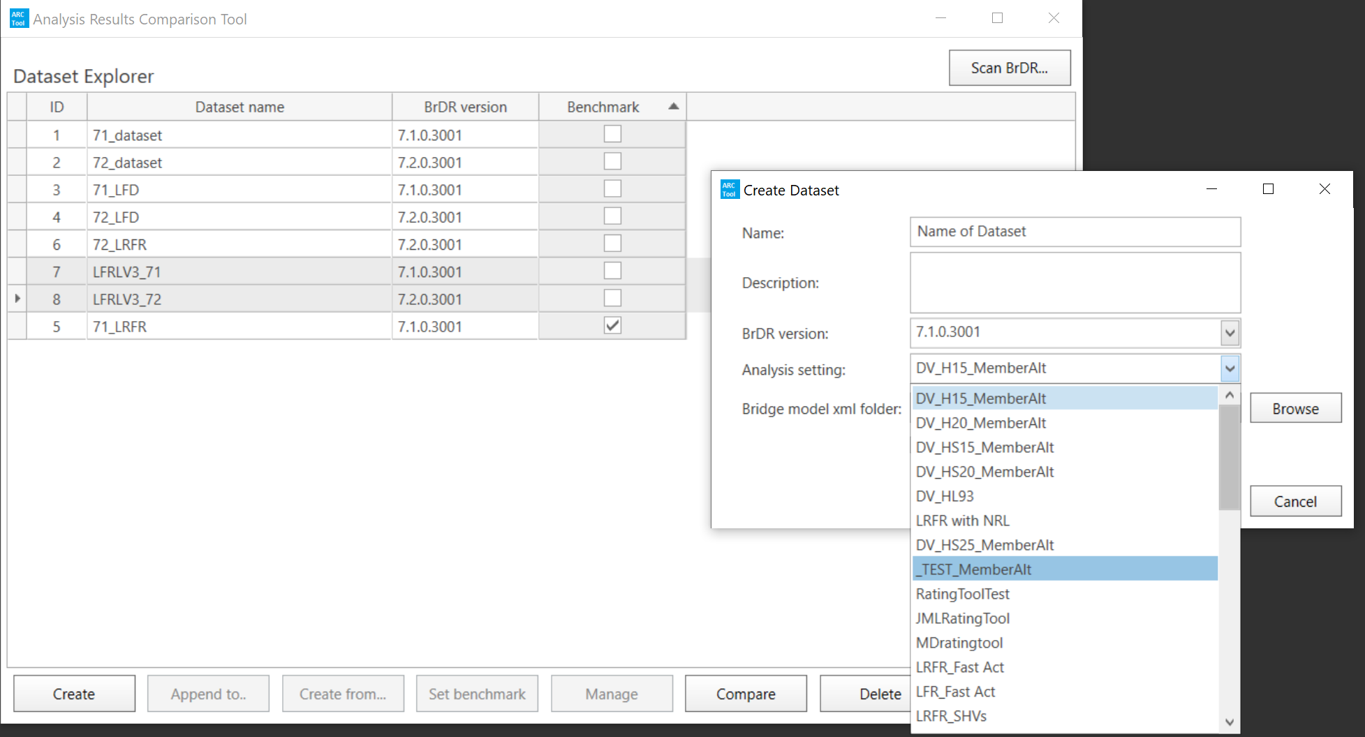
Testing BrDR 7.2 Using the ARC Tool in Idaho
Procedure With ARC Tool
Create Result File In ARC Tool For Both Versions
Make Sure Same Template Is Selected

Slide 20
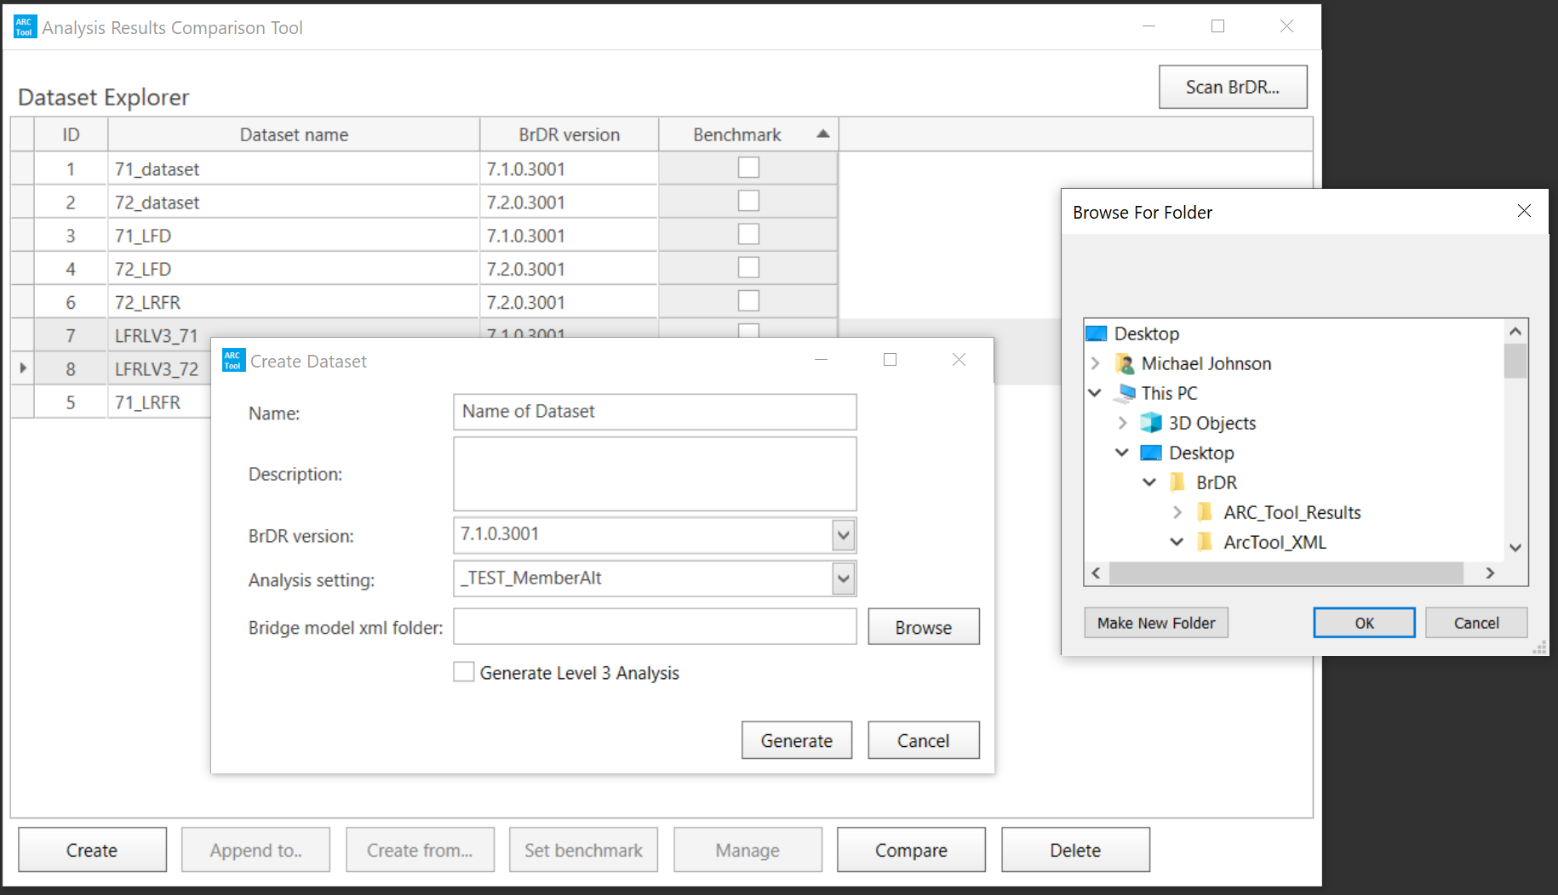
Testing BrDR 7.2 Using the ARC Tool in Idaho
Procedure With ARC Tool
Create Result File In ARC Tool For Both Versions
Make Sure Same Template Is Selected

Slide 21
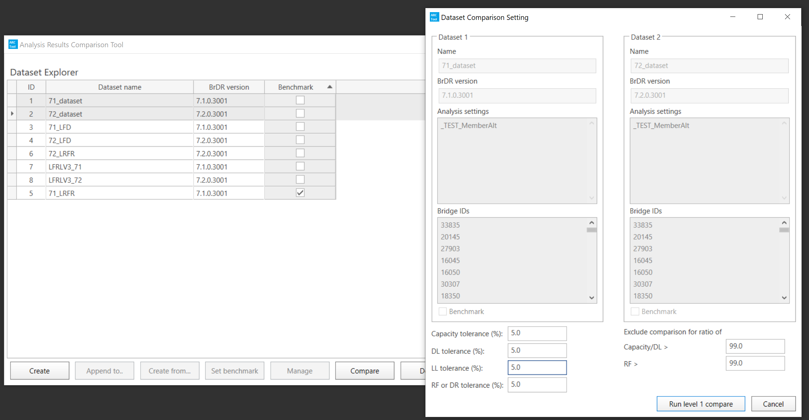
Testing BrDR 7.2 Using the ARC Tool in Idaho
Procedure With ARC Tool
Select Datasets To Compare
Verify Analysis Settings Are The Same
Set Desired Tolerance

Slide 22
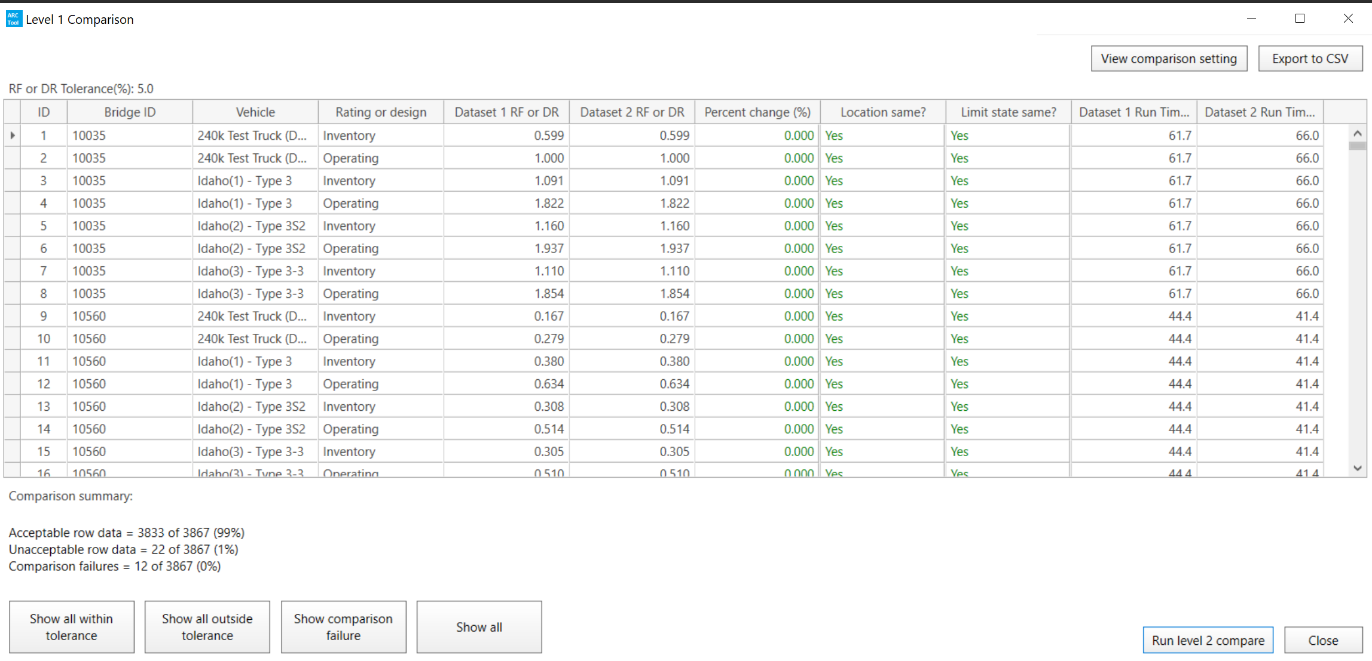
Testing BrDR 7.2 Using the ARC Tool in Idaho
Procedure With ARC Tool
Level 1
Overall Bridge Controlling Load Rating

Slide 23
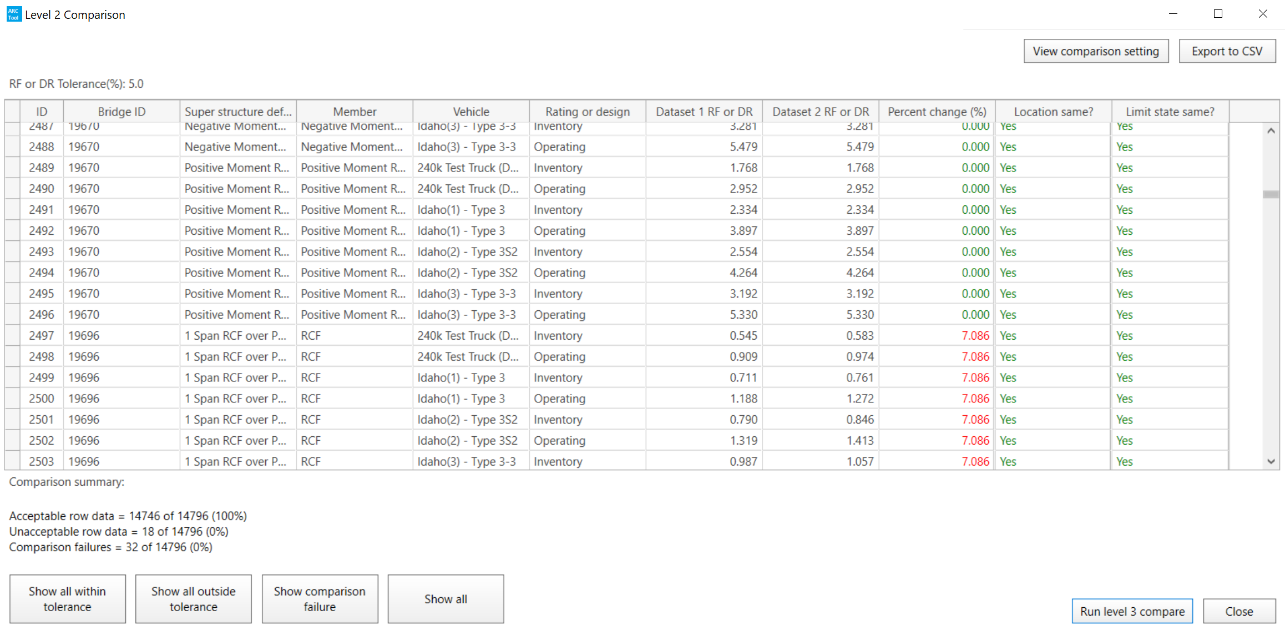
Testing BrDR 7.2 Using the ARC Tool in Idaho
Procedure With ARC Tool
Level 2
Bridge Member Controlling Load Rating

Slide 24
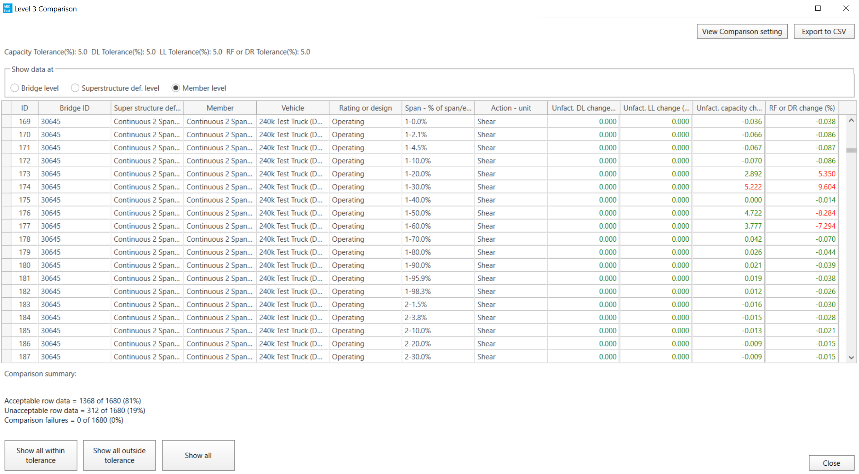
Testing BrDR 7.2 Using the ARC Tool in Idaho
Procedure With ARC Tool
Level 3
Deadload, Liveload, and Capacity Comparison
Used To Help Identify The Cause Of Difference

Slide 25
Testing BrDR 7.2 Using the ARC Tool in Idaho
How Will The ARC Tool Help?

Slide 26
Testing BrDR 7.2 Using the ARC Tool in Idaho
How Will The ARC Tool Help?
Reduce Time In Collecting / Sorting Data
Reduce Potential Human Error In Copying Data
Provides More Than Level 1 Results
Level 1 – Overall Controlling Bridge Load Rating
Level 2 – Controlling Member Load Ratings
Level 3 – Deadload, Liveload, and Capacity Comparison
Easier To Find Issues That Don’t Impact Overall Load Rating
Assists In Finding Location And Reason For Difference
Decreased Time To Test = Upgrade Sooner

Slide 27
Testing BrDR 7.2 Using the ARC Tool in Idaho
ARC Tool – Things To Know

Slide 28
Testing BrDR 7.2 Using the ARC Tool in Idaho
ARC Tool – Things To Know
First Version – Refine Based On User Input
Must Use Same Dataset When Comparing
Templates Created In BrDR
ARC Tool Creates Large Amount Of Temporary Files
May Fill Up Hard Drive And Cause Analysis To Stop

Slide 29
Testing BrDR 7.2 Using the ARC Tool in Idaho
ARC Tool – Things To Know
Member Alternative Names Do Matter
Certain Characters Cause File To Not Run
Must Remove File – Restart through “Append To..”
Level 3 Analysis Not Intended For All Bridges
Only Bridges Needing Further Investigation

Slide 30
Testing BrDR 7.2 Using the ARC Tool in Idaho
ARC Tool – Things To Know
Does Not Do All Bridge Types
Timber (Coming BrDR 7.3)
3D FEM Structures / Special Structures
Bridge in Legacy Engine

Slide 31
Testing BrDR 7.2 Using the ARC Tool in Idaho
ARC Tool – What Is To Come?

Slide 32
Testing BrDR 7.2 Using the ARC Tool in Idaho
ARC Tool – What Is To Come?
ARC 2.0 And Beyond
List of 30 Enhancements
Added Girder Types
Set-up / Preference
Handling Temporary Files
Processing
Multiple Computers
Multiple Databases
Compare Different Analysis Types
Others
Input from Users

Slide 33
Testing BrDR 7.2 Using the ARC Tool in Idaho
Results BrDR 7.2

Slide 34
Testing BrDR 7.2 Using the ARC Tool in Idaho
Results BrDR 7.2
Used Both Methods – Manual and ARC Tool
Results Were Consistent
Differences Due To Version Of v7.1 Used (7.1.0 vs. 7.1.1)
ARC Tool Does Not Do Timber and FEM Bridges
Need To Remove Bridge With Naming Conflicts

Slide 35
Testing BrDR 7.2 Using the ARC Tool in Idaho
Results BrDR 7.2
Tested 3116 Bridges
2980 Results Matched
123 ARC Tool Not Able To Run
5 Shear POI Location Changed
4 Permit Stress Rating Differences
2 POI Added @ Debonded Strand Locations
1 Difference in Calculation of Simultaneous Vu
1 Change in Steel Flexure Overload

Slide 36
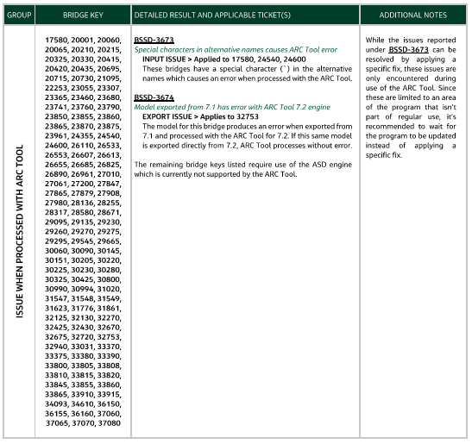
Testing BrDR 7.2 Using the ARC Tool in Idaho
Results BrDR 7.2
ARC Tool Not Able To Run (123 Total)
Special Character In Alternative Name (3)
Need To Run v7.2 Exported .xml (1)
Timber Bridges (119)

Slide 37
Testing BrDR 7.2 Using the ARC Tool in Idaho
Results BrDR 7.2
ARC Tool Not Able To Run (123 Total)
Special Character In Alternative Name (3)
Need To Run v7.2 Exported .xml (1)
Timber Bridges (119)
Matched When Ran Manually

Slide 38
Testing BrDR 7.2 Using the ARC Tool in Idaho
Results BrDR 7.2
Shear POI Location (5 Total)
v7.2 Added A POI For Shear At H/2

Slide 39
Testing BrDR 7.2 Using the ARC Tool in Idaho
Results BrDR 7.2
Permit Stress Rating Differences (4 Total)
v7.2 Allows Use Of Uncracked MOI when Applied M < Mcr

Slide 40
Testing BrDR 7.2 Using the ARC Tool in Idaho
Results BrDR 7.2
POI At Debonded Strand Locations (2 Total)
v7.2 Added A POI

Slide 41
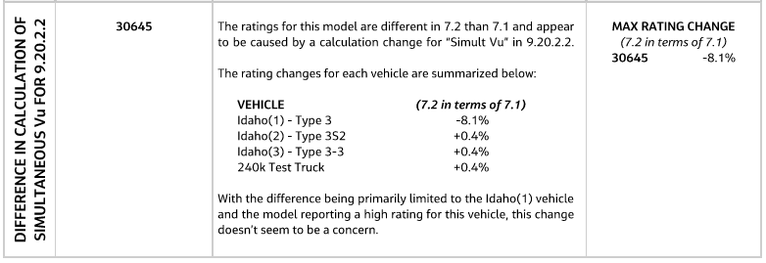
Testing BrDR 7.2 Using the ARC Tool in Idaho
Results BrDR 7.2
Difference in Calculation of Simultaneous Vu (1 Total)
v7.2 Change How Simultaneous Vu Is Calculated

Slide 42
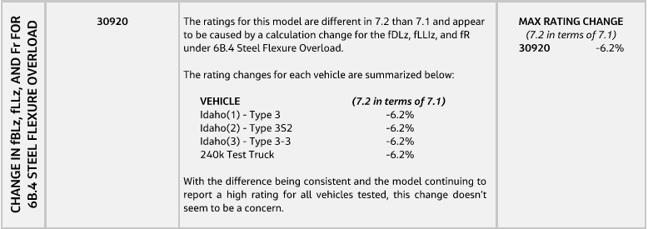
Testing BrDR 7.2 Using the ARC Tool in Idaho
Results BrDR 7.2
Change in Steel Flexure Overload (1 Total)
v7.2 Change How Several Variables Used For Steel Flexure Overload Are Calculated

Slide 43
Testing BrDR 7.2 Using the ARC Tool in Idaho
Results BrDR 7.2
ITD Will Be Upgrading To v7.2 Next Week

Slide 44
Testing BrDR 7.2 Using the ARC Tool in Idaho
Thank You

