Slide 1
AASHTOWare Bridge Task Force
Chair - Todd Thompson, PE
July 30, 2019

Slide 2
AASHTOWare Bridge Rating and Design Update

Slide 3
Agenda
Modernization status
Enhancements in 2020 7.1 release
Data integration endeavors
BrDR presentations
Task Force members

Slide 4
Bridge Rating Licensees (FY19)

Slide 5
Bridge Design Licensees (FY19)

Slide 6
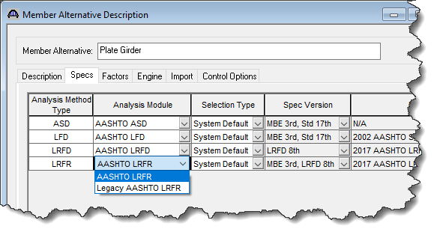
Release since last annual meeting
6.8.3 release – October 2018
Modernization Phase 1
Legacy user interface coupled with both the legacy and modernized analysis modules

Slide 7
Coming releases
Modernization Phase 2 – Fall 2019
6.8.4 release
MBE 3rd Edition with 2019 Interim and bug fixes (approx. 200)
Last release of the legacy system, and maintenance, specification updates, and support will cease effective June 30, 2021

Slide 8
Coming releases (Cont’d)
6.8.4 release
Only critical bug fixes will be incorporated into 6.8.4 going forward

Slide 9
Coming releases (Cont’d)
7.0 release
Modernized user interface coupled with the modernized analysis module
Same bug fixes and Spec Updates 6.8.4
Also includes 3 Load Rating Tool enhancements
Culvert – LFR (Funded by Idaho)
LFR Floor Systems (Funded by Illinois)
LFR for MCB (Funded by Mississippi)

Slide 10
Coming releases (Cont’d)
7.0 Beta testing
Beta TAG kicked off testing on March 19
Beta 3 released on June 3
Modernized system has more than 2 million lines of code, user interface has more than 800 windows

Slide 11
Coming releases (Cont’d)
7.0 Beta testing
Strategy is to divide and conquer based on structure types, configurations and features
32 Beta testers from 18 agencies
Identify testing gaps to be filled by third-party testing

Slide 12
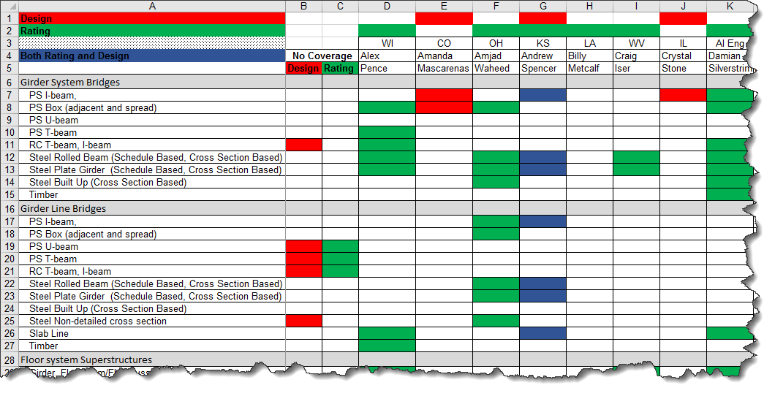
Coming releases (Cont’d)
Divide and conquer

Slide 13
7.1 Release
7.1 release – Fall 2020
Specifications updates and bug fixes
Modernization “Phase 3”: New features and feature enhancements
Total 38 tasks plus additional to be determined Maintenance and User Group enhancements

Slide 14
7.1 Release (Cont’d)
Prestressed Concrete Design Tool (Phase 2)
Design all the beams in the cross section with additional design parameters like iteration on number of beams
Line definition entry with user-defined live load distribution factors and dead loads

Slide 15
7.1 Release (Cont’d)
Prestressed Concrete Design Tool (Phase 2)
Provide structural framing plan, typical section and beam profile schematics
Create a camber table that includes the PCI multipliers
Compute stability checks for transport

Slide 16
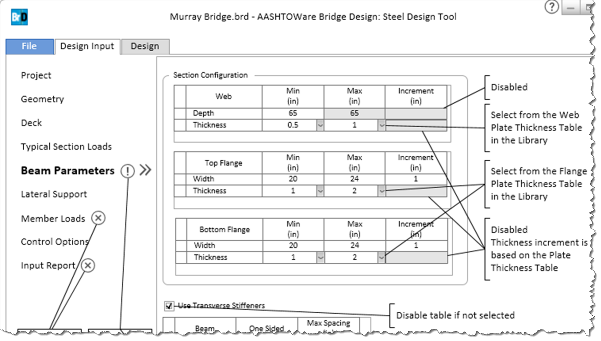
7.1 Release (Cont’d)
Steel Plate Girder Design Tool

Slide 17
7.1 Release (Cont’d)
AASHTO Timber Engine
Replace MADERO plus…
ASR and LRFR capability
Support timber glulam beams
Axle weight reduction for timber deck rating per AASHTO Standard Specifications

Slide 18
7.1 Release (Cont’d)
Improved and additional reporting capabilities
17 recommendations from BrDR Report TAG
BrM Web Service Integration (RIPI funded)

Slide 19
7.1 Release(Cont’d)
Schedule Based RC I-Beam with Post Tensioning (Mississippi, Caltrans and Task Force funded)
Phi Factor for moment MCB PT (BRDRSUP-1620) (Caltrans funded)
LLDF for one or two cell box girders (BRDRSUP-1621) (Caltrans funded)
Limiting Level Rule on single lane (BRDRSUP-1622) (Caltrans funded)

Slide 20
7.1 Release(Cont’d)
Limit applicability range values to lever rule (BRDRSUP-1623) (Caltrans funded)
User-defined load distribution (DC2) to MCB Webs (BRDRSUP-938) (Caltrans funded)
Establish LLDF using full box case (BRDRSUP-1624) (Caltrans funded)
Difference in skew between adjacent supports override (BRDRSUP-936) (Caltrans funded)

Slide 21
7.1 Release(Cont’d)
Range of applicability for slabs (BRDRSUP-1627) (Caltrans funded)
Report writer for girder-floor beam-stringer systems (BRDRSUP-1628) (Caltrans funded)
Analyze local web yielding and local web crippling for steel beam ends (BRDRSUP-695) (TAG #1 Request)
LLDF for steel beam-timber deck (BRDRSUP-1029) (TAG #3 Request)

Slide 22
7.1 Release(Cont’d)
Steel Channel for Exterior Girders (BRDRSUP-9313) (TAG #4 Request)
Hinges in Girder Floor Systems (BRDRSUP-581) (TAG #5 Request)
Model Section Loss in PS Girders (BRDRSUP-641) (TAG #6 Request)
Girder Profile schematic for cross-section based members (BRDRSUP-728 and 1435) (TAG #7 Request)

Slide 23
7.1 Release(Cont’d)
Cover Plates on both surfaces of flange (VI 11366) (TAG #9 Request)
Slab section schematic including reinforcing steel (BRDRSUP-1444) (TAG #10 Request)
Show PS strands on girder profile schematic (BRDRSUP-1431) (TAG #11 Request)
Option to account for 100% Section Loss (BRDRSUP-1436) (TAG #12 Request)

Slide 24
7.1 Release(Cont’d)
Allow MPF reduction due to low ADTT (BRDRSUP-97) (TAG #13 Request)
Rate culverts with variable thickness slabs and walls (BRDRSUP-732) (TAG #14 Request)
3D Analysis for superstructure with hinges (BRDRSUP-553) (Illinois Funded)

Slide 25
7.1 Release(Cont’d)
Load Rating Tool’s Permit Analysis Settings enhancement (Minnesota Funded)
Allow users to specific custom file paths for various output
$150,000 for User Requested Enhancements from 2019 RADBUG meeting

Slide 26
Enhancements
Task Force is looking for ideas and input from the RADBUG community and officers
Visit with Task Force members one on one with your ideas
Discuss it in the business meetings
Present some ideas in the Q&A session

Slide 27
Data integration endeavors
FHWA Bridge Information Modeling Standardization (HIF-16-011)
Evaluated AASHTOWare IFC Bridge Converter
TPF-5(372) Building Information Modeling for Bridges and Structures
Member of the Software Advisory Group

Slide 28
BrDR presentations
TRB – Comparison of Refined Analysis Software for Steel Girder Bridge Design
Presented BrDR refined analysis capabilities and provided benchmark results comparison (DL and LL results are in good agreement)
IBC – Bridge Load Rating, Posting and Permitting: Today and Tomorrow
Present BrR load rating capabilities, near and longer term directions

Slide 29
Task Force members
Chair | Todd Thompson | South Dakota
Vice Chair | Eric Christie | Alabama
Member – BrM | Beckie Curtis | Michigan
Member – BrM | Craig Nazareth | Rhode Island
Member – BrM | Kent Miller (Bruce Novakovich) | Nebraska
Member – BrM | David Hedeen (Mark Faulhaber) | Minnesota
FHWA Liaison – BrM | Derek Constable | FHWA
Member – BrD | Dean Teal | Kansas
Member – BrD | Mark Bucci (Jeff Olsen) | Louisiana
Member – BrR | Joshua Dietsche | Wisconsin
Member – BrR | Vinacs Vinayagamoorthy | California
Member – BrR | Mike Johnson (Ping Lu) | Idaho
FHWA Liaison – BrDR | Tom Saad | FHWA

Slide 30
Thank You!

